Slide 1
ED435-Goverance of University
Dr Kyaw Naing

Slide 2


Slide 3


Slide 4
NATIONAL EDUCATION STRATEGIC PLAN Page 191
University Autonomy

Slide 5
Diploma in Education Management (60 credit points)_
www.highlightcomputer.com/dipedmgt.htm
ED435-Goverance of University
Policies.zip (17.11MB)
http://www.filefactory.com/file/6p2gr2c393av/n/Policies.zip
University Rules Example.pdf (1.85MB)
http://www.filefactory.com/file/2xwo557n8395/n/University_Rules_Example.pdf
University Council
http://www.filefactory.com/file/czkcpxg8ien/University%20Council.zip
Management.zip (6.79MB)
http://www.filefactory.com/file/75fo5lxozc2x/n/Management.zip
Chapters.zip (0.59MB)
http://www.filefactory.com/file/63p2fmst97vj/n/Chapters.zip

Slide 6
ASSIGNMENT
By having studied the examples of university policies, University Rules, Management System etc of University of Technology-Sydney, produce university policies, University Rules, Management System to meet the needs of your TU/ Universities .

Slide 7
Division 1 — The Chancellor
Term of office of Chancellor
For the purposes of section ( ) of the Act, the term of
office of the Chancellor is ( ) years from the date of
his or her election.

Slide 8
Division 2 — Elected members of Council
Subdivision 1 — Preliminary
5 Returning Officer
An election referred to in this Division is to be conducted by a person
appointed by the Council to be the Returning Officer for the election.
(2) The Returning Officer may appoint a Deputy Returning Officer (with such
powers as the Returning Officer may determine) and other persons to assist the
Returning Officer in the conduct of all or any part of an election referred to in
this Division.
(3) The Returning Officer’s decision is, subject to the Act and this By-law, final
on all matters affecting the eligibility of candidates, the standards of behaviour
expected during elections and election campaigns, the conduct and results of an
election and such other matters as may from time to time affect the conduct of
elections.

Slide 9
6 Rolls
The Returning Officer is to keep the following:
for the purposes of section ( )of the Act—a Roll of Academic Staff containing the names and last known email addresses
(b) for the purposes of section 8D (1) (b) of the Act—a Roll of Professional Staff containing the names and last known email addresses
(c) for the purposes of section 8D (1) (c) of the Act—a Roll of Undergraduate Students containing the names and last known email addresses

Slide 10
Subdivision 2 — Provisions relating to candidates and voters
7 Qualification for elected (academic staff) member
8 Qualification for election as elected (professional) member
student) member
9 Qualification for election as elected (undergraduate
10 Qualification for election as elected (postgraduate student) member

Slide 11
Subdivision 3 Ballot
11 Conduct of ballot
12 Method of voting
Subdivision 7 Miscellaneous
28 Term of office of elected members of Council
29 Casual vacancy in office of elected member of Council
30 Election in anticipation of resignation

Slide 12
Division 3 — Appointed members of Council
(2) The Committee is:
(a) to determine which of those persons are to be recommended to the Council:
(i) for suggestion for consideration for appointment by the Minister, or
(ii) for appointment by the Council,
as the case may be, and
(b) to recommend the length of appointment for each such person, and
(c) to forward those recommendations to the Council at least 2 months before the relevant
term of office is due to expire.
(3) In determining the persons to be recommended under subclause (2) (a), the
Committee is
to have regard to:
(a) the skills and experience of the continuing members of the Council, and
(b) the skills and experience that will be needed for the Council as a whole (taking
into account the matters referred to in section 8C of the Act), and
(c) such other matters as the Committee considers relevant.

Slide 13
4) The Council is:
(a) to consider the recommendations forwarded by the Committee, and
(b) to determine which of the recommended persons are to be:
(i) suggested for consideration for appointment by the Minister, or
(ii) appointed by the Council,
(c) to determine:
(i) in the case of the persons referred to in paragraph (b) (i), the recommended length of appointment for each such person, or
(ii) in the case of the persons referred to in paragraph (b) (ii), the length of appointment for each such person.

Slide 14
Academic promotions
The purpose of promotion is to:
recognise, reward and retain academic staff who contribute to outcomes which advance the University’s strategic objectives and standing
(b) provide an identifiable career pathway for academic staff
(c) foster the development of the skills and performance excellence of academic staff, and
(d) recognise the achievement of high standards of workplace behaviour including ethical and collegial behaviour, respect for others and adherence to the principles of equity and diversity and personal accountability.
The particular circumstances of an applicant’s career
approved workplans, and the opportunities which have been available to him/her relative to the discipline and appointments held.

Slide 15
Criteria for promotion
Suitability for promotion will be judged on three criteria:
(a) qualifications
(b) performance and standing
(c) leadership within the University and personal standing.
Performance and standing
Applicants' performance and standing will be assessed in the following three areas of activity:
(1) teaching and educational development
(2) research, scholarship, creative work and/or the advancement of knowledge
(3) engagement and partnership, and academic management

Slide 16
An applicant who applies for promotion on this basis is expected to:
have served in the approved role or workload specialisation for at least one year
demonstrate how their specialisation contributes to the strategic objectives of University
demonstrate a sustained higher level of productivity and impact of an appropriate standard and quality in the area(s) of specialisation than applicants who contribute to all three areas, and
demonstrate sustained performance which meets expectations in terms of its standard and quality in any other areas of academic activity in which they are engaged during the period of the specialisation, and
in the case of education focused academic appointments, demonstrate that they meet the requirements of level descriptor for the level to which they are seeking promotion

Slide 17
To be promoted, the applicant’s overall performance in terms of the performance and standing criterion must be judged to be equivalent to the overall performance of an applicant who meets the contribution requirements for the level of promotion being sought .
Personal circumstances or approved working arrangements
Such circumstances or arrangements may include substantial career interruptions (such as absence on parental leave, or due to serious ill health, disability or ‘misadventure’), carer responsibilities or part-time or sessional employment which limits the academic staff member’s opportunity to work across the three areas.
An applicant who applies for promotion on this basis:
is encouraged to make explicit their specific circumstances1, outlining the impact that these circumstances have had on their performance and reasons why they have not had the opportunity to contribute at the minimum levels required in all three areas
will be expected to demonstrate an appropriate and sustained standard of performance in terms of the quality and impact of their contributions in those areas of academic activity in which they are engaged. It is recognised that those who apply on this basis may have a lower level of productivity.

Slide 18
Teaching and educational development
(a) effective teaching performance enabling appropriate learning outcomes from students
(b) effective use of appropriate teaching methods and assessment to achieve learning objectives (including where appropriate, the use of flexible learning methods)
(c) effective supervision of projects and/or theses of undergraduate, graduate, honours and/or research higher degree students
(d) alignment of teaching, learning and curriculum practice with the UTS Model
(e) quality and currency of, and innovative approaches to, subject, course or program content
(f) effective subject and/or program (re)development including the development of appropriate learning resources and textbooks
(g) systematic approach to providing effective student consultation
(h) responsibility for enabling effective learning experiences for students through practical work, field trips, clinical teaching, placement of students in mandatory work experience, etc.
(i) appropriate use of course content and design to foster the valuing and awareness of international, multicultural, gender, Indigenous and other diverse perspectives

Slide 19
A major or outstanding contribution
(a) teaching performance at a superior level
(b) encouragement of critical thinking, and innovative approaches by students
(c) innovative approaches to facilitating an effective learning environment for a diverse student population
(d) effective fostering of internationalisation including intercultural engagement
(e) innovative or exemplary approaches to practice-oriented and/or research inspired and integrated learning
(f) development of innovative or exemplary teaching materials or facilities, or approaches to teaching or assessment to foster effective student learning, including through the use of new technologies
(g) dissemination of innovative and/or research inspired teaching and/or educational development
(h) for senior lecturers a significant role and for associate professors and professors a leading role in the development and introduction of new courses or educational programs or the substantial review and renewal of existing courses or programs

Slide 20
(i) contributions to effective approaches to whole of program development of student graduate attributes including mapping assurance of learning and/or learning objectives to assessment
(j) demonstrated contribution to the timely completions of and quality of outcomes for honours and higher degree research students (eg class of honours, higher degree research examiners' reports, student publications and conference presentations, awards, employment outcomes)
(k) systematic use of peer review or benchmarking of teaching methods, assessment approaches, course design, learning aids and teaching materials to improve teaching and learning
(l) participation in professional development aimed at improving student learning, particularly for students for whom English is an additional language
(m) leadership in learning, teaching and educational development.
Research, scholarship, creative works and/or the advancement of knowledge
A satisfactory contribution, or commitment, refers to the level of scholarship necessary to maintain effectiveness as a teaching academic at the relevant level. Scholarship in this context is defined as the organisation and distillation of existing knowledge

Slide 21
(a) authorship of quality books, articles, papers, publications in electronic form, patents or inventions, scripts, exhibition or performance catalogues, scholarly translations either refereed or supported by other evidence of peer recognition
(b) authorship, direction or execution of performances, productions, exhibitions, or designs appropriate to the discipline or medium concerned and with independent reviews or other evidence of peer recognition
(c) record of outcomes from (for a senior lecturer demonstrated potential for) research collaborations: interdisciplinary initiatives; major international collaborations and other partnerships
(d) record of outcomes from (for a senior lecturer demonstrated potential for) established collaborative industry links and/or productive research contacts with industry and/or the professions
(e) record of (for a senior lecturer demonstrated capacity to) establish/ing links which support the University's goals in relation to internationalisation

Slide 22
(f) record of successfully conducting, promoting or leading research and development groups or activities related to the aims of the University
(g) record of successful competitive funding of research projects from research, teaching and learning, industry or artistic sources (present, past, source, team and amount of funding)
(h) record of contribution to the advancement of knowledge and/or its applications through approved consultancy work. Such consultancy work must be conducted in accordance with Council Directives for University Commercial Activities.
(i) contributions of a scholarly kind to the affairs of a professional organisation or learned society
(j) invitations: keynote addresses; displays of work, curatorial invitation, invited symposia, seminars at other universities; serving on external high level selection committees, visiting appointments held at other institutions, reviewer or assessor of research activities
(k) awards: international awards and fellowships, national awards from academies and learned societies, University awards
(l) editorial contributions to scholarly journals and other professional publications
(m) leadership of research, scholarship and/or creative activity.

Slide 23
Academic management
(a) reliable performance of administrative functions appropriate to the applicant’s level within a faculty or other unit
(b) evidence of initiative and ability to contribute to policy and strategy
(c) active involvement in University consultative and decision-making processes beyond the immediate academic unit, eg University, interdisciplinary activity, centre, staff association, etc.
(d) initiation or active maintenance of linkages between the University and external groups or employers of graduates
(e) program coordination and administration including effective management and review of a subject, course or program, and effective management, development and leadership of members of teaching teams including casual academic staff
(f) active participation in student recruitment or support activity (eg school visits, open days, career fairs, academic liaison officer, activities under the widening participation strategy) and graduations.

Slide 24
Leadership within the University and personal standing
(a) contribute to developing effective, collegial, supportive and productive working relationships within and external to University
(b) act in the interests of University
(c) independently and collaboratively, set and achieve objectives consistent with the strategic objectives of University
(d) contribute to the creation of an environment which enhances equity and respects diversity at University
(e) comply with the requirements of laws and University policies, directives, procedures and guidelines and generally act as a good corporate citizen
(f) actively model high standards of professional and ethical behaviour
(g) look for opportunities to improve quality and effectiveness and devise improved approaches and methods (ie Plan, Do, Review, Improve (PDRI))
(h) reflect on and seek guidance on performance and embrace opportunities for personal/professional growth or development.

Slide 25
University Academic Standards Framework
Academic Standards: Develop Coursework Graduates
Academic Standards: Develop Higher Degree Research Graduates
Academic Standards: Research

Slide 26
ACADEMIC STANDARD
Staff recruitment
Staff induction
Staff development
Subject preparation and delivery
Assessment
Student logistics
Campus and services design and delivery
Learning outcomes
Student satisfaction
Assessment
Feedback to students
Academic support
Student education on plagiarism — online and workshops
Academic Misconduct Procedures

Slide 27
Course planning
Course accreditation
External accreditation
Course performance reporting
Feedback surveys
Quality assurance
Management of risk
Compliance
Academic standards refer to the objectives against which levels of performance on key academic indicators of quality are assessed.

Slide 28
Framework principles
The following principles underpin the University Academic Standards Framework:
The focus of the Framework is on ensuring high quality outcomes for students and beneficiaries of research, engagement and other academic activities.
University sets a minimum level of performance in its academic activities and these are articulated as University academic standards.
The University academic standards framework provides high-level structure to statements of academic standards.
University will measure its academic standards achievement and benchmark its performance nationally and internationally.
University academic standards are related to other University standards, in particular standards of staff and student conduct.
University quality management and risk management frameworks are applied to University academic standards.

Slide 29
Academic Standards: Research
1. Create and establish research program
2. Develop and manage a research project
3. Conduct research
4. Manage research outcomes
5. Academic standards governance
6. Version control and change history
Appropriate research environment
Increased number of partnerships
Increase number of research projects funded by government, industry and universities
Research outputs publically available

Slide 30
Academic Standards: Develop Higher Degree Research Graduates
1. Confirm research strategic focus and capacity
2. Recruit and induct research students
3. Supervise and develop students
4. Examine research
5. Academic standards governance
6. Version control and change history
Research students each have a plan that reflects the student’s academic and professional experiences and goals.
students’ learning is complemented by academic and personal support and development programs.
students maintain a high level of academic integrity.
staff develop, and maintain, the necessary disciplinary, supervisory and research methodologies expertise to effectively deliver UTS research courses.
provides resources, learning spaces, technologies and other facilities to support students’ learning.

Slide 31
Development of Doctoral Study Plan
Supervision of Doctoral Study Plan
Student progression through three formal stages

Slide 32
Admissions Policy
Admissions Procedures
Admission (section 5, Student Rules)
Award Course Approval and Reaccreditation Policy and Procedures
Credit Recognition Policy
English Language Policy
Equal Opportunity and Diversity Policy
External articulation arrangements

Slide 33
Policy for the Assessment of Coursework Subjects
The policy acknowledges that assessment serves a range of purposes. It is an integral part of the learning process for students and strongly influences what and how students learn in their courses. Effective assessment supports learning, conveys to students the kinds of intellectual and personal engagement desired, provides feedback on learning and fosters students’ ongoing development.
Through assessment, judgements can be made about the quality and extent of students' achievements and performances. Assessment enables students to demonstrate that they meet or exceed minimum academic and professional requirements and allows University to meet its responsibilities to the community and to meet the required standards for recognition of its courses by the professions and industry.
Assessment should enable University to certify that any grade awarded corresponds to the student's performance and that the student has met subject and course requirements in an approved manner. Students, staff and the wider community need confidence in the continuing academic standards of University courses and the rigorous environment in which learning occurs

Slide 34
Assessment requirements: these are the demands placed on students in order to assess their achievement of the learning objectives in the subject. Assessment requirements include the nature of the assessment task (for example, essays, student presentations, literature reviews, laboratory reports, written examinations, open book examinations, group assessment, peer assessment, self assessment, computer based assessment, oral examinations, class quizzes, short answer examinations, experiential activities, simulations, clinical experiences, practical exercises, performances, folio presentations, class participation, etc), the outputs to be submitted for assessment, the timing of the task, the conditions under which the task must be undertaken, the learning objectives to be assessed and any detailed criteria to be met.
Competency-based skills assessment: assessment in which a student’s skills are assessed in relation to a specific work activity in order to determine whether the activity is being performed in a competent manner. Students are required to achieve a specified threshold level of performance in order to pass the assessment.

Slide 35
Criterion-referenced assessment: assessment in which a student’s work is assessed against stated criteria, and marks or grades are awarded according to the level of achievement of these criteria. (Standards-based assessment is a form of criterion-referenced assessment in which there is specification of both the criteria and standards of achievement for different levels.) Criterion referenced assessment differs from norm-referenced assessment in which grades are determined with reference to other students’ performance and the grade distribution is expected to conform to a normal distribution with only a certain percentage of students able to attain each grade. Assessment at UTS is not norm-referenced.

Slide 36
Formative assessment: assessment that provides feedback to students on their work and does not contribute to marks or grades.
Procedural irregularities: a ‘procedural irregularity’ means that the assessment process was not conducted according to the University’s procedures. Examples might include errors in adding marks, or with the administration of an examination, or an officer of the University failing to consider mitigating circumstances presented in accordance with published procedures.
Summative assessment: assessment that contributes to students’ final assessment results in a subject. Summative assessments other than final examinations normally also have the formative function of providing feedback on students’ work.

Slide 37
Assessment must be valid, fair and equitable
Assessment requirements must be clearly stated in the Subject Outline for each subject, which students must have access to before the first teaching week of the subject, or the equivalent in block or other modes of delivery. Assessment requirements as described in the Subject Outline must be adhered to during the course of the teaching period (unless otherwise changed in line with University Rules and policy and procedures). Any additional assessment information provided to students separately from the Subject Outline must be consistent with the requirements specified in the Outline.
The assessment pattern in a subject should provide reasonable opportunities for students to demonstrate their achievement of subject objectives. The assessment pattern will normally include two or three summative assessment tasks, none of which is worth more than 65 per cent, including at least two different types of assessment task, except in the case of capstone or similar project subjects. Subjects may have additional formative or other requirements.

Slide 38
Assessment workloads must be fair and reasonable
The assessment pattern in a subject will involve reasonable workloads for both students and staff consistent with the credit points allocated to the subject. The relative weightings of tasks must reflect their expected workloads.
Marking must be conducted in a fair and reasonable way and feedback provided in a timely fashion
Marking must be conducted in a way that is consistent with any specified criteria and standards for the task. Any moderation of results within a subject will be based on comparison of the standards of achievement of the stated criteria for the task across different markers. Where moderation is used, this will be indicated in the subject outline and, wherever possible, completed before marks/grades are released to students. Markers will not use negative marking (taking marks off for incorrect answers rather than giving no marks) of multiple choice or similar questions.
Students must receive feedback on their work in a timely manner that assists them to understand the learning objectives achieved and how they can improve the quality of their work. This will be provided in line with the description appearing in the Subject Outline. Students must receive some feedback on their progress within the first half of a teaching period.

Slide 39
Online and technology-based assessment may be used and must be appropriately resourced
Subjects may involve assessment tasks that are completed online (for example, blogs, wikis, participation in online simulations, creation of digital works) or submitted online or make use of technological equipment. Appropriate resources to complete these activities must be available to students.
Assessment in a course of study as a whole
While assessment tasks are implemented within subjects, consideration needs to be given to the pattern of assessment across entire courses of study. Assessment across a course will enable students to develop and demonstrate their achievement of the desired graduate attributes for the course be of a range of different types to provide opportunities for students to achieve the range of educational aims and develop the range of professional, personal, interpersonal and intellectual graduate attributes and to cater for the diversity of students support students’ transition to study, their progression through their studies and their transition to employment or further studies

Slide 40
be consistent with the University model of learning, include opportunities for practice-oriented learning, for students’ development of global and cross-cultural awareness, and learning from research and inquiry, in ways that are relevant to the professional/disciplinary domains of the course
include assessment experiences that are culturally sensitive and that provide choices that enable students to prepare for their intended future contexts enable students to learn for, and in, the future and develop their capacities for professional and personal judgement

Slide 41
Preparation and requirements of subject assessment
The assessment pattern in a subject will be designed in accordance with the principles outlined in this policy. Students must be provided with information in the Subject Outline concerning assessment in a subject and how their final mark and/or grade is/are determined. This includes the nature and timing of assessment task(s), the learning objectives assessed by each task, the marks/weights associated with each objective or assessment requirement for each task. The information supplied in the Subject Outline must comply with the Subject Outlines policy. The Subject Outline must be available for access by students before the first teaching week of the teaching period (Rules 3.7.3 and 8.1.2).
Where additional assessment information is provided to the student, to be used in conjunction with the Subject Outline, it must be entirely consistent with the Subject Outline and this policy. Further, it is subject to the same Rules and procedures applicable to the Subject Outline.

Slide 42
Students are expected to undertake their responsibilities in a manner consistent with the policy and procedures for the assessment of coursework subjects, the Rules of the University and the University Student Charter.
Where a student is unable to complete all prescribed assessment requirements because of substantiated, continuing disability or illness, carer’s responsibilities, pregnancy or English language difficulties, the University will make reasonable arrangements to enable the student to demonstrate the attainment of the learning objectives of the subject in a manner that, as far as possible, ensures parity with the other students (Rule 8.2.1). This is achieved through variation to assessment

Slide 43
Credit Points for University Coursework Awards Policy
Granting credit to students for their prior learning, including the types of learning that may be recognised, the processes UTS uses, and the types of credit that can be granted.
Types of learning:
Formal learning refers to learning that takes place through a structured program of learning and assessment that leads to the full or partial attainment of a recognised Australian Qualifications Framework (AQF) qualification or other qualification formally recognised by University
Informal learning refers to learning gained through work-related, social, family, hobby or leisure activities and experiences. Unlike formal and non-formal learning, informal learning is not organised or externally structured in terms of objectives, time or learning support.
Non-formal learning refers to learning that takes place through a structured program of learning but does not lead to a formally recognised qualification.

Slide 44
Processes for recognising credit:
Articulation is a formal arrangement approved by Academic Board, or through processes approved by Academic Board, that enables students to progress from one qualification completed at University or another institution to a particular University course with a specified amount of credit.
Credit transfer is an arrangement that provides students with agreed and consistent credit outcomes based on identified equivalence in learning outcomes, volume of learning, program of study, including content, and learning and assessment approaches from specified providers into a University course.
Recognition of Prior Learning (RPL) is the assessment of an individual’s relevant prior learning to determine the outcome of that individual’s application for credit towards a University qualification

Slide 45
Types of credit that may be granted:
Specified credit is credit granted towards particular or specific components in a qualification.
Unspecified credit is credit granted towards elective components in a qualification.

Slide 46
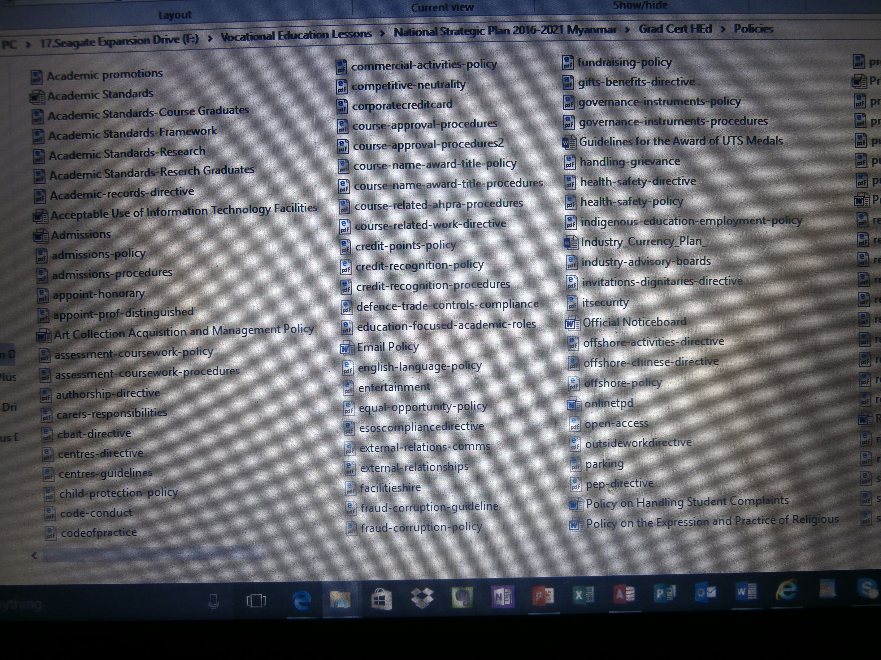

Slide 47
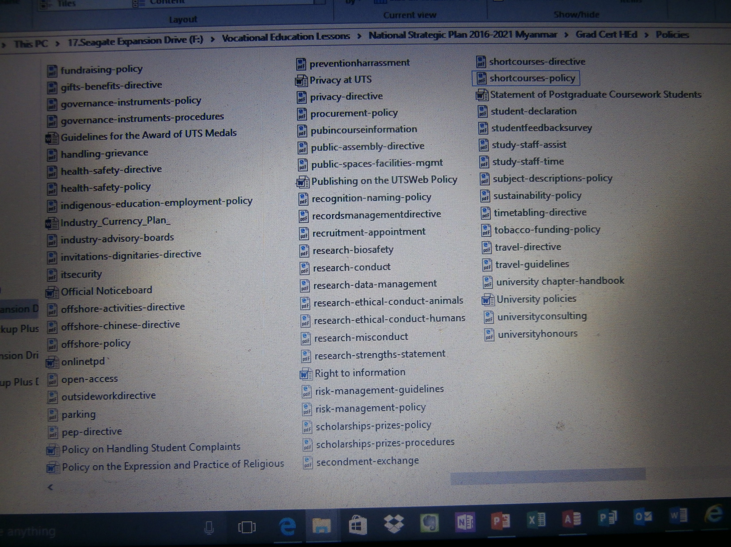

Slide 48
Policy principles
The following principles of good governance apply to the development, review, amendment, rescission, implementation and management of UTS governance instruments:
i. Ensure that all governance instruments comply with the University Act, University By-Law, University Rules, industrial agreements and awards and relevant Commonwealth and State government legislation.
ii. Ensure that all governance instruments clearly articulate their relationships with any relevant Rules, Standing Delegations of Authority, external legislation or other University instruments.
iii. Recognise the importance of maintaining official University records relating to each governance instrument, its approvals and its subsequent amendment and review history.
iv. Ensure that all governance instruments are approved, amended and rescinded by the same authority (as outlined in section 3).

Slide 49
Review cycles
All University governance instruments must be reviewed regularly by the official review date outlined in the approved instrument, or every five years, whichever is the earlier. The process for reviewing governance instruments is outlined in the Procedures.
Any proposed amendments identified as part of a review should be submitted for approval in accordance with this Policy and the Procedures.

Slide 50
Health and Safety Policy
• the likelihood of the hazard or risk concerned occurring, and
• the degree of harm that might result from the hazard or risk, and
• what the person concerned knows or ought reasonably know about the hazards and risks and ways of eliminating or minimising those risks, and
• the availability and suitability of ways to eliminate those risks, and
• after assessing the extent of the risks and the availability of ways of eliminating or minimising those risks, the costs associated with available ways of eliminating or minimising those risks, including whether the costs are grossly disproportionate to the risk.’

Slide 51
Industry Currency Plan
This template to be used by all teaching staff to forward plan their annual return to industry (20 hours) on a three (3) year rolling basis.
Ensure evidence of the return to work is retained.
 | Employer (incl section / dept) | Duration (insert days / hours) | Field of Practice | Tasks / Duties to be performed
Year 1 – 2015 | e.g. Advanced Analytical Australia - Agrifoods dept | e.g. Four (4) days per week at seven hours per day during April 2015 | eg Histology Haematology | eg Instrument techniques in : Biotoxin analysis in shellfish and Pesticide residue in in imported food.
Year 2 – 2016
Year 3 – 2017
Teacher Name: |  | College
Faculty:
Teaching Section:

Slide 52
The University is committed to providing a learning and working
environment in which complaints are responded to promptly
and with minimum distress and maximum protection to all parties.
As part of its commitment to creating a supportive and open organisational
culture, the University is committed to ethical and responsible
management, transparency in its decision-making processes, and a visible,
accessible and fair complaints process.
The University views student complaints as providing an opportunity to
review and improve its policies and practices, and also to gain insight into
student levels of satisfaction.

Slide 53
Purpose and scope
This policy applies to all aspects of a student's educational experience at
University. Students may make a complaint about:
other students of the University
academic and support staff (including continuing, contract, sub-contract
or casual, visiting appointments, guest lecturers)
visitors to the University, or
people external to University that students interact with as part of an
approved external program of study such as work experience, industrial
or clinical placements, exchanges or work-based learning units.
Students may make a complaint about any matter which relates to their
program of study at University even if the incident which is the basis of the
complaint did not occur on campus. The scope of this policy includes
incidents arising from field trips, external placements, exchanges,
University social functions, offshore or distance education courses, etc.

Slide 54
Records Management
This includes:
• developing and reviewing recordkeeping policies and procedures, standards and guidelines
• monitoring the records program and the performance of business units against records management standards and procedures, and this Directive
• providing recordkeeping training and education programs
• providing advice on recordkeeping practices and issues as part of an advisory service to business units across the University
• coordinating the authorisation of record destruction activities in accordance with general retention and disposal authorities issued under the State Records Act
• managing the storage of and access to the UTS Archives
• planning disaster prevention, response and recovery operations relating to records.

Slide 55
Responsible Conduct of Research Policy
Good research practice at University
a. honesty and integrity
b. respect for human research participants, animals and the environment
c. good stewardship of public resources used to conduct research
d. appropriate acknowledgement of the role of others in research
e. responsible communication of research results
f. sharing of research data, where appropriate, with the wider research community and with the public
g. transparent costing and sustainability of research.

Slide 56
Ethical values and principles:
research merit and integrity
beneficence
respect for human beings
justice.

Slide 57
Management of research data and primary materials
The researcher must decide which data and materials should be retained, although in some cases this is determined by law, funding agency requirements or influenced by publisher’s needs or by convention in the discipline.
The purposes of managing and retaining research data are mainly to support the published or reported outcomes of research and to justify them if challenged, but also in some circumstances to add to national and international repositories of data where the research may be difficult or impossible to repeat.

Slide 58
Curatorial staff are University staff responsible for:
assisting researchers with the organisation and management of research data
assessing and enforcing appropriate data retention standards, based on the requirements imposed by funding bodies, legislation and University policy
coordinating the analysis (in collaboration with researchers and technical support staff) of the appropriate research data and metadata to be gathered from, and applied to, the University's research data repository.

Slide 59
As a minimum, a Research Data Management Plan will describe:
project name
Executive Author
description of the project and the type of data to be collected/generated
ownership
data formats
approximate storage size required (order of magnitude estimate)
location of data
data retention lifetime as defined and required in section 5.2.5 of this Directive
backup and disaster recovery options
any accessibility issues arising from commercialisation or licensing
any accessibility issues arising from ethics approvals
data disposal approach
criteria and principles for determining which data will be stored and which disposed (this could include legislative requirements).

Slide 60
Research program:
a clear identity that marks internal cohesion around a research focus in an area of comparative advantage for University and a corresponding attractive external ‘signature’ (advantageous positioning in relation to the external environment, opportunities and constraints)
a compelling strategy with clear goals, objectives and income potential
a clear articulation as to the manner in which the research outcomes of the centre will have impact for society, environment, industry
evidence of being nationally and internationally competitive
strategic ‘fit’ with the University’s Strategic Plan and Research aims, and
a coherent, sustainable program of research, addressing significant research problems and/or major issues of importance to the local, national or global community.

Slide 61
Researchers:
a sufficiently sized team of researchers to provide critical mass as appropriate to the discipline
high level of productivity/activity of the researchers involved
achievements of the researchers in relation to discipline-appropriate indicators of quality and peer esteem
achievements against relevant indicators of impact, at the level of the research group and/or individual researchers, and
a researcher development program, including mentoring and succession planning

Slide 62
Organisational framework:
an organisational framework which is self-sustaining in terms of leadership, management and governance and, as appropriate, funding, and
the option for an external advisory board should this be required in the centre strategy.
External engagement:
research links with external researchers and/or end users, which could include industry partnerships and/or Australian or international research links, and
as appropriate, the ability to generate significant levels of external research income to increase research capacity at University, and
reputation and influence (peer esteem and standing; leadership in research; influential relationships with government, industry, business and community; international standing and links).
Faculty support and cross-faculty links:
the endorsement of supporting faculty(ies), and
cross-faculty links that support research and external engagement

Slide 63
The key aims of risk management are to: prevent adverse incidents; and
Advanced University’s objectives.
This Policy:
provides a consistent risk management framework in which the risks concerning business processes and functions of University will be identified, considered, and addressed in key approval, review and control processes
encourages pro-active rather than re-active management
provides assistance to improve the quality of decision making throughout University
provides advice about legal and statutory requirements, and
assists in safeguarding University's assets — people, finance, property and reputation.
AS/NZS ISO 31000:2009 Risk management — Principles and guidelines.

Slide 64
Academic Promotion
Academic Records
Academic Standards
Acceptable Use of Information Technology Facilities
Admissions
Appointment of Distinguished Professor
Art Collection Acquisition and Management
Assessment of Coursework Subjects
Authorship
Award Course Approval and Reaccreditation
Biosafety in Research

Slide 65
Centres
Child Protection
Code of Conduct
Commercial Activities
Competitive Neutrality
Concerning Behaviour Assessment and Intervention Team (CBAIT)
Corporate Credit Card and Staff Reimbursements
Costing and Pricing of Research Projects (
Course Name and Award Title Nomenclature

Slide 66
Course Related Work Experience
Credit Points for UTS Coursework Awards
Credit Recognition
Defence Trade Controls Compliance
Education Focused Academic Roles
Email
English Language
Entertainment
Equal Opportunity and Diversity
ESOS Compliance

Slide 67
Ethical Conduct of Research Involving Animals
Ethical Conduct of Research Involving Human Participants
Expression and Practice of Religious, Political and Other
Values, Beliefs and Ideas
External relations
Facilities Hire
Financial Assistance for Staff Studying at univertsity
Fraud and Corruption Prevention and Public Interest
Disclosures
Fundraising
Gifts and Benefits
Governance Instruments
Handling Staff Grievances

Slide 68
Handling Student Complaints
Harassment (Prevention of)
Health and Safety
Honorary Appointments
Indigenous Education and Employment
Industry Advisory Boards
Information Technology Security
Intellectual Property
Invitations to Dignitaries

Slide 69
Offshore Activities
Open Access
Outside Work
Parking
Postgraduate Coursework Students' Rights and Responsibilities
Privacy
Procurement
Professional Experience Program (PEP)
Public Assembly on University Campus
Public Spaces and Facilities Management
Publication of Official University Award Course and Fee Information
Recognition Naming

Slide 70
Records Management
Recruitment and Appointment
Research Data Management
Research (Ethical and Responsible Conduct of)
Research Financial Management
Research Funding from the Tobacco Industry
Research Management
Research Misconduct
Research Strengths
Responsible Conduct of Research
Risk Management

Slide 71
Scholarships and Prizes
Short Courses
Staff and Students with Carers' Responsibilities
Staff Secondments and Exchanges
Strategic Planning and Improvement Framework
Student Charter
Student Declaration
Student Feedback Survey
Study Time for Support Staff
Subject Descriptions and Outlines

Slide 72
Supervisors and Research Degree Students
Sustainability
Temporary Exclusion of a Student from Facilities and/or Participation
in Activities
Timetabling
Travel
Treasury
University Consulting
University Honours
University Medal (Award of)
Publishing

