Slide 1
Assessment is recognised in the literature as a driver of student learning; framing how they engage in and prioritise their learning. With this growing recognition, a plethora of literature has emerged about how to improve student experiences of assessment in universities. While the development of higher order skills of analysis, synthesis, evaluation and creation are espoused in the literature of good assessment practice, how well represented are they in the teaching and learning practice of academics?
A predominance of lower order learning outcomes, raising questions about academics’ understanding of:
The processes underpinning higher order learning
The design of learning outcomes to include a focus on higher order learning
The development of assessment strategies to support higher order learning
The challenge for academics in engaging students more actively in their learning lies in addressing the predominance of lower order and the paucity of higher order outcomes at all levels, from first year to post-graduate level.

Slide 2
From our students’ point of view, assessment always defines the actual curriculum. In the last analysis, that is where the curriculum resides for them, not in the lists of topics or objectives.
Assessment sends messages about the standard and amount of work required, and what aspects of the syllabus are most important
Involving students in authentic tasks requiring higher order thinking skills such as analysis, synthesis, evaluation and creation are among the ways that learning can be designed to engage students.
Bloom published his taxonomy of learning outcomes to provide a framework for describing outcomes as cognitive processes (Bloom, 1956). The six categories in Bloom’s taxonomy were knowledge, comprehension, application, analysis, synthesis and evaluation arranged in a hierarchical ascending order of difficulty, beginning with knowledge acquisition.

Slide 3
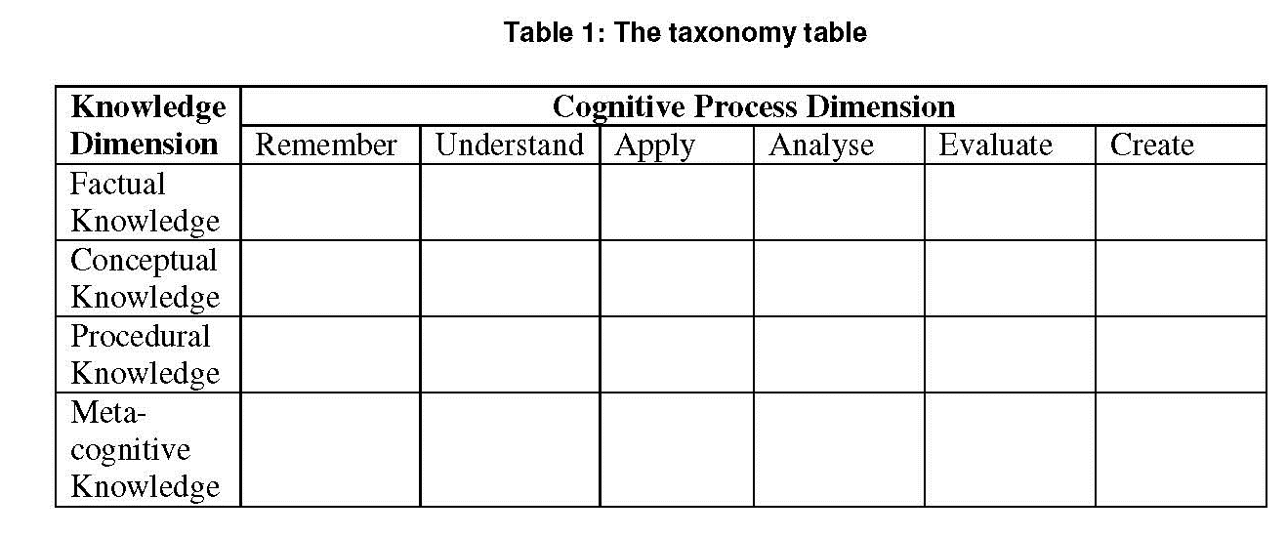
Higher order learning is typically associated with the bottom right of the matrix. While the value of higher order skills such as problem solving, leadership, innovation and creativity are increasingly acknowledged (Bath, Smith, Stein, & Swann, 2004), integrating many of them
into assessment strategies has proven a challenge (Astleitner, 2002; Burns, 2006; Clarkson & Brook, 2007; Race, 2001, 2003).

Slide 4
It is difficult to assess metacognitive knowledge by simple, traditional methods. The tools and processes for assessing lower order skills, such as remembering, may be simpler to develop and administer than those focusing on higher order skills such as metacognition.
In the Cognitive dimension, the most frequently used code was ‘understand’, mainly in relation to the knowledge dimension of ‘conceptual’. An example is:
To be able to describe the relationship between language and its social context
‘Understand’ was also used in relation to the knowledge dimension ‘procedural’, for example:
Understand how to pose and define a problem in relation to accounting information systems, clarify the issues involved and select and monitor the most effective process to use

Slide 5
Conceptual knowledge’:
Competence in applying geoscientific principles to understanding the sedimentary and igneous environments in the world around you .
And, in relation to ‘procedural’ knowledge:
Use a computer package to find solutions to formulated problems

Slide 6
‘Apply’ targeted generic skills such as problem solving or
communication, without any links to the discipline context.
An example is:
Be able to make appropriate use of primary and secondary sources in mounting an argument .
There were limited examples of ‘analysis’ and ‘evaluation’, for example:
Comparative analyses of aspects of HRM in operation in schools and workplaces
Some examples seem to suggest higher order learning but have not included sufficient detail to be sure.
An example is:
Ensure that procedures are safe for personnel and ethical with regard to flora and fauna .

Slide 7
Two learning outcomes were categorised in the cognitive dimension as ‘create’, for example:
Develop change management strategies .
Only one was coded as ‘metacognitive’, however, this specific example was not explicitly expressed as a learning outcome. It was part of a statement about generic skills:
Problem solving skills: Any piece of assessment is a problem to be solved. You need to identity the problem and implement the most effective and efficient solution.
You are then able to reflect on past assessment to learn how you may be able to improve your problem solving skills. How could you do it better next time? How can you apply this to other scenarios?

Slide 8
How learning outcomes are articulated:
• Some focused on the intentions of the teacher
• Some focused on learning processes
• Some focused on generic skills without embedding these into the specific discipline context
• Some included no verb at all, although this may have been due to academics’ paraphrasing their unit outlines, rather than including the exact wording

Slide 9
How these outcomes were assessed
The assessment strategies used for each learning outcome.
Strategies Response Percent Response Count
Assignment
Discussion
Essay
Practical
Quiz
Individual Presentation
Group Presentation
Reflection/Journal
Role play
Simulation
Portfolio
other
Assignments, discussions, essays and practicals were the most commonly used strategies.
This seems to align with the cognitive processes ‘understand’ and ‘apply’ and the types of knowledge ‘conceptual’ and ‘procedural’.

Slide 10
Difficulties with Assessment
Generic skills
Communication/ interpersonal skills
Practical skills Teamwork/ group work
Participation
Use clear language to convey higher order learning outcomes to their students
Align their outcomes with assessment strategies and some do not.

Slide 11
Feedback literacy is characterised by diversity and difference; that there are different levels of engagement with feedback; and that there is no universal formula for producing effective feedback
An Academic Literacies Approach
Shortly after commencing the literature review for our research we discovered a framework to theorise student reading and writing which was comprehensive and persuasive: the Academic Literacies approach.
It positions student reading and writing as a particular form of literacy which must be acquired within particular contexts.

Slide 12
An Academic Literacies Approach
Shortly after commencing the literature review for our research we discovered a framework to theorise student reading and writing which was comprehensive and persuasive: the Academic Literacies approach.
This approach has been developed by Lea and Street (Lea and Street 1998, Lea 2004, Street 2004). It positions student reading and writing as a particular form of literacy which must be acquired within particular contexts.
EPISTEMOLOGICAL-relating to the theory of knowledge, especially with regard to its methods, validity, and scope, and the distinction between justified belief and opinion
ONTOLOGICAL-showing the relations between the concepts and categories in a subject area or domain

Slide 13
Critical Discourse Analysis
Critical Discourse Analysis is a method that combines elements of sociolinguistics with the broader analysis of the operation of power in social relations and institutions.
It is a multidisciplinary method but its use does not necessarily require a detailed knowledge of linguistics, sociology, psychology or politics

Slide 14
Critical Discourse Analysis was an appropriate method for research within the theoretical framework of the Academic Literacies approach.
PRACTITIONER RESEARCH IN HIGHER EDUCATION
Approach Focus Academic reading and writing
Study skills Student skills deficits Technical/instrumental skills
Academic socialisation Student orientation to learning:
deep, surface, strategic Learned through acculturation to norms of
academic practice
Academic literacies Epistemological and ontological dimensions of learning and teaching; institutional power relations
Situated complex and contested literacy practices
5

Slide 15
A macro-sociological analysis of feedback as a form of practice, powerfully shaped by institutional and wider social structural factors; and
A micro-sociological analysis of feedback as a ‘genre’ of communication: a class of communicative events with particular communicative purposes
Actively produced and made sense of by members of particular ‘communities of practice

Slide 16
Three- dimensional model of
Critical Discourse Analysis. This consisted of:
Understanding the meaning of the statements within our interview texts;
2. Exploring how the discursive practices that produce feedback both enable and constrain the ways in which it is communicated to, and consumed (interpreted) by students; and
3. Analysing feedback as a type of social practice shaped by wider institutional and structural power relations, which open up and close down the possibilities for particular individuals to feed forward feedback.

Slide 17
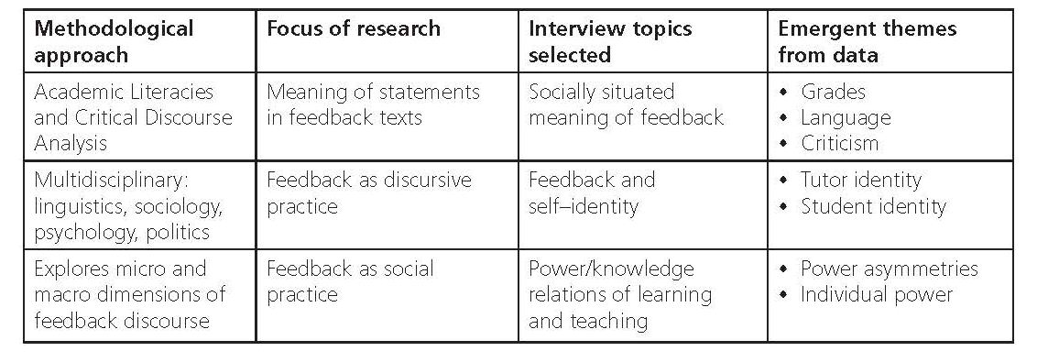
The socially situated meaning of feedback discourse
The starting point of our investigation into feedback literacy was what Light and Cox (2001) call ‘an engagement model’. Within this model, students in particular learning environments are conceived to be actively engaged in the creation and mediation of meaning (Higgins et al., 2002).
The meaning of feedback is made both individually and collectively by students reading feedback on their own and within the context of their peer groups – or what two students referred to as their ‘study buddies’.

Slide 18
Written feedback could be redundant. Given that the grade descriptors provided by higher education institutions forms part of the institutional dialogue with students
Concentration on the grade can be interpreted by tutors as a lamentable sign of a surface or strategic approach to learning.
While acknowledging student instrumentality, we consider it to be only part of the complex process in which students produce the meaning of feedback discourse.
Students inhabit a learning environment in which grades are powerful signifiers of success and failure. Furthermore, economic imperatives, particularly the need to undertake employment to fi nance their studies, impel students to adopt an instrumental strategy towards their studies. Increasingly, students are enrolled as full-time but are – in reality – studying part-time

Slide 19
Cultivating students’ feedback literacy may require careful consideration of the complexity of the language we use and reflection upon what form of language in feedback is appropriate to particular levels of study.
Criticism
If students interpret feedback discourse to be ‘just’ then they are more likely to actively engage with its meaning.
Well, nobody likes criticism, but if it’s just criticism, then that’s fine
If somebody feels that they have been marked down wrongly it can become really emotive, quite emotional … and they can really struggle to get up from that

Slide 20
If tutors give the impression of not caring, then feedback can be written off as a manifestation of this lack of interest and dismissed. One of the signifiers of tutor care is the creation of bespoke feedback.
Students engage more readily with feedback that is personalised but not personal, as this, to them, is a clear indication that tutors care about individual students’ work.
Furthermore, when tutors demonstrate ‘they actually care about what they are teaching’ (Year 2 student), then students generally feel more
cared about and are more willing to engage with feedback.

Slide 21
Student identity
A growing body of research has found that feedback that cannot be understood by students produces a loss of self-esteem, and their identity as a capable learner becomes threatened.
A student who perceives that they did not perform adequately in an assessment, but feels incapable of understanding why or what to do about it, is doubly disempowered.
As Ivanic et al. (2000) argue, such students have a very personal reaction to feedback: it is interpreted not simply as a commentary upon their work but upon their failings as human beings. It compromises their ‘ontological security’ (Giddens, 1991).
That is, feedback possesses the potential to disturb a student’s sense of both their educational and social being.

Slide 22
Feedback is useful because it boosts your confidence, showing you that you are doing things in the correct order … you don’t necessarily develop as a person through the feedback you are given. You develop as a person through some of the academic staff you meet.
The power/knowledge relations of learning and teaching
As Higgins et al. (2001:272) argue, power and authority are two of the most significant features of feedback discourse.
The power and authority manifest in feedback is a product of both the micro relations of learning and teaching and the macro-relations that exist in particular academic institutions.
The Academic Literacies approach attempts to capture both these dimensions by considering feedback as both a discursive and a social practice.
The two themes of greatest salience that emerged from within this topic were
• asymmetries of power; and
• the power of the individual student.

Slide 23
Power asymmetries
Bakhtin argues that ‘meaning is achieved through struggle’ (Holquist, 1990:39).
Meaning emerges from the continual dialogue between the different voices of tutor and student. While there was open acknowledgement of these differences voiced within the interview data, there was also a
Firm assertion by two widening participation Year 3 students of the necessity of asymmetries in power.
For us to learn, you need to have the power dynamic where the teacher has more power than the student. (Year 3 student)
I would just accept it. I wouldn’t challenge it. Obviously they are the experts; you don’t know what you are doing. (Year 3 student)

Slide 24
Individual power
The theme of individualism, discussed above, emerged again in the context of discussion of the routes to academic success.
I think it’s down to the individual because if you want to do well then you have to work out a way of doing well. (Year 3 student)
It’s about learning to regulate your own learning style to make sure you get the best out of it. (Year 3 student)

Slide 25
Diversity and Difference
Acquiring feedback literacy is part of the broader process of acquiring academic literacy, of learning to think, read and write in new ways. This process is also part of the transformation of the student self.
In becoming feedback literate, students become different people. As Bakhtin’s work suggests, active participation in feedback discourse opens up the possibility of students acquiring a different voice, and provides opportunities for the construction, deconstruction and reconstruction of students’ academic self-identities

Slide 26
Analysis of students’ interpretations of feedback discourse was diversity and difference:
• There was not one student voice but many;
• Feedback means different things to different students;
• Different tutor and student identities mediate feedback in different ways; and
• Power/knowledge relations within specific academic institutions take diverse forms and have diverse effects. This results in different forms of student engagement with feedback.

Slide 27
These forms of engagement can usefully be seen as having different levels (Barnett and Coate, 2005:124):
• an epistemological level, that is an engagement in knowing (acquiring academic knowledge);
• a practical level, that is an engagement in doing (reading, thinking about, and feeding forward feedback); and
• an ontological level, that is an engagement of the self (investment of identity in academic work).

Slide 28
The purpose of feedback is to:
• help and encourage students in their learning;
• justify the grade awarded;
• follow institutional policy and regulations; and
• ensure that quality and standards are maintained

Slide 29
The quality of your teaching relies on your ability to structure and design class activities that are engaging and support student learning.
The range of activities you use should accommodate all learning styles and encourage students to assume responsibility for their learning.
You can create a dynamic and flexible learning environment that accommodates individual learning needs by using interactive activities.
Such activities should provide students with opportunities to share ideas, test their thinking and examine different perspectives on issues.
environment

Slide 30
To ensure activities are relevant and achieve optimal student engagement and learning, when designing learning activities consider:
• The course and lesson objectives, and learning outcomes
• The cultural characteristics and diversity of the student group.
• The subject matter – this will influence the extent to which teaching activities are appropriate.
• The size of the class and the facilities and resources available to conduct activities.
Course and lesson objectives
When considering which activities to use in a lesson it is important to ensure the activity is relevant, learner-centred and will contribute to achieving the lesson and course objectives. When designing classroom activities you should articulate how the learning outcomes link to lesson objectives

Slide 31
Cultural aspects that may impact on the effectiveness of classroom activities include:
• Attitudes towards teachers and authority.
• Gender, perceived differences in seniority or student status.
• Collectivism and low tolerance for uncertainty.
• Saving face.
Attitudes towards teachers & authority
Students may come to a university classroom having limited experience of student-centered learning.
Your students may regard you as the expert and are therefore unlikely to challenge your views. Student-centred approach may feel strange and confusing to some students when they begin a program. As a result, trying to engage students in a class discussion that involves critical thinking, and challenges to your ideas, may be difficult

Slide 32
.
Gender & perceived differences in seniority or student status
In some university classrooms it may be common for female students to defer to males. If the student group is made up of mature-age professional students they may defer to a student who holds a senior position in an organisation.
The implications are that some students may be reluctant to express their views before the more ‘senior’ or male students have expressed theirs.
Students may be hesitant to present a contradictory view. By thoughtfully structuring activities teachers can still engage all students. In a group discussion you might group all the men or students of high status together so everyone can freely contribute to a small group discussion.

Slide 33
Collectivism
Many cultures have a collectivist orientation. Students might be more
comfortable working together to form a collective view on a topic and present
the thoughts of the group rather than express their own individual thoughts.
Low tolerance for uncertainty
Some societies tend to have a low tolerance for uncertainty. In the classroom
this means students will like to know exactly what is expected of them. It also
means they might prefer routines over surprises. If you plan to use new and
innovative activities that may be different from anything they have experienced,
you should think carefully about how you will prepare students.
Saving face
A person’s image or status within a social structure, or face, is an important
aspect in many cultures. In the classroom the fear of losing face might arise
when students do not understand your instructions or explanation, which can
result in their reluctance to ask questions.

Slide 34
In order to present a class using a student-centred approach that
accommodates student diversity:
• Decide how students will best learn a new piece of information or skill rather than simply concentrating on how you will present it.
• Design activities carefully to engage students’ curiosity, enthusiasm and participation.
Class size, facilities and resources
When selecting activities it is important to consider the logistics. For example, you may need to consider whether there will enough students to conduct an activity, or there may be too many students to make the activity effective.
It is also important to consider whether the activity is viable given the room/s and equipment available.

Slide 35
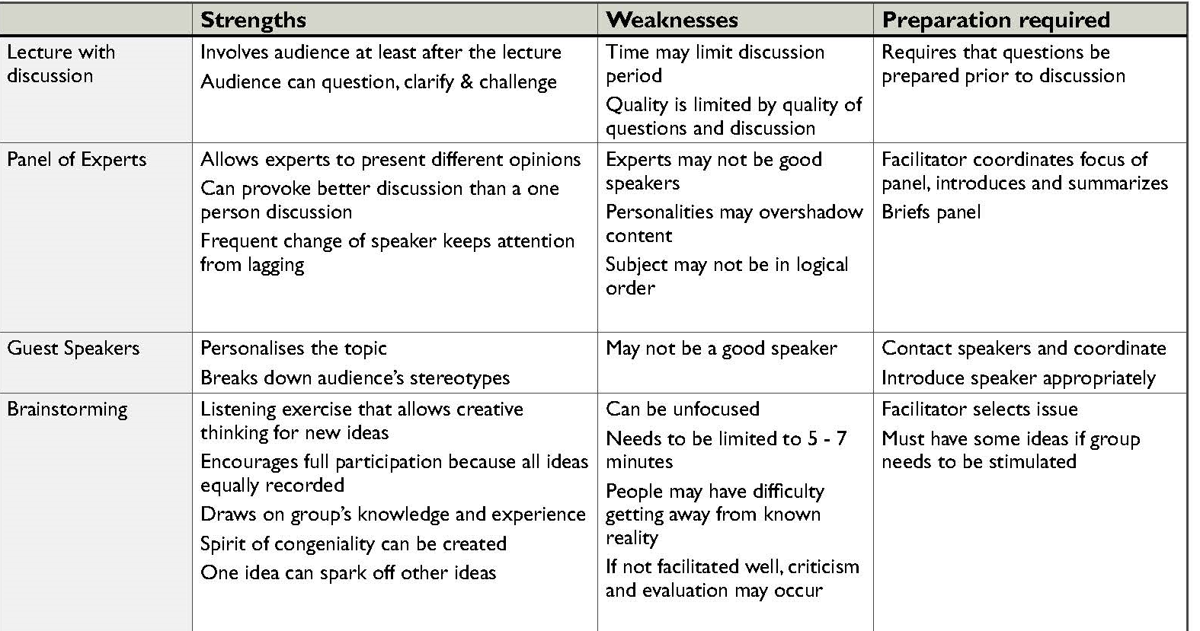

Slide 36
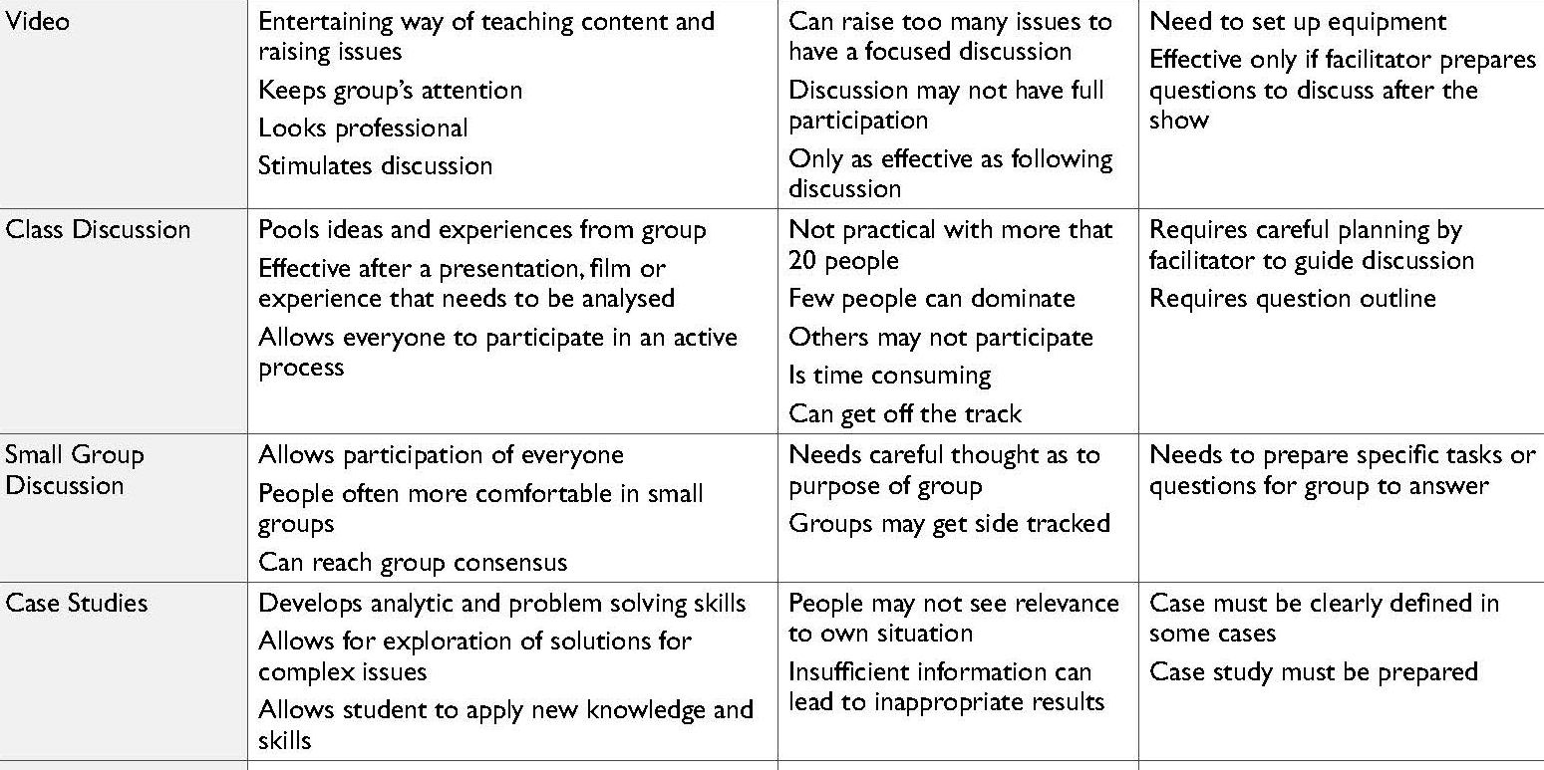

Slide 37
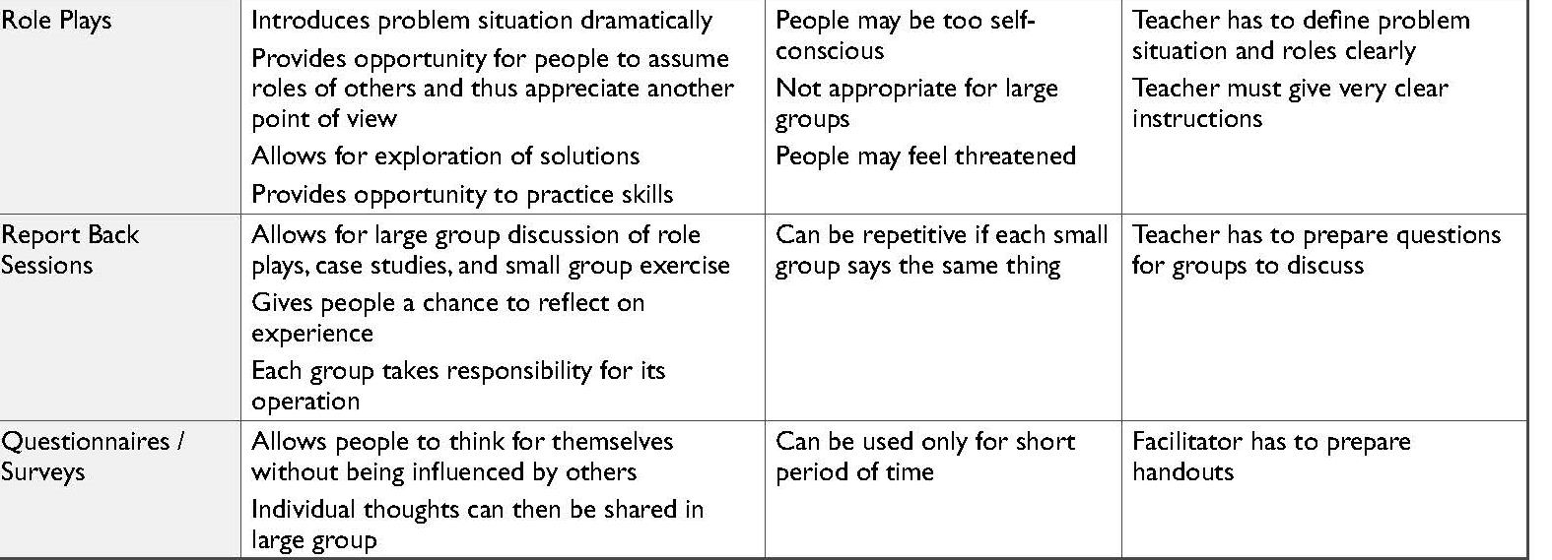
Further reading
Engaing in practice.pdf

Slide 38
Beliefs about the nature of knowledge, termed “epistemological beliefs”, are relevant to understanding educational strategies of both learners and teachers.
Epistemological beliefs arguably have particular relevance in the discipline and profession of psychology, due to an emphasis on integration of knowledge from multiple theoretical perspectives.
Beliefs about the nature of knowledge influence learning and teaching (Bendixen & Rule, 2004). These “epistemological beliefs” (EB) can vary across individuals and disciplines (Hofer, 2001; Kaartinen-Koutaniemi & Lindblom-Ylänne, 2008).
Despite their importance, to our knowledge, there is no previous published review of EB specific to teaching and learning psychology.

Slide 39
Less experienced tertiary students are more likely to demonstrate dualist beliefs, whereby knowledge is viewed as absolute and the teacher’s role is to communicate that knowledge.
In the next stage, multiplism, there is acknowledgement of multiple perspectives, but still the idea that there is a specific, yet undiscovered, truth.
Later, relativism acknowledges that some viewpoints are better than others.
The most sophisticated beliefs, commitment within relativism, involve making and evaluating flexibly held commitments to beliefs that incorporate personal values (Brownlee, Boulton-Lewis, & Purdie, 2002; Hofer, 2001).
Later EB research, including children’s and adults’ education, has identified similar developmental stages, termed realist, absolutist, multiplist and evaluativist by Kuhn (2005; 2009).

Slide 40
Constructivism posits that individuals learn through experience, deriving meanings that are influenced by context and by their previous knowledge and viewpoints (Lea, Stephenson, & Troy, 2003; Muis, 2007).
A constructivist approach to learning aligns with EB at the relativism or commitment within relativism stages, due to its emphasis on the importance of students’ experiences and perspectives in developing their knowledge.
More generally, EB can be viewed as a “psychological approach to the philosophical field of epistemology”

Slide 41
Measurement
EB measures vary with different models (e.g., see reviews by Braten et al., 2009; Buehl, 2008; Hofer, 2006; Limón, 2006).
Many studies have used the Schommer Epistemological Questionnaire (EQ; Schommer, 1990) or have adapted it (Jehng, Johnson, & Anderson, 1993; Kardash & Wood, 2000; Schraw, Bendixen, & Dunkle, 2002).
EQ factors of Simple Knowledge, Certain Knowledge, Innate Ability, and Quick Learning have fair internal consistency

Slide 42
Domain Specificity: EB in Psychology versus Other Disciplines
EB may be domain- or discipline-specific (Hofer, 2001; Kaartinen-Koutaniemi & Lindblom-Ylänne, 2008), although domain-general EB may co-exist (Muis, Bendixen, & Haerle, 2006).
Domain-specificity has been examined by comparing students of different disciplines and by comparing students’ EB regarding knowledge domains.
Paulsen and Wells (1998) assessed EB among 290 university students majoring in disciplines that were hard-soft (“hard” emphasising one specific paradigm; Biglan, 1973a) or pure-applied (“applied” emphasising applying subject matter to practical problems).

Slide 43
Relationship with Learning Approaches
EB may influence learning through a link with learning approaches (Entwistle & Peterson, 2004; Hofer & Pintrich, 1997). “Surface” learning focuses on outcome goals such as obtaining a qualification, whereas a “deep” approach involves intrinsic motivation and abstract meaning.
A third “strategic” approach involves striving to achieve highly while organising one’s time efficiently (Cassidy & Eachus, 2000). Naive EB have been associated with surface learning approaches whereas sophisticated beliefs have been associated with deeper approaches

Slide 44
Relationship with Academic Achievement
Sophisticated EB have been associated with better performance on both experimental tasks and course grades. Schommer (1990) asked undergraduate psychology students to write conclusions for and demonstrate mastery of passages from psychology or nutrition.
Higher certainty of knowledge beliefs were associated with absolute (oversimplified) conclusions, whereas completion of more university courses was associated with more tentative conclusions, reflecting more sophisticated EB. Higher quick learning beliefs were also associated with oversimplified conclusions and poorer mastery on the psychology passage as well as overestimation of understanding.

Slide 45
Teaching
Students prefer teaching approaches to be aligned with their present EB, yet learning is enhanced when students’ existing conceptions are challenged (Entwistle & Peterson, 2004). Student-centred approaches to learning and teaching naturally align with a constructivist epistemology (Lea et al., 2003).
However, student-centred approaches are more often claimed than realised in practice .
EB may also affect assessment. Lea and Street (1998) noted that academic writing may be viewed differently by educators and students as well as by different individuals. They suggested an “academic literacies” approach that acknowledges epistemological variability among writing contexts. Interviews revealed that academics’ ideas about “good” writing were based in the meaning of knowledge, often discipline-specific. However, academics were often unable to identify explicitly what would improve poor student writing from an epistemological basis and instead more frequently described surface features such as structure and form. More attention by teachers to the epistemological basis of their expectations would help them communicate clearer expectations and give students feedback on core rather than surface issues.

Slide 46
Assessment may also affect students’ beliefs and approaches. Among first- and second-year university students studying research methods in health, social work or counselling, higher use of strategic learning was related to both higher academic achievement and perceived proficiency at course completion (Cassidy & Eachus, 2000).
Deep learning did not correlate with achievement or perceived proficiency.

Slide 47
Explicit versus Implicit Teaching
The extent to which it is beneficial to explicitly teach students about EB, compared with using strategies that implicitly foster more sophisticated beliefs, is unclear.
Explicit teaching regarding EB involves strategies such as students completing and then discussing an EB measure, as used in some educational psychology courses (Hofer, 2001). Explicit EB instructional studies have been concentrated in education. For example, EB of pre-service early childhood teachers increased in sophistication when both explicit and implicit teaching of EB was included in their university program (Brownlee, Petriwsky, Thorpe, Stacey, & Gibson, 2011). Explicit instruction regarding EB during teacher training was endorsed in a comprehensive review of teachers’ EB (Schraw & Olafson, 2003).
Explicit teaching is an instructional strategy used by teachers to meet the needs of their students and engage them in unambiguous, clearly articulated teaching
Explicit Instruction: Students are given definitions or other attributes of words to be learned. Implicit Instruction: Students are exposed to words or given opportunities to do a great deal of reading

Slide 48
Hammer and Elby (2002) demonstrated that teaching strategies can implicitly encourage students to use epistemological resources that will aid learning. Examples given include encouraging student debate, using design and construction activities, and using bridging analogies.

Slide 49
Good teaching
The question of what is “good” or “effective” teaching is an important and contentious one (Duarte 2013). Some academics believe their role is to provide the required discipline content to students.
On occasion, others cite very eloquent arguments that the discussion should focus on enhancing learning; they contend that talking about teaching only deflects attention from what they must consider, plan and organise and do, and what skills and competencies they need to hone.
Likewise, some academics do not believe it is their job to help students learn; rather, they are simply there to explain concepts and answer questions (Bhatti 2012; Prosser & Trigwell 1999a).
The latter view also underpins conceptions that it is not the academic’s fault if students do not learn, as students’ learning is somehow divorced from the actions of the lecturer, who provided the content, or “cast pearls before swine”, in the lecture theatre. Our later research found there were even some within the professoriate who deny that there is a pedagogical knowledge base (Scott & Scott in press).

Slide 50
Instructional design
This unit was proposed to satisfy a key criterion in the pursuit of accreditation for the business degree; that is, there was the need to ensure that students were provided with the opportunity to
demonstrate their development and refinement of a range of professional skills integrated with their discipline knowledge.
Unlike most other units in the B.Com, which were content-focused,
this capstone unit was designed to simulate a real-world business setting whereby students were expected to apply their discipline knowledge accrued over the course of their degree to the
operation of a (virtual) company

Slide 51
To do a lecture which reviewed the success of the previous week’s
team decisions and identify some of the common errors and problematic areas that teams encountered which affected their performance…I was not supposed to guide or interfere with the teams’ decision-making or discussions, as they were supposed
to be quite autonomous.
The students expect me to teach, and if I do not give them the right direction they will get angry with me.... [The students] had no experience and I could have given them good advice, but this was not allowed…my hands were tied by the unit outline and
structure of the unit, which meant the students were teaching themselves.… I am not sure why I was there, really.
For optimal teaching and learning results, there must be both good
instructional design and good teaching – that is, effective teaching that promotes optimal learning outcomes.
READ Internship

Slide 52
The Teacher–Student Relationship
The teacher–student relationship is one of the most powerful elements within the learning environment.
A major factor affecting students’ development, school engagement and academic motivation, teacher–student relationships form the basis of the social context in which learning takes place (Hughes & Chen, 2011; Roorda et al., 2011; Spilt, Koomen & Thijs, 2011).
Teacher–student interactions are not only influenced by a number of aspects including gender, but in turn also influence a student’s academic outcomes and behaviour. Supportive and positive relationships between teachers and students ultimately promote a “sense of school belonging” and encourage students to “participate cooperatively in classroom activities

Slide 53
Intellectual Quality
Intellectual quality can be identified as pedagogy that focuses on producing a deep and conceptual understanding of important skills, ideas and areas of study (NSW DET, 2003). Classrooms high in intellectual quality encourage all students to engage in challenging work that provides opportunities for the development of higher-order
thinking and substantive communication, as students work to actively construct knowledge.
Quality Learning Environment
A quality learning environment is achieved when the classroom or other learning environment displays “high levels of support for learning” (NSW DET, 2003, p.12).
Dempsey and Arthur-Kelly refer to the classroom environment as the “range of conditions in the learning setting that interact to influence the learning outcomes from that setting” (2007, p.110). In such environments, positive relationships are formed between teachers and students as they work cooperatively in an encouraging atmosphere.

Slide 54
Significance
Significance refers to pedagogy that helps students see connections between their learning and prior knowledge, assisting students in understanding that their learning matters.
Learning is therefore made meaningful as students can see the importance of their work in contexts beyond the classroom, and the ways in which their learning and knowledge can be applied
Within the learning environment, importance needs to be placed on the development of positive teacher–student relationships, as these relationships have immeasurable effects on students’ academic outcomes and behaviour.
READ Academic and workforce
READ dimensions_of_quality.pdf
READ NASPA partnership workbook 2017.pdf

