Slide 1
As a practice-oriented profession, social work has made major contributions to the health and well being of older adults and their families. But with the expanding older population comes the need to make sure every social worker is prepared to work with older clients. The first step in that preparation is faculty who can teach gerontological social work and develop the evidence-based research needed for effective interventions.
Social work education programs need to create a cadre of faculty leaders to prepare the profession for the rising demands for aging-related services. Acting as mentors, teachers, and role models, these faculty would increase the number of well-trained geriatric social workers while raising the visibility of geriatric social work among
policymakers and experts in other fields.

Slide 2
Mentoring
Universities can provide junior faculty with a mentor who provides guidance on geriatric research. The dean can invite a professor at the school to become a research mentor or create an alliance with an expert from another university’s school of social work. Deans at schools of social work could establish a long-distance system of mentoring for their young faculty, as well.

Slide 3
Bolstering Research
Besides offering mentors, institutions can provide financial and skills-improvement resources to encourage and help doctoral students and junior faculty undertake geriatric research projects.
University-sponsored research and doctoral grants can be viewed as an investment.
Doctoral students and junior faculty in gerontology who pursue important research are more likely to receive tenure-track appointments, win additional grants from public and private sources, and generate published articles that will elevate the field of gerontology and university prestige.
To strengthen research skills, the university can provide teaching release time so that junior faculty can attend specialized programs in social work research methodology.
The dean of social work can cooperate with deans of other schools on campus to design a one-semester seminar or a faculty retreat that includes gerontology faculty from social work, nursing, medicine, and public health. The university also can conduct workshops on grant writing and research funding.

Slide 4
A rough continuum of practice experiences, from more to less student immersion in practice: recognition of work-based learning (offered by the university) recognition and intellectual extension of learning in practice;
a wide range of internships and practicums what presupposes a deep involvement of enterprises into the educational process in general;
field trips and visits, real and virtual;
simulations and role plays: high to low fidelity, face-to-face or online;
problem-based, issues-based or practice case-based approaches to learning in subjects (popular case studies);
student use of cutting-edge technologies in practice-based scenarios;
student-created media resources that illustrate aspects of practice, including podcasts and vodcasts (higher immersion for the creators, lower for other users);
guest lectures and vodcasts or podcasts from professional practitioners (again there is a reference to the link between business and university).

Slide 5
Professional development organisers suggest using the following guidelines:
Begin with the end in mind and plan for this end-result.
Craft the driving question; select and refine a central question.
Plan the assessment and define outcomes and assessment criteria.
Map the project: decide how to structure the project.
Manage the process: find tools and strategies for successful projects

Slide 6
TYPE OF STUDIES
•Professional studies:
–Offer an adequate level of professional competences to qualify for employment;
–Mainly delivered by polytechnic, colleges and schools of professional higher education;
–Very rare at universities.
•Academic studies:
–Prepare for scientific work and develop competences for implementation of scientific achievements;
–Exclusively offered by universities.

Slide 7
Practical elements such as:
–Work placements;
–Fieldwork;
–Practicum;
–Laboratory exercises;
–Projects;
–Volunteering;
When organized as work placement:
–The employer nominates a mentor;
–HEI’s sign contracts with employers (but not in all cases);
–Competences are evaluated through learning diary, reports, certificates from employer or exams;
–In most cases students status is not regulated;
–Students rarely receive financial compensation.
•When organized at higher institution:
–Course coordinator is mentoring the work;
–In most cases competences are evaluated through exams

Slide 8
Practical learning incorporated in theoretical courses should be improved and widened;
•Student in work placement should have clear status within the working organisation;
•Learning outcomes in practical learning are not always/sufficiently defined;
•Evaluation methods needed to be improved/developed;
•Cooperation with employers should be deepened

Slide 9
The growing attention within higher education to enhancing students’
employability responds to student motivations and to policy concerns.
It can reinforce rather than threaten traditional academic values, but it may also require organisational change within higher education.
Definitions of employability can focus on immediate employment, on immediate employability, or on sustainable employability. The third of these, in particular, requires attention to be paid to longer-term career development.
The growth of career development learning has significant implications for the organisational location of careers services within institutions and for the competences required by their staff.

Slide 10
Attention to career development in definitions of sustainable employability has not always been as strong as it might have been.
The terminology used to describe career development learning in higher
education has fluctuated, with career(s) education and career management skills as alternative formulations. A number of different conceptual models have also been developed, with the DOTS model being particularly influential.
Career development learning can be viewed as addressing an aspect of
employability, or a set of related meta-skills.
Career development learning can be delivered through specifi c modules,
through more general curriculum integration, or outside the curriculum. The modular approach has been growing.
In a number of institutions, close links have been established between career development learning and the processes of personal development planning.

Slide 11
The teaching and learning methods used in career development learning need to be personally engaging (and therefore active and interactive in nature); they also need to make the world of work real (and therefore include or draw from direct experiences of work).
The assessment methods used need to reflect the learning goals of the programme.
Careers services within universities can make a substantial contribution to career development learning.
There are a number of different models for the respective roles of the careers service and of teaching departments in delivering career development learning.
The nature of such models is likely to vary, depending in part on whether the course is vocational, semi-vocational or non-vocational in nature.
●

Slide 12
Students’ success in gaining employment is determined not only by the effects of their higher education but also by their own pre-existing attributes and by the Career development.
Employability is viewed as being influenced by four broad and inter-related components:
Understanding (viewed as being broader and deeper than ‘knowledge’).
Skills (or, preferably, ‘skilful practices’, which includes the deployment of skills).
Efficacy beliefs (including students’ views of themselves and personal qualities).
Metacognition (including students’ self-awareness regarding, and capacity to
reflect on, their learning)

Slide 13
The attention to career development in definitions of sustainable employability has
not always been strong:
Knight & Yorke (2004, p.25) include ‘skilful career planning and interview
technique’ in their list of ‘seven meanings of employability’, but the specification
of interview technique tends to restrict the focus, as does the accompanying
note which suggests that its concern is with ‘knowing the rules of the jobseeking
game’.
The definition of employability offered by Yorke (2004, p.7) – which focuses on
the ‘skills, understandings and personal attributes that make graduates more
likely to gain employment and be successful in their chosen occupations’ – can
be read as assuming that graduates will remain within a single occupation, and
as not attending to the competences required to manage progression within and
possibly across occupations.

Slide 14
Self awareness – in terms of interests, abilities, values, etc.
Opportunity awareness – knowing what work opportunities exist and what their requirements are.
Decision learning – decision-making skills.
Transition learning – including job-search and self-presentation skills.
Self awareness
Identify knowledge, abilities and transferable skills developed by one’s degree
Identify personal skills and how these can be deployed
Identify one’s interests, values and personality in the context of vocational and life planning
Identify strengths and weaknesses, and areas requiring further development
Develop a self-reflective stance to academic work and other activities
Synthesise one’s key strengths, goals and motivations into a rounded personal profile

Slide 15
Opportunity awareness
Demonstrate knowledge of general trends in graduate employment and opportunities for graduates in one’s discipline
Demonstrate understanding of the requirements of graduate recruiters
Demonstrate research-based knowledge of typical degree-related career options and options in which one is interested

Slide 16
Decision making
Identify the key elements of career decision-making, in the context of life planning
Relate self-awareness to knowledge of different opportunities
Evaluate how personal priorities may impact upon future career options
Devise a short/medium-term career development action plan
Identify tactics for addressing the role of chance in career development
Review changing plans and ideas on an ongoing basis

Slide 17
Transition learning
Demonstrate understanding of effective opportunity-search strategies
Apply understanding of recruitment/selection methods to applications
Demonstrate ability to use relevant vacancy information, including ways of accessing unadvertised vacancies
Identify challenges and obstacles to success in obtaining suitable opportunities, and strategies for addressing them
Demonstrate capacity to vary self-presentation to meet requirements of specific opportunities
Demonstrate ability to present oneself effectively in selection interviews and other selection processes
Identify challenges and obstacles to adapting successfully to new environments, and strategies for addressing them
Demonstrate awareness of attitudes crucial to the achievement of one’s goals

Slide 18
Positioning behaviours (making sure one has the contacts, skills and
experience to achieve one’s desired career outcomes)
Strategic choice of mobility opportunity – initiation of job moves, or acceptance
of proposed changes made by another party (e.g. one’s employer)
Strategic investment in human capital – investing in training or educational
qualifications
Job content innovation – development of substantive changes in methods or
Environment
Influence behaviours (actively attempting to influence the decisions of key
gatekeepers to desired career outcomes)
Self-promotion
Ingratiation – making oneself more attractive to others
Upward influence – increasing gatekeepers’ understanding of one’s desired
outcomes and their sense of obligation to deliver them
Active network development procedures used

Slide 19
Boundary management (balancing the demands of work and non-work
domains)
Boundary maintenance – concerned with the location of the boundary between work and non-work roles
Role transition – navigating the transition between work and non-work roles.

Slide 20
Career management/self-reliance/effective learning skills
Self awareness
Able clearly to identify skills, values, interests and other personal attributes
Able to pinpoint core strengths and ‘differentiating factors’
‘portfolio’) feedback
Able to identify areas for personal, academic and professional development
Self-promotion
Able to define and promote own agenda
Can identify ‘customer needs’ (academic/community/employer) and can
promote own strengths in a convincing way, both written and orally, selling
‘benefits’ to the ‘customer’, not simply ‘features’
Equipped with evidence of abilities (e.g. summary statement, record or
Actively willing to seek feedback from others, and able to give constructive

Slide 21
Exploring and creating opportunities
Able to identify, create, investigate and seize opportunities
Has research skills to identify possible sources of information, help and support
Action planning
Able to plan a course of action which addresses: ‘Where am I now?’ ‘Where do I
want to be?’ ‘How do I get there?’
Able to implement an action plan by: organising time effectively; identifying
steps needed to reach the goal; preparing contingency plans
Able to monitor and evaluate progress against specific objectives
Networking
Aware of the need to develop networks of contacts
Able to define, develop and maintain a support network for advice and information
Has good telephone skills

Slide 22
Matching and decision making
Understands personal priorities and constraints (internal and external), including need for a sustainable balance of work and home life
Able to match opportunities to core skills, knowledge, values, interests etc.
Able to make an informed decision based on the available opportunities
Negotiation
Able to negotiate the psychological contract from a position of powerlessness
Able to reach ‘win/win’ agreements
Political awareness
Understands the hidden tensions and power struggles within organisations
Aware of the location of power and influence within organisations

Slide 23
Coping with uncertainty
Able to adapt goals in the light of changing circumstances
Able to take myriads of tiny risks
Development focus
Committed to lifelong learning
Understands preferred method and style of learning
Reflects on learning from experiences, good and bad
Able to learn from the mistakes of others
Transfer skills
Able to apply skills to new contexts

Slide 24
4.3 Relevance to employability
According to Watts & Hawthorn (1992, p.15), personal transferable skills and
career management skills have some degree of overlap but are essentially different
in focus:
The focus of career management skills is upon competence in making and
implementing the decisions that determine one’s career
The focus of personal transferable skills is on competence within the positions
that one enters as a result of these decisions and transitions.
It has subsequently been suggested (Watts, 1997, p.43) that career management
skills can be viewed in two ways:
As a sub-set of employability skills.
As a related set of meta-skills which enable individuals to develop and use the
full range of their other skills.

Slide 25
5.1 Delivery strategies
In broad terms, three delivery strategies for promoting career development learning can be distinguished (Hustler et al., 1998):
Through specific modules.
Through more general cross-curricular integration.
Outside the curriculum.
There are three forms of modular approach:
Generic, where the same module is designed to be available to students in any
department or course.
Customised, where a generic template is adapted to the needs of particular
departments or courses.
Bespoke, where modules are developed for specifi c purposes within particular
departments or courses.

Slide 26
The teaching and learning methods used in career development learning need to meet at least two major requirements:
They need to be personally engaging, and therefore based on active involvement of students and use of interactive teaching and learning methods.
They need to make the world of work ‘become “real”’ (AGCAS, 2005, p.10), and
therefore include active involvement of employers and, where possible, direct
experiences of work.

Slide 27
Pedagogy for Employability Group (2004, p.13) include:
Facilitative teaching styles that encourage and model an open and honest exploration of the career planning process.
Using short ‘buzz-group’ discussions within lecture-group sessions.
Self-audits (e.g. of personal and career management skills).
Role-play (e.g. recruitment personnel, mock interviews).
Peer review (e.g. of CVs or of assignments).
Card-sort exercises (e.g. devising a sequence of decision-making activities).
‘Snowballing’ activities which begin with pair-based work, progressively combining to produce a larger-group response to the challenge set.
Problem-based methods.
Supplementing lectures with on-line peer discussion groups or tutor-managed discussion forums.
Self-directed learning.

Slide 28
In addition, there is potential for active involvement of students in the design and
delivery of programmes.
This can include (Hustler et al., 1998, pp.31-34):
Systematic consultation of students, through surveys or focus-group
discussions, in designing programmes.
Using immediate student feedback in reviewing programmes.
Contacting former career management module students after graduation to
provide longer-term feedback.
Involving such graduates in the delivery of modules to current students.

Slide 29
Career development learning can use all of these experiences as resources for learning. In particular, it can:
Help students to prepare for such experiences in ways which harness their career development learning potential.
Help students to refl ect on the career development learning they can draw from such experiences, both during and after the experiences (see Moon, 1999; 2004).
Help students to develop evidence of work-related experience and possibly proficiency that can be used in future job applications

Slide 30
Assessment and evaluation
Reflective essays or reports.
Learning logs and portfolios, including action plans.
Group or individual projects.
Group or individual presentations.
Direct assessment of CVs, applications and interviews.
Written examinations.

Slide 31
Role of careers services
Individual and group guidance.
Information services.
Employer liaison and placement services.

Slide 32
The integrated guidance model, in which the careers service becomes an integral part of a continuous guidance process available to students pre-entry, on entry, and throughout the student’s course, as well as on exit from it.
The integrated placement model, in which the careers service’s concern for placement on graduation becomes part of an integrated placement operation which also includes course-related placements, and placements into part-time and vacation jobs.
The curriculum model, in which the careers service becomes part of the
teaching delivery vehicle for, or of a consultancy service designed to support academic departments in, incorporating into course provision the development of employability and career management skills.
The learning organisation model, in which the careers service becomes part of a service designed to foster the career development of all members of staff, including contract researchers and other staff, as well as students.

Slide 33
Models of partnership with teaching departments
Within vocational courses, which are linked to a specific occupation, and are
regarded as essential for entry to, and as providing preparatory training for, that
occupation (e.g. medicine, architecture), the department is likely to view career
development related to that occupation as being its own primary responsibility
(though is unlikely to pay any attention to career development outside it).
Within semi-vocational courses, which lead to a wide range of occupations, but
with the expectation that they will be regarded as essential or desirable for entry
to many of those fi elds (e.g. chemistry, psychology), the department is likely to
view responsibility for career development learning as being shared with the
careers service.
Within non-vocational courses, from which it is common for students to enter a
wide range of occupations, to most of which the subject content of their course
is not directly relevant (e.g. history, philosophy), the department is likely to view
career development learning as being primarily the responsibility of the careers
service.

Slide 34
There are a number of different models for the respective roles of the careers service and teaching departments in delivering career development learning.
These include (Hustler et al., 1998, p.41):
Specialist: delivered solely by careers advisers.
Consultancy: careers advisers lend support and expertise to work undertaken by departments, including involvement in planning groups, materials development and informal staff development.
Parallel delivery: academic staff and careers advisers have separate slots in a departmentally-based programme, usually initiated and owned by the department.
Integrated: academic staff and careers advisers work as a joint course team.

Slide 35
To play roles as teachers and as academic leaders (ibid, pp.39-40).
This requires: Greater pedagogic knowledge and skills than they have usually had in the past.
A stronger grounding in career development theory, not only as a theoretical
basis for their own professional practice but also as a body of knowledge for
them to teach to students as part of the students’ career development learning
Academic empathy’, in order to work effectively with the distinctive contexts and
cultures of different teaching departments and disciplines
Develop Academic Potential
Click HERE

Slide 36
Scholarships are not only about money, though! Besides the financial support, scholarship givers often provide you with book support, internships, seminars or valuable business- and academic contacts for example. On the other hand, some scholarships have also certain requirements for you to fulfil. You might for example be obliged to participate in certain research projects, take part in conferences or work for a certain company or institution after your studies. Also, some scholarships need to be renewed regularly, mostly on a yearly basis! That's why you should inform yourself carefully when choosing your scholarship.
Merit-based scholarships (fellowships)
These scholarships are among the most common ones and are usually awarded by private organisations as well as by public institutions or directly from the university where you are going to study. Most scholarship holders of merit-based scholarships are chosen by considering the academic performance as well as extracurricular activities like volunteer commitment, work experience or other experiences. However, there are also special fellowships that focus less on the academic but for example more on artistic, athletic or musical abilities. Many merit-based scholarships are awarded without regard for financial need.

Slide 37
Specific scholarships
Besides fellowships, many organisations award specific scholarships where the awardees have to meet certain criteria such as nationality, gender, religion, political affiliation, race, special needs e.g. due to disabilities or a specific medical history and many more. Need-based scholarships
Depending on your personal and your familys financial situation, you might qualify for a need-based scholarship. In Europe those scholarships are often referred to as student grants and offered by public institutions such as governments (government funding) but also by charitable organisations for example. Even if you are not citizen of the country you are going to study in, you might qualify for a need-based scholarship if you fulfil certain requirements. For example in Germany! Often, need-based scholarships are combined with low-cost or free student loans.

Slide 38
Many institutions have standardized formats for faculty CVs; some institutions offer the following subsection headings within the Bibliography section:
• Peer Reviewed Educational Materials
• Enduring Materials (Peer Reviewed and Non-Peer Reviewed)
• Other Forms of Educational Scholarship

Slide 39
Scholarship Defined:
1) Clear goals – the educator explicitly states the basic purposes for the work, and defines realistic, achievable objectives, including desired goals and outcomes.
2) Adequate preparation – the educator shows an understanding of existing scholarship relevant to the endeavor and has skills and resources drawn from this research and from prior experience to advance the project.
3) Appropriate methods – in conjunction with the material and the context, the educator chooses, applies and, if necessary, modifies methods wisely.
4) Significant results – the educator achieves the goals, and contributes notably to the field in a manner that invites further exploration.
5) Effective presentation – the educator uses a suitable style and organization to present the work with
clarity and integrity in appropriate forums to reach the intended audience.
6) Reflective critique – the educator thoughtfully assesses the work him/herself and uses the resulting
perceptions, along with reviews and critique from others, to refine, enhance or expand the original
concept.

Slide 40
Peer Review and Dissemination:
The expansion of the concept of scholarship to include other kinds of academic work besides traditional research and the widespread acceptance of the six Scholarship Assessed criteria for scholarship only compliments the roles that peer review and dissemination continue to play in all higher education, including medical and dental education.
Peer review has always been a systematic evaluation tool in assessing research and now, given the Scholarship Assessed criteria, peer reviewers are readily able to judge whether work in any domain meets the quality and standards of scholarship in the academic community.

Slide 41
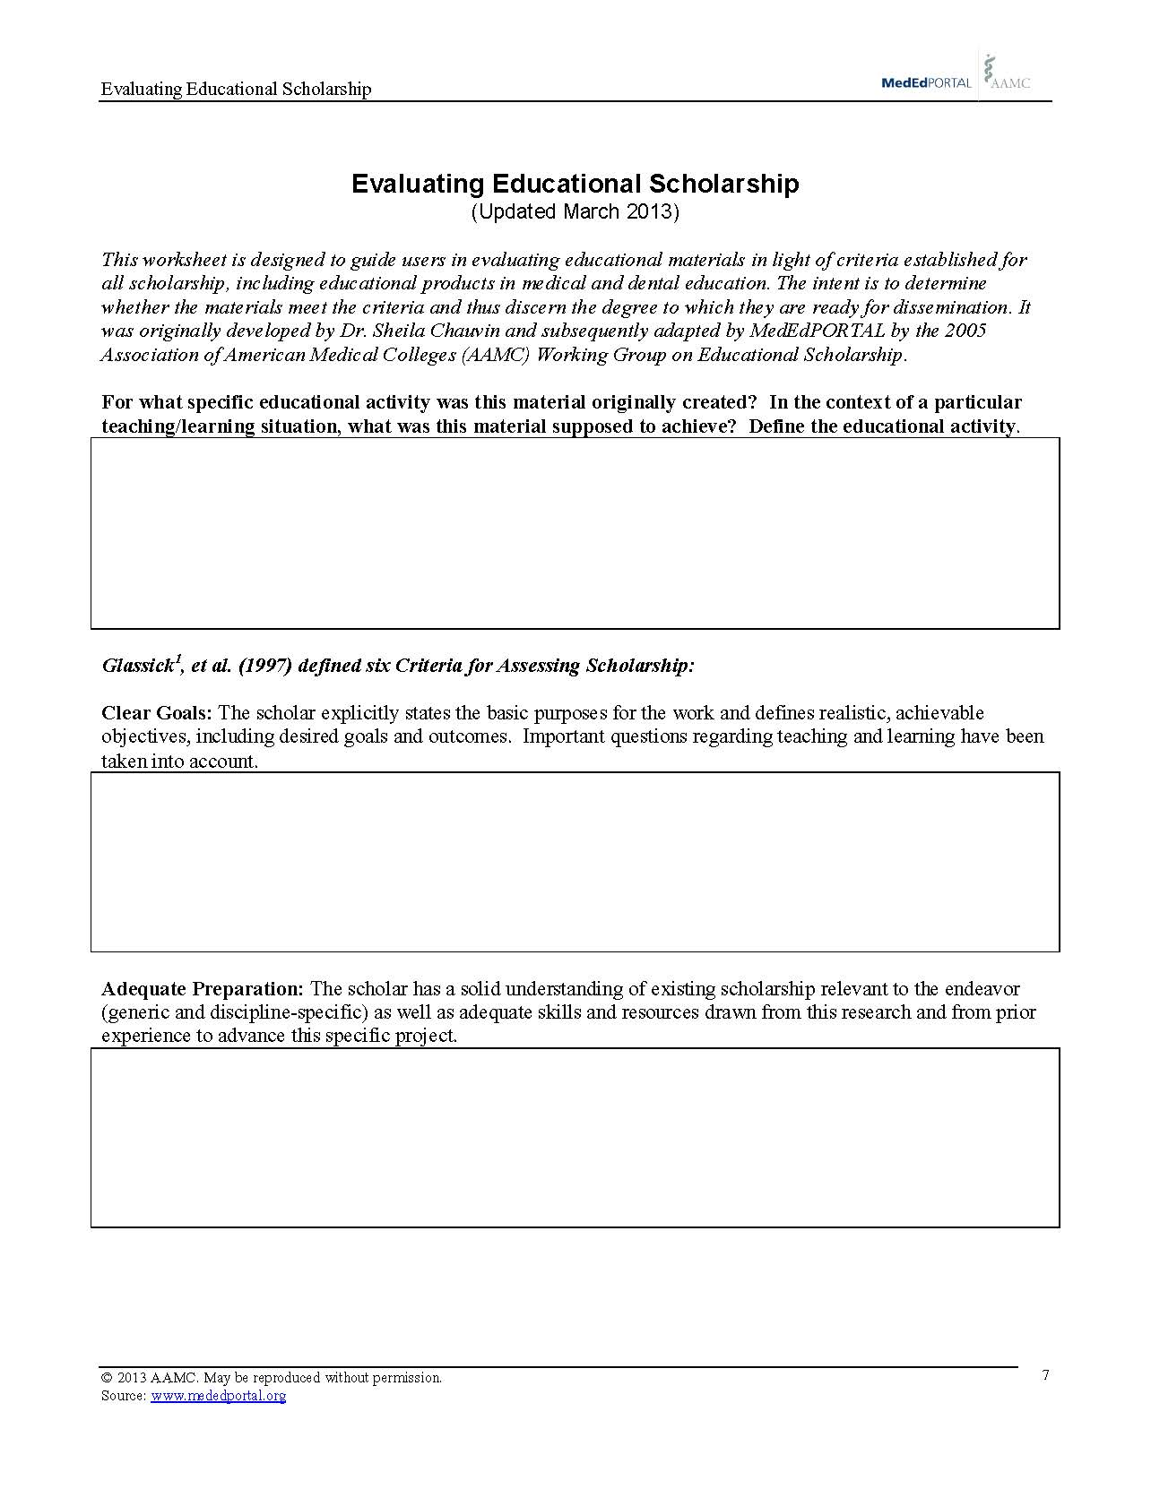

Slide 42
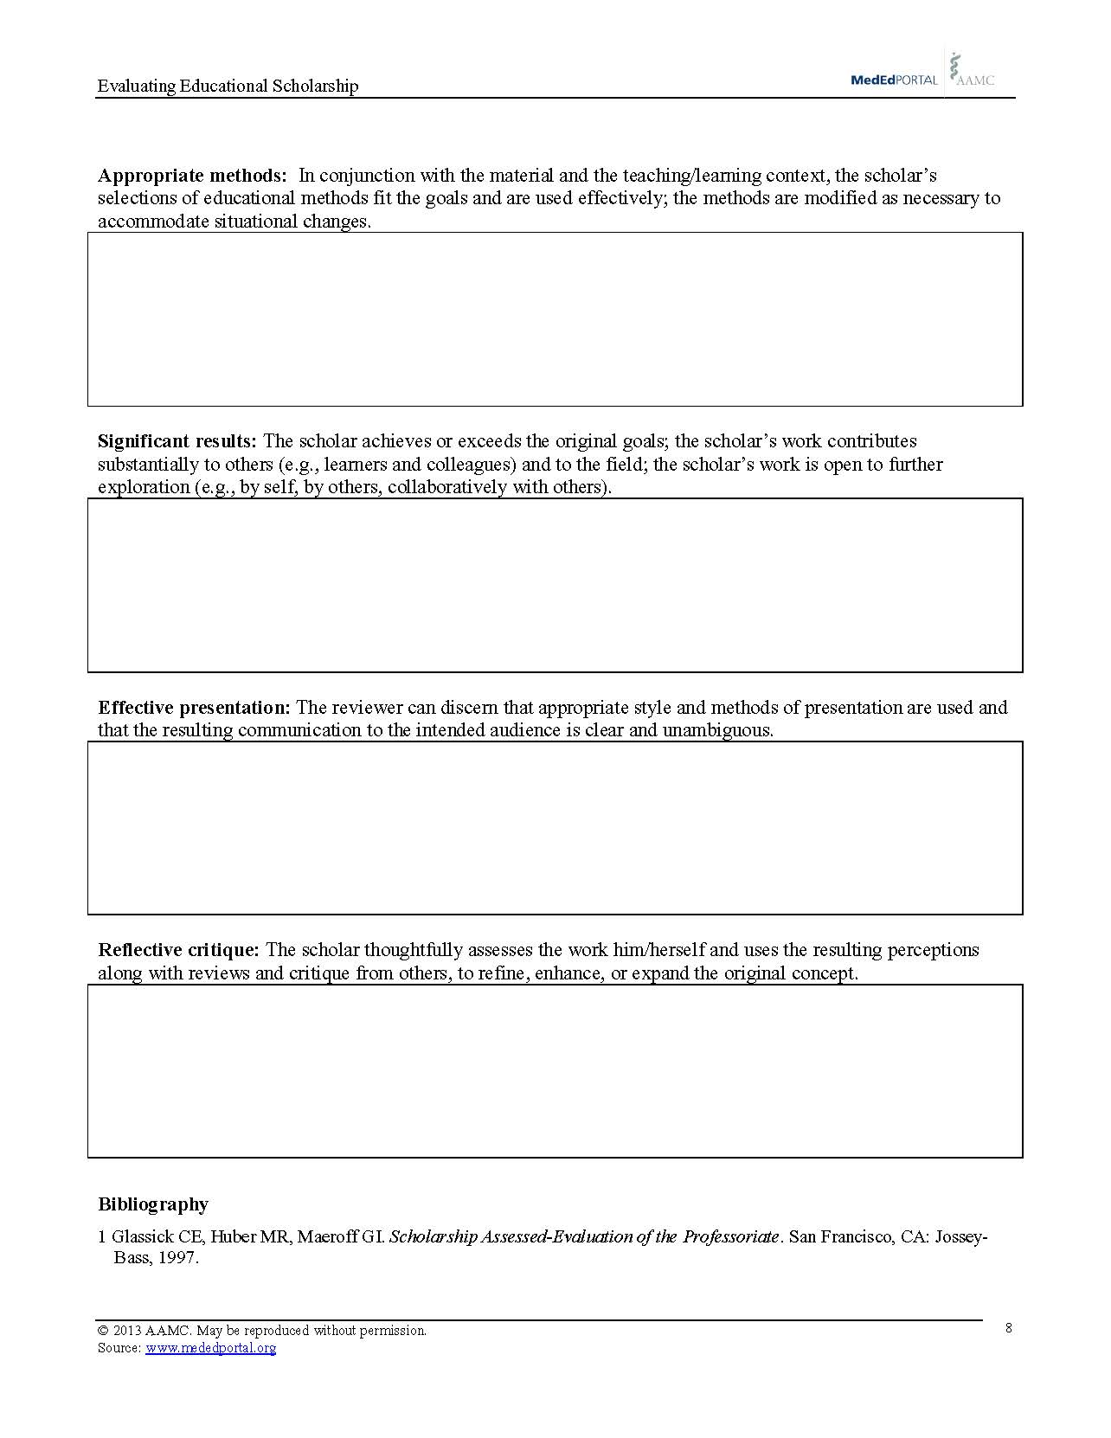

Slide 43
