Slide 1
Teaching Evidenced based medicine
How to teach about systematic reviews
David Nunan, PhD
Departmental Lecturer/Senior Researcher, Nuffield Department of Primary Care Health Sciences
Tutor Centre for Evidence based medicine
University of Oxford
September 2015

Slide 2

MSc in EBHC x 25
PICO, searching, levels of evidence, study design, RCTs, Dx, stats
1 ½ hours – appraising systematic reviews
What would you consider “the essentials”?
Notes:
The reason I’m presenting this to you is because I would like to know if you had to teach a session on systematic reviews…..

Slide 3

KNOW YOUR AUDIENCE

Slide 4
Objectives
Show some techniques/tips for critical appraisal of systematic reviews
Help you plan your own 1 ½ hour teaching critical appraisal
Have some fun and help make teaching critical appraisal of systematic reviews easier
Notes:
to

Slide 5
Scenario
Mr Smith is 64 years old and recently diagnosed with atrial fibrillation (AF), a condition associated with a high risk of stroke. You wish to know if prescribing warfarin will reduce his risk of stroke?
How will you answer this?
Conduct a trial?
Search and appraise a relevant RCT?
Conduct a systematic review?
Strip down to your underwear and do a ceremonial dance to the great and mighty evidence gods
Search and appraise a relevant SR?

Slide 6
EBM and Systematic Review
EBM (quick & dirty)
Steps
  Question (PICO)?
  Find the best evidence?
  Appraise?
  Synthesised?
  Apply?
Time: 120 seconds
1 - 20 articles
This patient survives!
Systematic Review
Steps
  Question (PICO)
  Find the best evidence x 2+
  Appraise x 2+
  Synthesize
  ---
Time: 6 months+, team
< 2,000 articles
This patient is dead
Find a systematic review (and appraise it quickly)!
Notes:
So as a practicing clinician it’s unlikely you are going to have time to perform a systematic review.
You need to perform a methodological sound search (probably needing an information specialist to help)
You need to check the results of your search – twice (title/abstract, then inclusion/exclusion criteria) and 2 people need to do this
You then both have to appraise the included studies
Then both have to extract the data
Then synthesize – perhaps a statistician needed here
Then apply the results to your practice

Slide 7
ENGAGE YOUR AUDIENCE

Slide 8
What is a systematic review?
“The application of strategies that limit bias in the assembly, critical appraisal, and synthesis of all relevant studies on a specific topic.”
  Oxford Centre of Evidence Based Medicine (OCEBM) Levels Table
Ensures that all available evidence is taken into account and minimises ‘cherry-picking’
Not performing SRs can be dangerous and/or unethical!
Notes:
2nd point – minimise the chance of studies with +ve or –ve effects being cherry-picked to support a certain position.
3rd point – failure to conduct SRs in medicine can be very bad and I’ll give you an example why = corticosteroids in women in preterm delivery.

Slide 9
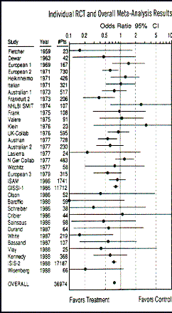
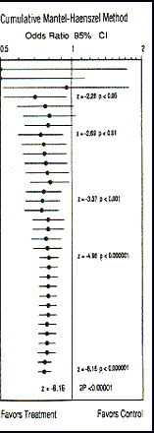
a) I can tell which of these trials were potentially dangerous/unethical to perform
b) If I had more time I could sort of work it out, maybe…
c) Huh?!....
Notes:
The story of streptokinase for MI demonstrates the importance of SRs and is nicely illustrated in this slide.
What we have on the left are the point estimates for individual RCTs of streptokinase for mortality following MI. Each study is independent of the other one until the final meta-analysis at the bottom.
On the right, the same studies are presented but the difference is that each point estimate is the result of a meta-analysis of that study and the all the studies preceding it one so that you get a cumulative risk score. E.g. The result displayed in the European 1 study is the result of the pooled results for that study, as well as Dewar and Fletcher before it.
Based on this figure then, can anyone tell me at what point could we be certain that streptokinase saves lives? = 1977 (some might say 1974)
And yet we can see that from 77 onwards their were another 10 years worth of trials – 10 years were people with MI were being put into trials and denied a life saving treatment. This for me illustrates the power and importance of SRs.

Slide 10
GUAGE THE LEVEL OF YOUR LEARNERS

Slide 11
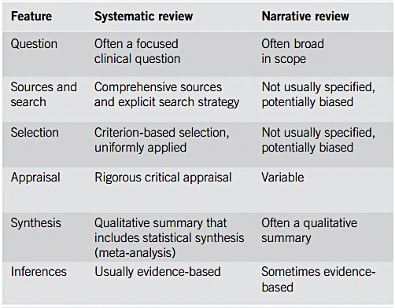
What makes a review “Systematic”?
Notes:
1. PICO – which you will be familiar with now
2. Using reproducible methods including predefined search strategies
3. A-priori defined inclusion/exclusion criteria and selection, extraction etc. described
4. Often using a mix of objective and subjective assessments
5. This can include meta-analysis and assessment of heterogeneity
6. Not extrapolating beyond the data or populations that were studied

Slide 12
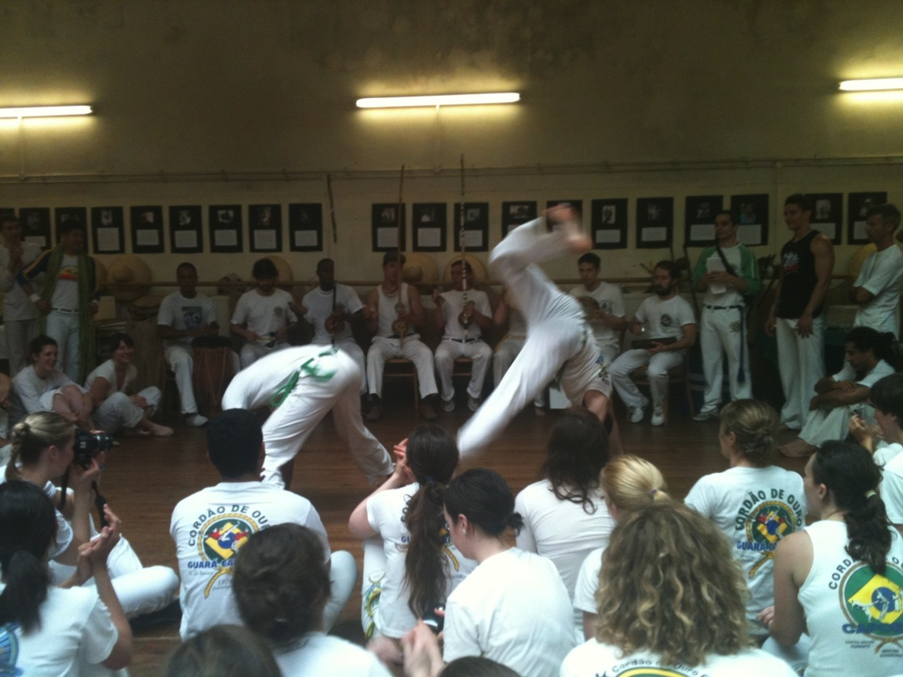
?
Notes:
Does anyone know what’s going on in this picture? Wait a few seconds see if anyone answers = Capoeira, Brazilian martial art etc…
So I’ve been practicing this a little and a few months ago I was performing in a show and hurt my knee. Would you like to see how I did this?
At the time knee wasn’t too bad, didn’t have to stop straight away, but after a few hours pain and stiffness increased but not much swelling.
The next day couldn’t put much weight on my leg and couldn’t straighten it either.
So I went to the GP that day and he told me that it’s likely I’ve damaged my anterior cruciate ligament. He recommended that I get it scanned and if it comes back positive he recommended surgery as early as possible as in his experience this led to better outcomes compared to patients that delayed surgery. I asked him what types of outcomes and he said things like returning to former activity and less recurrence of injury.
So me being a practitioner of evidence based medicine alarm bells started ringing in my head - I mean the first thing I was thinking is where is he getting this from? What is the evidence?
This happened just before my annual 2 week summer pilgrimage to the sunshine coast……….

Slide 13

Delay or not delay?
Notes:
…Eastbourne…which is where my parents live. I said to the doctor that I was supposed to be going away and he told me it was up to me but he still recommended not delaying. So my question to you is should I delay or not delay?

Slide 14
FIND A HOOK

Slide 15
Practising EBM – the 4 A’s
Step 4
Apply the evidence
Step 3
Step 2
Appraise the evidence
Step 1
Acquire the best evidence
Ask a clinical question

Slide 16
Our clinical question
Amongst adults with acute ACL injuries, does
early reconstructive surgery compared with
delayed reconstructive surgery lead to
favourable return to former activity and/or risk of recurrent knee injury?
Population
Intervention
Control
Outcome 1
Outcome 2

Slide 17
REINFORCE KEY CONCEPTS

Slide 18
Practising EBM – the 4 A’s
Step 4
Apply the evidence
Step 3
Step 2
Appraise the evidence
Step 1
Acquire the best evidence
Ask a clinical question

Slide 19
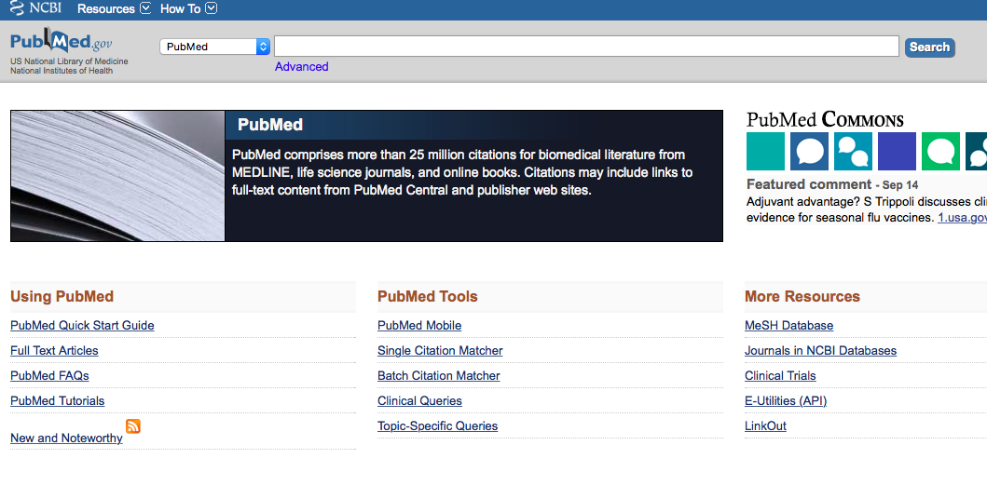
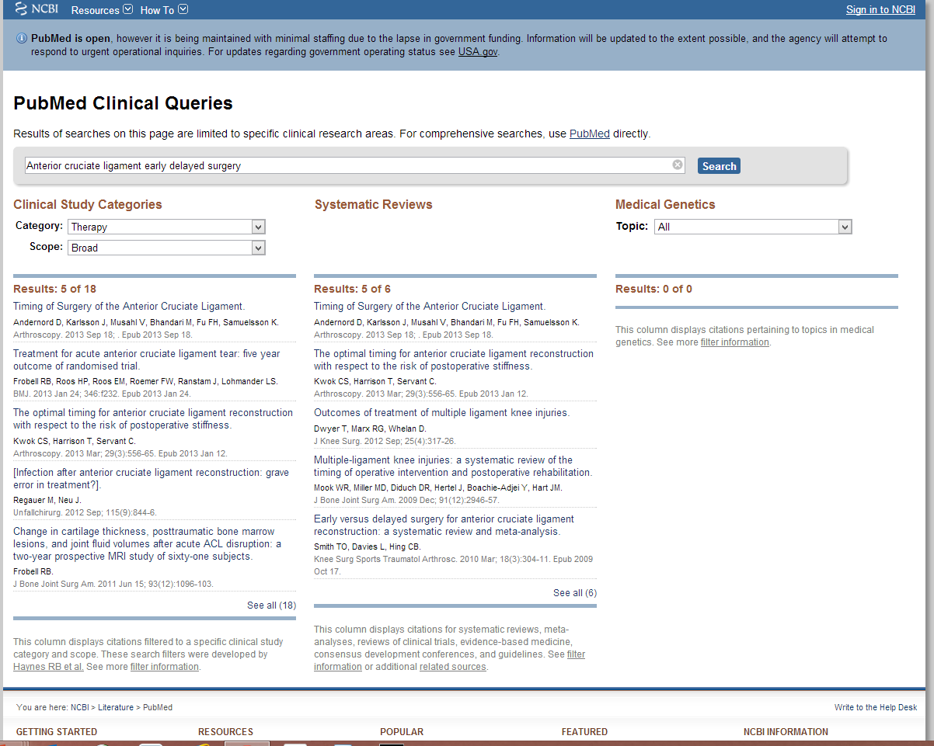
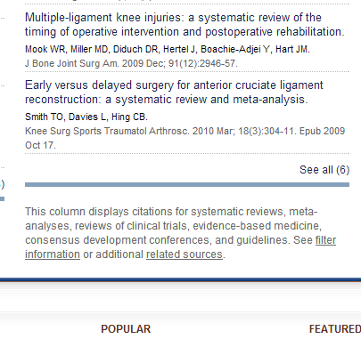
Notes:
Using your new found searching skills you came across this SR

Slide 20
Practising EBM – the 4 A’s
Step 4
Apply the evidence
Step 3
Step 2
Appraise the evidence
Step 1
Acquire the best evidence
Ask a clinical question

Slide 21
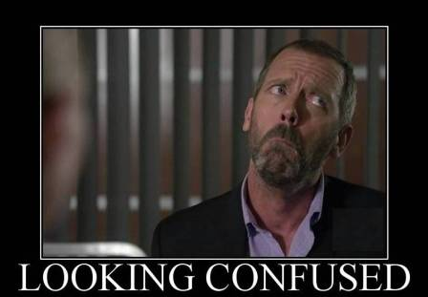
“Hang on. Systematic reviews collect, appraise and combine evidence.”
“So why do we need to appraise them?”
Not all systematic reviews are high quality!

Slide 22
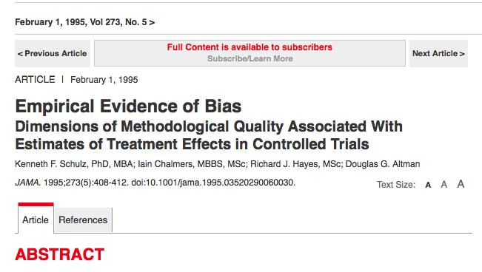
Concealing group allocation
41%
for inadequately concealed trials
30%
for unclearly concealed trials
Notes:
Non-randomised controlled trials:
can detect associations between an intervention and an outcome.
But….they cannot rule out the possibility that the association was caused by a third factor linked to both intervention and outcome.
Meta-analysis of controlled trials shows that failure to conceal random allocation and the absence of double blinding yield exaggerated estimates of treatment effects
Random allocation ensures no systematic differences between intervention groups in factors, known and unknown, that may affect outcome.
Double blinding ensures that the preconceived views of subjects and clinicians cannot systematically bias the assessment of outcomes.
Intention to treat analysis maintains the advantages of random allocation, which may be lost if subjects are excluded from analysis through, for example, withdrawal or failure to comply.

Slide 23
USE EXAMPLES TO ILLUSTRATE IMPORTANT POINTS

Slide 24
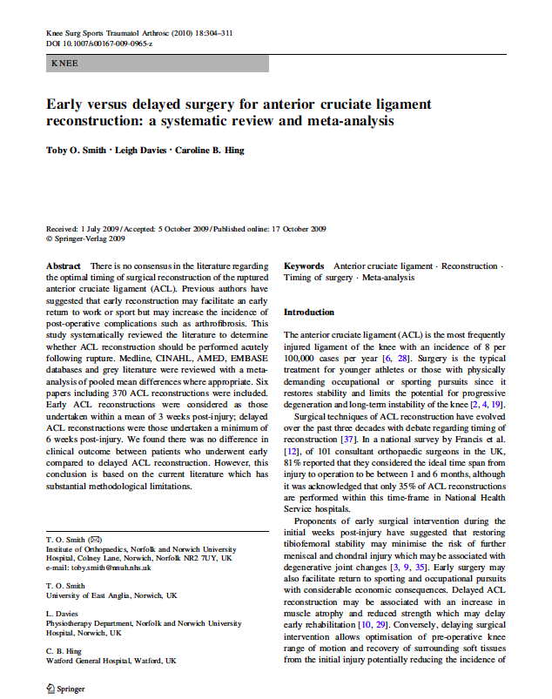
Appraising a systematic review
?

Slide 25


Tools for critical appraisal
CASP: Critical Appraisal Skills Programme Checklists
Critically Appraised Topics: generic systematic reviews (ACP Journal club)
SIGN: Scottish Intercollegiate Guidelines Network
GATE Frame
Notes:
AMSTAR = A measurement tool to assess systematic reviews
Shea et al. BMC Medical Research Methodology 2007 7:10uality of Systematic Reviews

Slide 26

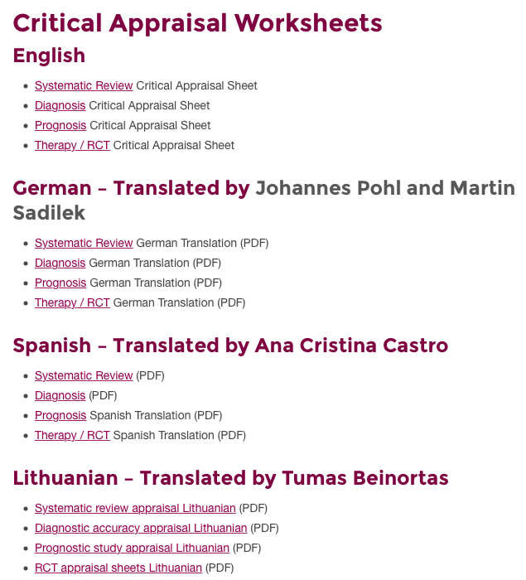

Slide 27
USE A TOOL TO GUIDE APPRAISAL

Slide 28
2 steps to CEBM systematic review appraisal sheet:
  Step 1: Are the results of the review valid?
  Step 2: What were the results?
6 questions in total
We are going to work through each section as a group

Slide 29
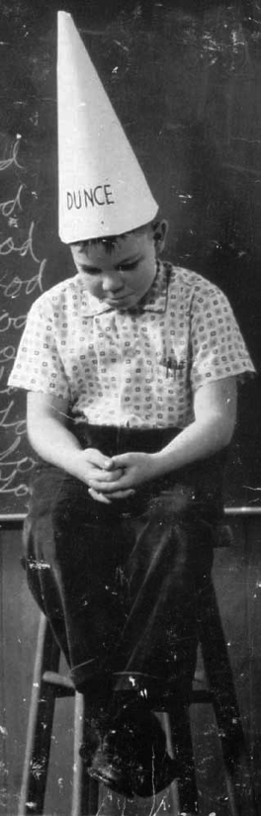



Slide 30
TRY AND CREATE A SAFE ENVIRONMENT

Slide 31
Appraising a systematic review
3 minutes

Slide 32
Step 1 – Are the results of the review valid?
Question – what is the PICO (etc.)
Finding – comprehensive?
Appraise – did they select good ones?
Synthesise – numerically/appropriate?

Slide 33
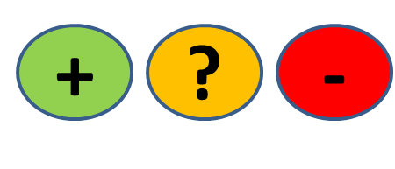
QUESTION
FIND
APPRAISE
SYNTHESISE
1. What question (PICO) did the systematic review address?
  Is question clearly stated early on?
  Treatment/exposure described?
  Comparator/control described?
  Outcome(s) described?
Title, abstract, introduction
Notes:
1 min them, 1 min feedback
Title, abstract or final paragraph of the introduction should state the question.
Our PICO:
P = patients with ACL injury = yes (initial injury suggests not chronic condition but no info on age)
I = Early ACL reconstruction = yes
C = Delayed reconstruction = yes
O = clinical and radiological = unclear
So overall we happy to say yes?
Tip = If cannot ascertain what the focused question is after reading these sections, search for another paper.

Slide 34
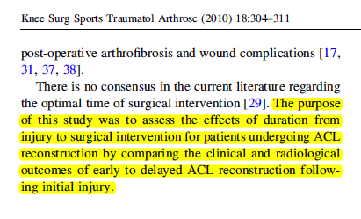
QUESTION
FIND
APPRAISE
SYNTHESISE
P
O’s
I
C
Notes:
1 min them, 1 min feedback
Title, abstract or final paragraph of the introduction should state the question.
Our PICO:
P = patients with ACL injury = yes (initial injury suggests not chronic condition but no info on age)
I = Early ACL reconstruction = yes
C = Delayed reconstruction = yes
O = clinical and radiological = unclear
So overall we happy to say yes?
Tip = If cannot ascertain what the focused question is after reading these sections, search for another paper.

Slide 35
QUESTION
FIND
APPRAISE
SYNTHESISE
2. Is it unlikely that important, relevant studies were missed?
Look for
  Which bibliographic databases were used? More than 1?
  Search terms used (text and MeSH)?
  Search for unpublished as well as published studies?
  Search for non-English studies?
Methods
Notes:
1 min them, 1 min feedback
Title, abstract or final paragraph of the introduction should state the question.
Our PICO:
P = patients with ACL injury = yes (initial injury suggests not chronic condition but no info on age)
I = Early ACL reconstruction = yes
C = Delayed reconstruction = yes
O = clinical and radiological = unclear
So overall we happy to say yes?
Tip = If cannot ascertain what the focused question is after reading these sections, search for another paper.

Slide 36
Is finding all published studies enough?
QUESTION
FIND
APPRAISE
SYNTHESISE
Negative studies less likely to be published than ‘Positive’ ones
How does this happen?
Positive studies SUBMITTED 2.5x more often than negative (Dickersin, JAMA, 1992)

Slide 37
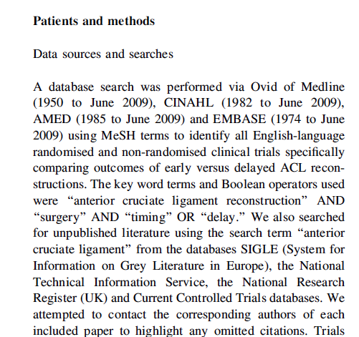
QUESTION
FIND
APPRAISE
SYNTHESISE
Notes:
2 min + 1
Methods and results sections.
1. Was the search strategy described sufficiently? Major bibliographic databases but also reference lists from relevant studies, Citation index, experts. Did they use MESH terms? = yes
2. Search terms used = yes
3. Limited = Yes - English language only. We should use all studies, getting non-English translated. Maybe resources did not allow for this.
4. Unpublished = yes – contacted authors
Results section will tell you numbers of titles/abstracts etc – in this case they also present a nice flow chart which tells us that an additional paper was found by contacting the authors (page 306)
One more aspect of the search strategy that was good and ensured studies were not missed = two investigators selected articles.
Overall it is unlikely important/relevant studies were missed.
Boolean operators – if anyone brings this up these are = AND, OR, NOT as you learnt with Nia last Thursday/Friday?

Slide 38
QUESTION
FIND
APPRAISE
SYNTHESISE
3. Were the criteria used to select articles for inclusion appropriate?
Look for
  Inclusion/exclusion criteria a priori?
  Are eligibility criteria related to PICO?
  Types of studies?
Methods
Notes:
1 min them, 1 min feedback
Title, abstract or final paragraph of the introduction should state the question.
Our PICO:
P = patients with ACL injury = yes (initial injury suggests not chronic condition but no info on age)
I = Early ACL reconstruction = yes
C = Delayed reconstruction = yes
O = clinical and radiological = unclear
So overall we happy to say yes?
Tip = If cannot ascertain what the focused question is after reading these sections, search for another paper.

Slide 39
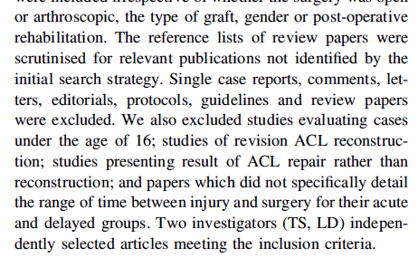
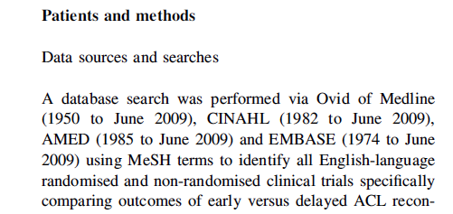
QUESTION
FIND
APPRAISE
SYNTHESISE
Notes:
2 min + 1
1st = Yes in methods section
2nd = Excluded all non-trial studies, under age 16, studies on revised ACL reconstruction, studies that did not detail time between injury and surgery for acute and delayed groups; are they related to PICO = yes.
3rd = Can anyone see a major point about the types of studies selected? = Non-randomised trials also included.
Anyone willing to suggest why? = Nature of the study – impossible to blind patients to early or delayed surgery. But…
…could have blinded surgeons to this (although ethically and logistically difficult)
…but could easily have blinded the assessors.

Slide 40

Is it worth continuing?

Slide 41
QUESTION
FIND
APPRAISE
SYNTHESISE
4. Were the included studies sufficiently valid for the type of question?
Look for
  Criteria for quality assessment defined?
  Appropriate for the question?
  Were the assessment results provided?
Methods, Results
Notes:
1 min them, 1 min feedback
Title, abstract or final paragraph of the introduction should state the question.
Our PICO:
P = patients with ACL injury = yes (initial injury suggests not chronic condition but no info on age)
I = Early ACL reconstruction = yes
C = Delayed reconstruction = yes
O = clinical and radiological = unclear
So overall we happy to say yes?
Tip = If cannot ascertain what the focused question is after reading these sections, search for another paper.

Slide 42
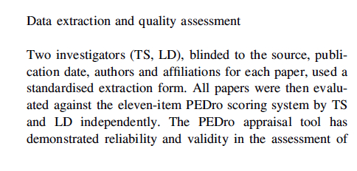
QUESTION
FIND
APPRAISE
SYNTHESISE
  Criteria for quality assessment defined?
Notes:
2 min + 1
Yes = the PEDro scale
Yes = validated for RCTs (unclear whether this holds for non-RCT)
Yes = table in the results section and appraisal page 307
[PEDro: gives score out of 11
Concealment allocation = person(s) deciding eligibility is unaware which arm of study subject is assigned to. If randomization is done at a central location then concealment is typicall assured.
Baseline comparability =must provide demographic details including details of severity of condition and minimum 1 outcome measure
Adequate follow up = score given if study provides info on #allocated to treatment and #assessed for final outcomes plus this #must be at least 85% of overall n.
Intention-to-treat = analysis is based on data from all subjects allocated to treatment and not just those completing the study]….
So are we happy that the studies were sufficiently valid = No or unclear
Okay if you turn over your appraisal sheets we’re now going to look at the actual results themselves.

Slide 43
QUESTION
FIND
APPRAISE
SYNTHESISE
Do your homework

Slide 44
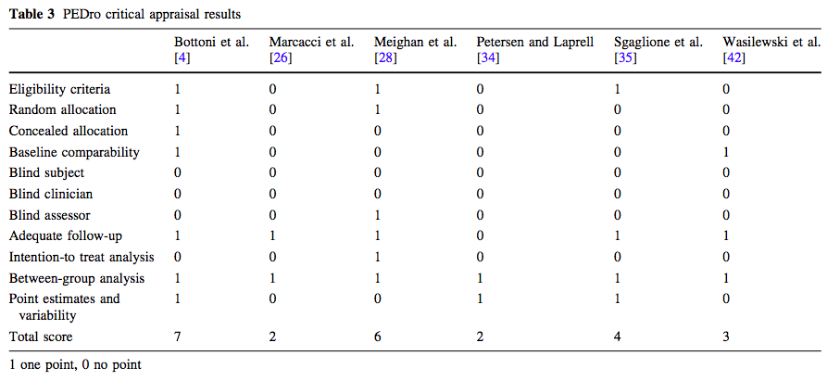
Appropriate for the question?
Were assessment results provided?
QUESTION
FIND
APPRAISE
SYNTHESISE
Notes:
2 min + 1
Yes = the PEDro scale
Yes = validated for RCTs (unclear whether this holds for non-RCT)
Yes = table in the results section and appraisal page 307
[PEDro: gives score out of 11
Concealment allocation = person(s) deciding eligibility is unaware which arm of study subject is assigned to. If randomization is done at a central location then concealment is typically assured.
Baseline comparability =must provide demographic details including details of severity of condition and minimum 1 outcome measure
Adequate follow up = score given if study provides info on #allocated to treatment and #assessed for final outcomes plus this #must be at least 85% of overall n.
Intention-to-treat = analysis is based on data from all subjects allocated to treatment and not just those completing the study]….
So are we happy that the studies were sufficiently valid = No or unclear
Okay if you turn over your appraisal sheets we’re now going to look at the actual results themselves.

Slide 45
QUESTION
FIND
APPRAISE
SYNTHESISE
5. Were the results similar from study to study?
Consider whether
  The results of all the included studies are clearly displayed
  The results are combined (meta-analysis)
    Are studies sufficiently similar
  The reasons for any variations in results are discussed
Notes:
1 min them, 1 min feedback
Title, abstract or final paragraph of the introduction should state the question.
Our PICO:
P = patients with ACL injury = yes (initial injury suggests not chronic condition but no info on age)
I = Early ACL reconstruction = yes
C = Delayed reconstruction = yes
O = clinical and radiological = unclear
So overall we happy to say yes?
Tip = If cannot ascertain what the focused question is after reading these sections, search for another paper.

Slide 46
Meta-analysis
QUESTION
FIND
APPRAISE
SYNTHESISE
= calculated “best guess” of the true effect size
The statistical combination of the results gives a pooled, weighted average of the primary results
It weights the effect size (result) of each study in relation to sample size of the study
Optional part of SR
Systematic reviews
Meta-analyses
Notes:
P1 - ….from each of the studies included in the meta-analysis
P2 -

Slide 47
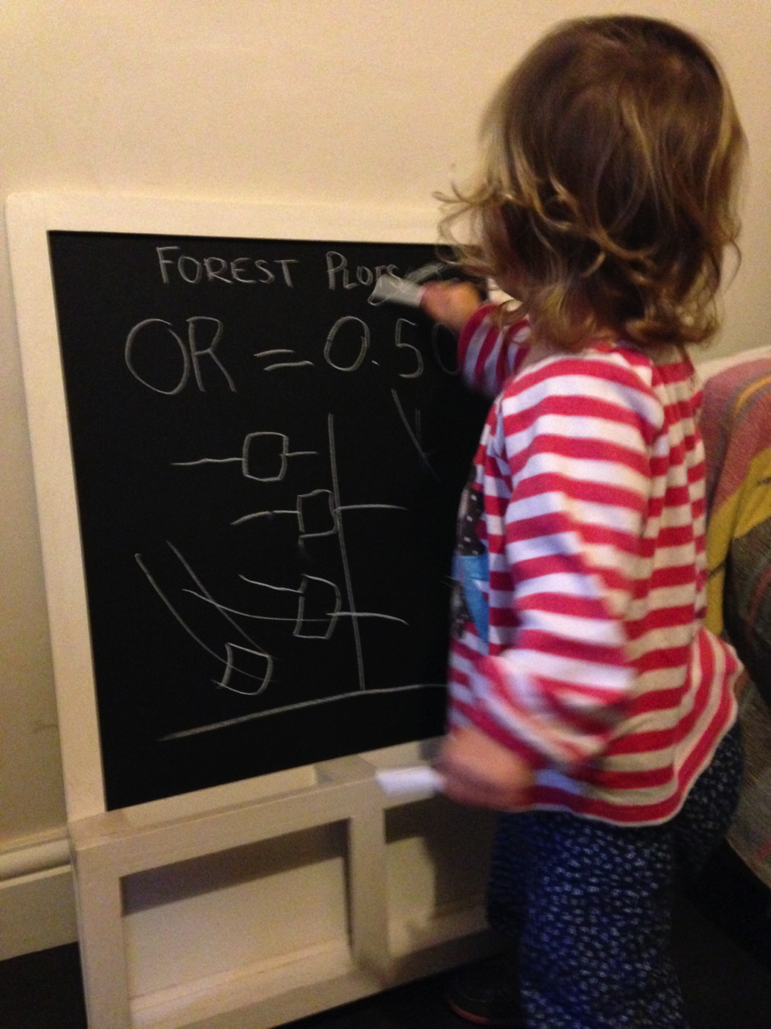
FOREST PLOTS
Line of no effect
trials
Confidence interval
Overall effect
Measure of effect

Slide 48
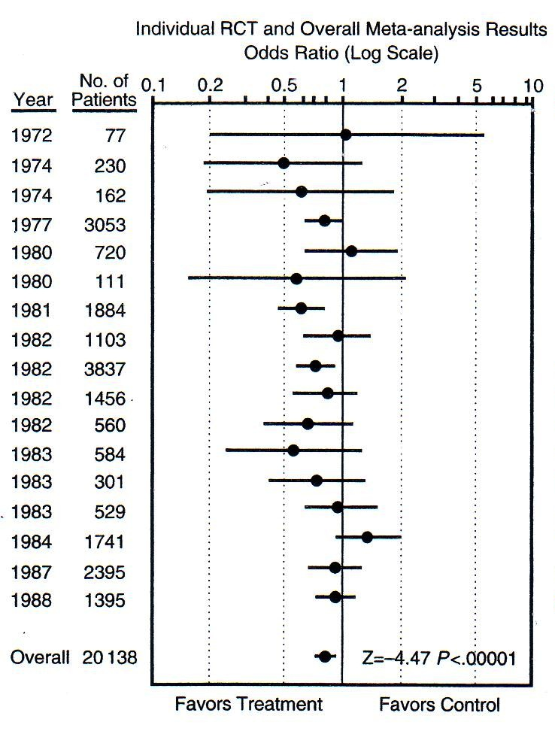
QUESTION
FIND
APPRAISE
SYNTHESISE
Which is the smallest study?
Which is the largest study?
How many are statistically significant?
Smallest
P<0.05
P<0.05
Largest
Is treatment better than control?
How much better?
Notes:
Smallest, largest, significant etc….
Can anyone tell the acute illness of our patient? = MI (streptokinase for reducing risk of mortality post MI from thrombotic event)
Now, based on this forest plot do we give an antithrombotic drug for reperfusion (in this case streptokinase) = YES

Slide 49
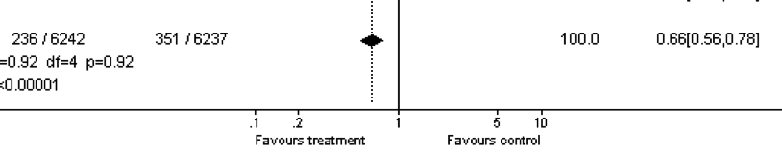

QUESTION
FIND
APPRAISE
SYNTHESISE
Effect size =
1 – 0.66 = 0.34
0.34 x 100 = 34%
There is a 34% reduced risk of mortality in the treatment compared to the control group
Notes:
1 = The overall effect is represented by the diamond at the bottom (labelled ‘Total’) and represents the combined or pooled ratio. The ends of the diamond represent the 95% CI. Here we can see that treatment reduces mortality by 34%

Slide 50
Stats - keep it simple

Slide 51
Heterogeneity
QUESTION
FIND
APPRAISE
SYNTHESISE
“The quality or state of being diverse in character or content”

Slide 52
Heterogeneity (diversity)
QUESTION
FIND
APPRAISE
SYNTHESISE
Clinical heterogeneity
Variability in the participants, interventions and/or outcomes studied
Methodological heterogeneity
Variability in study deign and risk of bias
Statistical heterogeneity
The observed intervention effects being more different from each other than we would expect due to random error (chance) alone

Slide 53
High heterogeneity
= appropriate to pool data?
QUESTION
FIND
APPRAISE
SYNTHESISE

Slide 54
QUESTION
FIND
APPRAISE
SYNTHESISE
Are the results similar across studies? 3 tests:
  ‘Eyeball’ test – do they look they same?
  Formal tests
    Proportion of variation not due to chance (I²)
      Variation between tests, now preferred estimate
        0% to 40%: might not be important;
        30% to 60%: may represent moderate heterogeneity;
        50% to 90%: may represent substantial heterogeneity;
        75% to 100%: considerable heterogeneity
    Test of ‘Null hypothesis’ of no variation (p-value)
      Cochrane Chi-square: p<0.10 = heterogeneity
Notes:
Best done when there is a forest plot. In our knee study we don’t have this option. If we go back to example on sheet, the dotted vertical line running through the combined estimate crosses the horizontal lines of all the individual studies = studies are homogenous.
Formal statistical tests = cochrane chi squared test. If this is statistically significant there is definite heterogeneity. Significance set at 0.1 (rather than usual 0.05) as the chi-square test has low power to detect heterogeneity.
Can also use something called I-squared = more recently developed. Ranges between 0 and 100%, measures the variability between studies. As a rule of thumb I2<25% means studies regarded as homogenous and I2>75% means heterogeneity is very high.

Slide 55
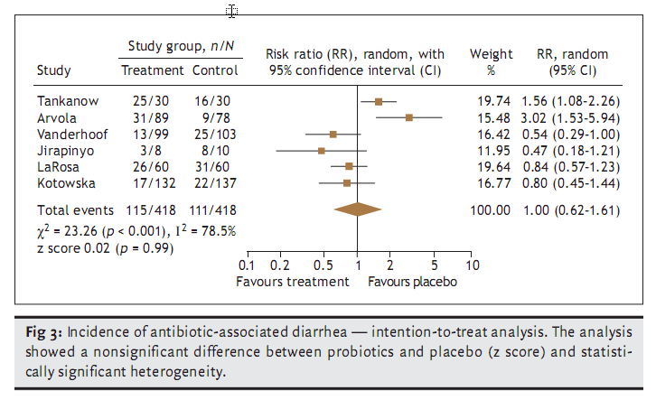
Are these trials different?
QUESTION
FIND
APPRAISE
SYNTHESISE
Notes:
Show of hands if you think there is heterogeneity present between these studies?

Slide 56
(Try to) keep it simple

Slide 57
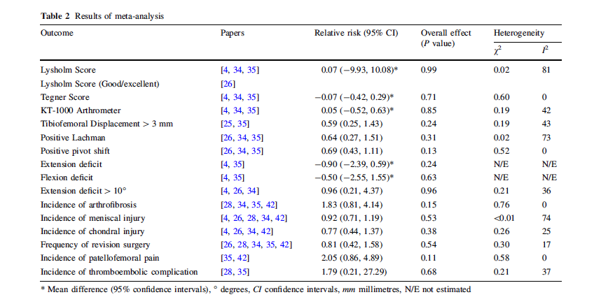
QUESTION
FIND
APPRAISE
SYNTHESISE
5. Were the results similar from study to study?
Notes:
1 min
So what do we think about the similarity of studies in our knee paper?
Indications are that there is high heterogeneity for 2 out of the 7 measures, none for 3 and some for remaining 1.
Do the authors discuss the heterogeneity? = small mention in results and a bit around studies of isokinetic strength, however, no discussion of scores in table 2.
Overall, results similar from study to study = yes and no.

Slide 58
QUESTION
FIND
APPRAISE
SYNTHESISE
Step 2 – What were the results?
Consider
  What these are (numerically if appropriate)
  How were the results presented/expressed (risk ratio, odds ratio, etc.)
  If you are clear about the review’s ‘bottom line’ results
Notes:
1 min them, 1 min feedback
Title, abstract or final paragraph of the introduction should state the question.
Our PICO:
P = patients with ACL injury = yes (initial injury suggests not chronic condition but no info on age)
I = Early ACL reconstruction = yes
C = Delayed reconstruction = yes
O = clinical and radiological = unclear
So overall we happy to say yes?
Tip = If cannot ascertain what the focused question is after reading these sections, search for another paper.

Slide 59
What are we interested in?
Notes:
2 min
Summary table: missing info on treatment and control (how many events, weight of studies?) = therefore weakness of paper.
The main things were interested in are the effect measure and the significant of the effect. In this case the effect measure is relative risk because we are mainly looking at dichotomous outcomes (yes/no) or frequencies (numbers of events/incidence). When we’re looking at continuous measures as outcomes we would assess the mean difference between the groups. An example is given here for first two outcome measures (Lysholm and Tegner scores).
Effect measures = Relative risk: “Are we all happy with relative risks”? More or less?” Okay, so RR is the probability of an event in one group divided by the probability of the event in another group.
A RR of 1 means no difference in risk/probability of an event between groups;
RR <1 = event is less likely to occur in treatment group than control (i.e. favours early surgery);
RR >1 = event is more likely to occur in treatment group (i.e. favours delayed surgery);
So, looking at an example using revision surgery, the relative risk of 0.81 suggests a more favourable outcome for the treatment group and suggests that the risk of revision surgery is 19% lower in the group who received early surgery. But…look at the significance for the effect. Can anyone tell me if it is statistically significant or not? Answer = not because it is greater than the cut-off of 0.05 so we would conclude that there is no difference between groups.
Recall what we said we were interested in:
Return to activity – did anyone find information on this? If you look carefully in the text of first paragraph on page 306 = Marcacci et al paper. Also, Lysholm and Tegnar scores give an indication of the level of PA an individual may return to = no difference.
Recurrent injury – we have three measures. Delaying surgery appears to decrease the risk of arthrofibrosis but again not significant. Risk of other injuries appears higher if surgery delayed but non-significant.
SO OVERALL – appears that delaying surgery will not affect any of the outcomes of concern to me.
“Can anyone think of another way in which these results could have been presented that might have made assessing them easier” = Forest plot. Give praise if someone says this then mention that there is example of a forest plot on their sheet. If no one answers, then say “one way is to use something called a forest plot.”
So our study did not use a forest plot. Any reasons why not?
one reason I can think of is because of the number of outcomes. Each one would require a forest plot = 16. This would most likely have been way beyond the editorial specifications of the journal although they could have put them as a data supplement online.
Authors don’t know how to do them…
Others = ????
So if you turn back to your appraisal sheet, there’s one more thing we need to look at = similarity of the included studies.

Slide 60
Our clinical question
Amongst adults with acute ACL injuries, does
early reconstructive surgery compared with
delayed reconstructive surgery lead to
favourable return to former activity and/or risk of recurrent knee injury?
Population
Intervention
Control
Outcome 1
Outcome 2

Slide 61
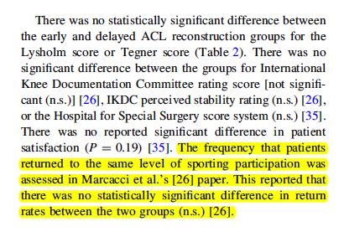
Return to former activity (page 306):

Slide 62
Risk of recurrent knee injury
Notes:
2 min
Summary table: missing info on treatment and control (how many events, weight of studies?) = therefore weakness of paper.
The main things were interested in are the effect measure and the significant of the effect. In this case the effect measure is relative risk because we are mainly looking at dichotomous outcomes (yes/no) or frequencies (numbers of events/incidence). When we’re looking at continuous measures as outcomes we would assess the mean difference between the groups. An example is given here for first two outcome measures (Lysholm and Tegner scores).
Effect measures = Relative risk: “Are we all happy with relative risks”? More or less?” Okay, so RR is the probability of an event in one group divided by the probability of the event in another group.
A RR of 1 means no difference in risk/probability of an event between groups;
RR <1 = event is less likely to occur in treatment group than control (i.e. favours early surgery);
RR >1 = event is more likely to occur in treatment group (i.e. favours delayed surgery);
So, looking at an example using revision surgery, the relative risk of 0.81 suggests a more favourable outcome for the treatment group and suggests that the risk of revision surgery is 19% lower in the group who received early surgery. But…look at the significance for the effect. Can anyone tell me if it is statistically significant or not? Answer = not because it is greater than the cut-off of 0.05 so we would conclude that there is no difference between groups.
Recall what we said we were interested in:
Return to activity – did anyone find information on this? If you look carefully in the text of first paragraph on page 306 = Marcacci et al paper. Also, Lysholm and Tegnar scores give an indication of the level of PA an individual may return to = no difference.
Recurrent injury – we have three measures. Delaying surgery appears to decrease the risk of arthrofibrosis but again not significant. Risk of other injuries appears higher if surgery delayed but non-significant.
SO OVERALL – appears that delaying surgery will not affect any of the outcomes of concern to me.
“Can anyone think of another way in which these results could have been presented that might have made assessing them easier” = Forest plot. Give praise if someone says this then mention that there is example of a forest plot on their sheet. If no one answers, then say “one way is to use something called a forest plot.”
So our study did not use a forest plot. Any reasons why not?
one reason I can think of is because of the number of outcomes. Each one would require a forest plot = 16. This would most likely have been way beyond the editorial specifications of the journal although they could have put them as a data supplement online.
Authors don’t know how to do them…
Others = ????

Slide 63
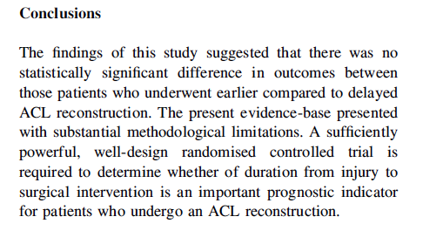
What’s the ‘bottom line’ of the review?
Notes:
Are we happy with the conclusions of the paper?
Are they based on the data they have provided in the paper? = yes

Slide 64
Practising EBM – the 4 A’s
Step 4
Apply the evidence
Step 3
Step 2
Appraise the evidence
Step 1
Acquire the best evidence
Ask a clinical question

Slide 65
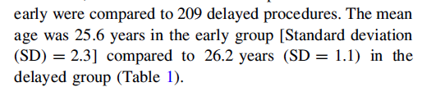
Can I apply these results to my case?
Is my patient so different to those in the study that the results cannot apply?
Notes:
Look back in results section on page 305 – mean age of approx. 26 years suggest very close to my age with acute injury, so results do apply.

Slide 66
Delay or not delay?
Notes:
So based on findings of this review, what do you think. Should I go catch pneumonia in the English channel (might be good for my knee) or should I get the surgery done?

Slide 67
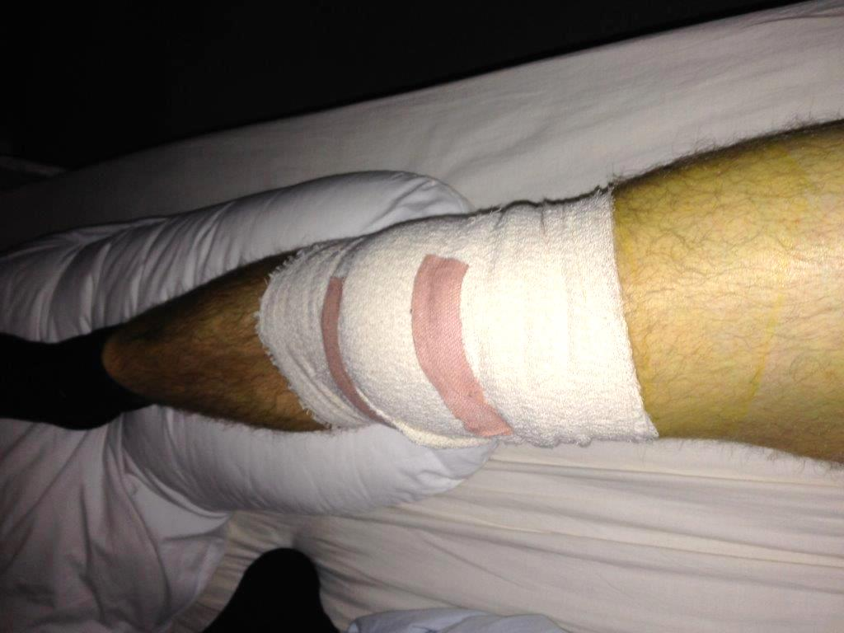
October 27th 2014
Notes:
So based on findings of this review, what do you think. Should I go catch pneumonia in the English channel (might be good for my knee) or should I get the surgery done?

Slide 68
‘Clinical pearls’
Appraise systematic reviews for QFAS
Don’t forget to ask “Is it worth continuing?”
Look for ‘key’ references: Cochrane Risk of Bias, GRADE, PRISMA
I² >50%: adequate statistical heterogeneity to suggest looking deeper into clinical, methodological heterogeneity reported
Would your patient meet the inclusion criteria of trials/studies in the review?

Slide 69
a) I can tell which of these trials were potentially dangerous/unethical to perform
b) If I had more time I could sort of work it out, maybe…
c) Huh?!....
Notes:
The story of streptokinase for MI demonstrates the importance of SRs and is nicely illustrated in this slide.
What we have on the left are the point estimates for individual RCTs of streptokinase for mortality following MI. Each study is independent of the other one until the final meta-analysis at the bottom.
On the right, the same studies are presented but the difference is that each point estimate is the result of a meta-analysis of that study and the all the studies preceding it one so that you get a cumulative risk score. E.g. The result displayed in the European 1 study is the result of the pooled results for that study, as well as Dewar and Fletcher before it.
Based on this figure then, can anyone tell me at what point could we be certain that streptokinase saves lives? = 1977 (some might say 1974)
And yet we can see that from 77 onwards their were another 10 years worth of trials – 10 years were people with MI were being put into trials and denied a life saving treatment. This for me illustrates the power and importance of SRs.

Slide 70
ASSESS LEARNING

Slide 71
Tips for teaching systematic reviews
Know & engage your audience
Have a hook
Reinforce relevant concepts (e.g. PICO)
Try to create a safe environment
Use a tool to guide critical appraisal
“Is it worth continuing?”
Stats/forest plots/heterogeneity – keep it simple!
Notes:
Anything else we take away is a bonus.

Slide 72
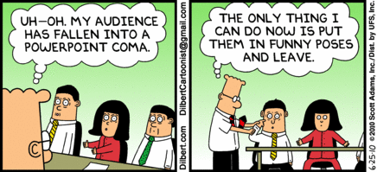
Thank you

Slide 73

Publication Bias: Solution
All trials registered at inception,
    The National Clinical Trials Registry: Cancer Trials
    National Institutes of Health Inventory of Clinical Trials and Studies
    International Registry of Perinatal Trials
Meta-Registry of trial Registries
  www.clinicaltrials.org
  www.controlled-trials.com

Slide 74


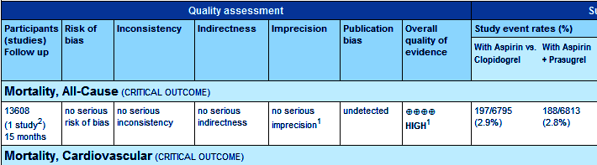
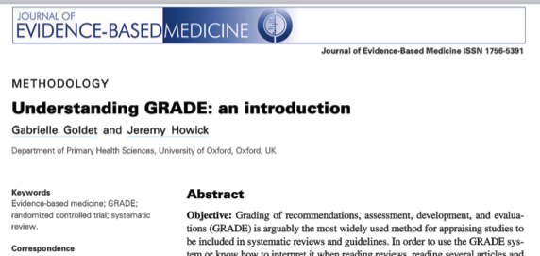
COCHRANE & GRADE
JEBM; 6:50-54
Notes:
This diagram shows the results of a systematic review of RCTs of a short, inexpensive course of a corticosteroid given to women about to give birth too early. The first of these RCTs was reported in 1972. The diagram summarises the evidence that would have been revealed had the available RCTs been reviewed systematically. A decade later it indicates strongly that corticosteroids reduce the risk of babies dying from the complications of immaturity. By 1991, seven more trials had been reported, and the picture had become still stronger. This treatment reduces the odds of the babies of these women dying from the complications of immaturity by 30 to 50 per cent.
Because no systematic review of these trials had been published until 1989, most obstetricians had not realised that the treatment was so effective. As a result, tens of thousands of premature babies have probably suffered and died unnecessarily (and needed more expensive treatment than was necessary). This is just one of many examples of the human costs resulting from failure to perform systematic, up-to-date reviews of RCTs of health care.

Slide 75
PRISMA (QUORUM)
Preferred Reporting Items for Systematic Reviews and Meta-Analyses
Consists of a 27-item checklist and four phase flow diagram
Evidence-based minimum set of items for reporting in systematic reviews and meta-analyses
Can be used for critical appraisal but not designed for it
http://www.prisma-statement.org/

Slide 76

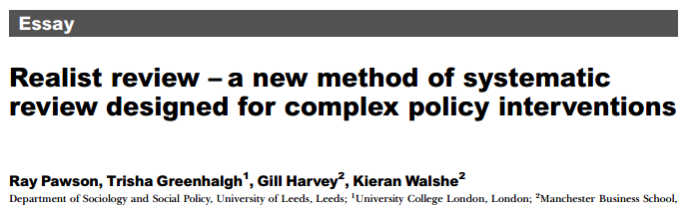
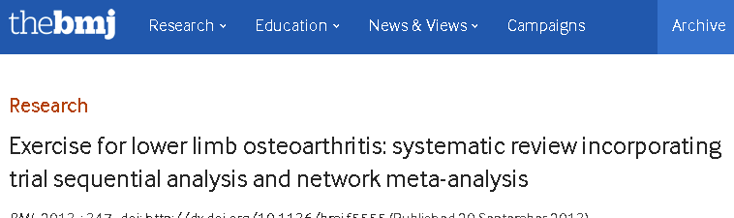
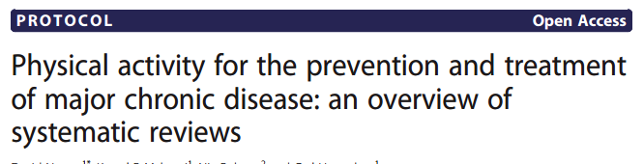
Coming soon….already here?

Slide 77
Fixed effects model
Assumptions:
Studies do not differ in design and how they are conducted.
Any variation between the results of the studies is due to chance.
That large studies will have less variation and so are given a heavier weight.
That bigger studies are better (this is not always the case).
It’s more precise than a random-effects model, because in the presence of statistical heterogeneity it usually has narrower confidence intervals.

Slide 78
Random effects model
Assumes the studies are not all estimating the same intervention effect.
Can be used to incorporate heterogeneity among studies.
Not a substitute for a thorough investigation of heterogeneity - is intended primarily for heterogeneity that cannot be explained.
Accounts for heterogeneity but does not explain it.
Provides a more conservative estimate of effect.
Studies are given a more equal weighting.

Slide 79
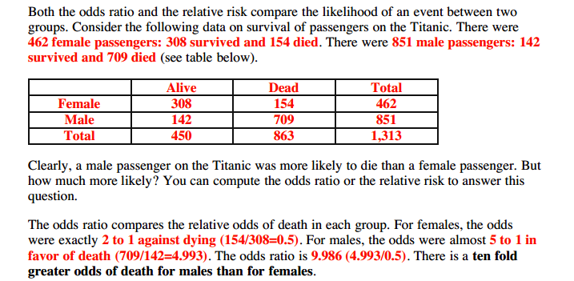

Risk and odds ratios

Slide 80
Publication bias
Occurs when publication of research results depends on their nature and direction
Often happens because smaller (n and effect size) studies not submitted/rejected, selective reporting, selective citation (of +ve results)
Funnel plots help identify if there is a bias:
  Treatment effect vs. study size
  Smaller the study = wider the effects
  Largest studies will be near the average (truth), small studies will spread on both sides = symmetric funnel
  Asymetric funnel indicates publication bias – but not all the time (e.g. heterogeneity)
  Interpretation difficult if only a few studies in meta-analysis

Slide 81
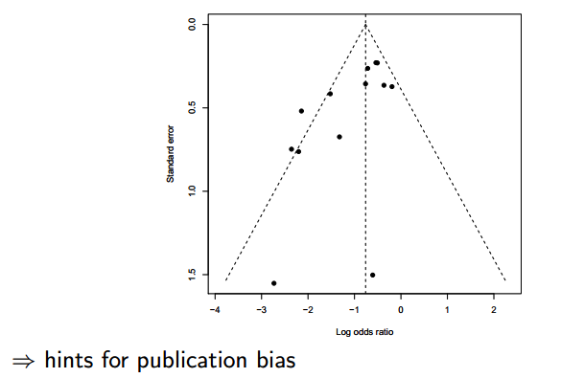
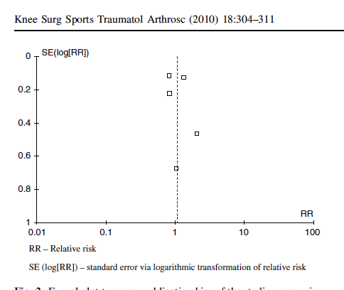
Funnel plots

