Slide 1
Meta-synthesis Findings:
Potential versus Reality
Deborah Finfgeld-Connett, PhD, RN, FAAN
Sinclair School of Nursing
University of Missouri

Slide 2

Meta-synthesis Definition
Meta-synthesis is:
  a qualitative research methodology
  that is used to synthesize findings across qualitative investigations to produce more generalizable results (Finfgeld-Connett, 2010)

Slide 3
Background
Meta-synthesis has:
  Been used for over 25 years to investigate many complex topics
  Undergone multiple interpretations and refinements
    Noblit and Hare (1988)
    Paterson, Thorne, Canam, and Jillings (2001)
    Sandelowski and Barroso (2007)
    Etc.

Slide 4

Assumptions Underlying
Meta-synthesis
Expect more from a meta-synthesis than from a single qualitative investigation
Findings that make up a meta-synthesis database have already been saturated within the context of the study in which they originated

Slide 5
Assumptions Underlying
Meta-synthesis
Redundant saturation of existing findings is not a priority
Priority is to synthesize more informative metaphors and move them into relationship

Slide 6

Scholars predicted that meta-synthesis research would:
  Result in novel interpretations and valuable insights
  Transform qualitative findings into new wholes that could be used to enhance clinical practice, theory development, and policy formation

Slide 7
Problem
Doubts about whether these objectives are being achieved (e.g., Sandelowski, 2004)
Personal observation
  meta-synthesis findings are under-developed

Slide 8
Investigation

Slide 9
Questions
What types of meta-synthesis findings have been produced since Noblit and Hare’s (1988) methodological guidelines were published?
What types of findings should be generated in the future?
What can manuscript reviewers and editors do to facilitate this process?

Slide 10
Methods
Systematic Literature Review

Slide 11



Data Source
Published reports of meta-synthesis research

Slide 12

Data Collection
Electronic databases were searched:
  CINAHL
  PsycINFO
  PubMed
  Social Work Abstracts

Slide 13

Data Collection
Search terms:
  Meta-synthesis
  Meta-ethnography
  Meta-summary
  Meta-study
  Meta-interpretation
  Meta-interpretive

Slide 14
Data Collection
491 unique references

Slide 15
Data Collection
Exclusion Criteria
  Articles that did not report meta-synthesis research
  Non-English
  My own work

Slide 16

Data Collection
Using exclusionary criteria, 213 citations remained

Slide 17
Data Collection
A random numbers table was used to select articles for review
N = 100 peer-reviewed meta-synthesis articles
Sampling concluded when no new insights were apparent, and those that had been identified were fully supported

Slide 18
Data Extraction
Qualitative findings were extracted from the findings section of each article and organized in table format

Slide 19
Data Analysis
Constant comparison process was used to determine what types of findings are resulting from meta-synthesis investigations

Slide 20
Results

Slide 21
Sample Attributes
N = 100 meta-synthesis articles
Publication dates ranged from 1998 through 2013
Average sample size was 23 (median 14; range 3-292)

Slide 22
Sample Attributes
Methods cited:
  Meta-ethnography (Noblit & Hare, 1988)
  Meta-study (Paterson et al., 2001)
  Meta-summary (Sandelowski & Barroso, 2007)
  Combinations

Slide 23
Two Types of
Meta-synthesis Findings
Isolated findings
Findings in relationship
  Non-dynamic relationships
  Dynamic relationships
  Models

Slide 24
Isolated Findings
Attributes
Table
Result from traditional content analysis wherein data are iteratively grouped and categorically labeled
Are often presented in table format
Raw data | Sub-categories | Category
Raw data
Raw data
Raw data
Raw data

Slide 25
Isolated Findings
Predominant in 38 of the 100 articles that were reviewed

Slide 26
Isolated findings are okay if…
Consistent with Noblit and Hare’s (1988) notion of reciprocal translations
  New and innovative syntheses rather than mere substantiations of existing concepts or reformulations of familiar metaphors (e.g., synonyms)
  New metaphors that are more economic, cogent, apparent, broad, and credible

Slide 27
Example of Isolated Findings
Two themes relating to living with macular degeneration (Bennion et al., 2012)
  emotional impacts
  interaction with health services

Slide 28
Example of Reciprocal Translations
Themes pertaining to how women cope with the challenge of simultaneously nurturing more than one infant (Beck, 2002)
  Bearing the burden
  Riding an emotional roller coaster
  Lifesaving support
  Striving for maternal justice
  Acknowledging individuality

Slide 29

Which is more meaningful?
A
B
Isolated Findings
Finding in Relationship

Slide 30
Findings in Relationship
Among the 100 meta-synthesis articles that were reviewed, 62% (n = 62) reported some form or forms of findings in relationship
  Uneven analysis and synthesis across data

Slide 31
Findings in Relationship
Lines of argument (Noblit & Hare, 1988)
  Non-dynamic
  Dynamic

Slide 32

Non-dynamic Relationships
Associations are evident among findings
Dynamic interactions between and among elements are not articulated

Slide 33
Dynamic Relationships
Dynamic interactions between and among concepts are articulated
Relationships are frequently illustrated in figures using arrows that are indicative of directional hypotheses
C
A
B

Slide 34
Uni-directional Relationships
One-way interaction
Figures depicted using one-way (→) arrows

Slide 35
Uni-directional Relationships r/t Self-administration of Medication
Self-regulation of medication administration involves the use of alternative coping strategies
Alternative coping strategies are not seen by patients as medically legitimate
Self-regulation flourishes if sanctions are not severe (Britten et al., 2002)

Slide 36
Bi-directional Relationships
Two-way interactions between phenomena
Figures include double-headed arrows (↔) or feedback loops

Slide 37
Example: Complex Relationships
Loss of meaning and loss of hope simultaneously affect each other, which results in emotional distress (Monforte-Royo et al. 2012)
Distress
Hope
Meaning

Slide 38
Complex Relationships
Refutational translations (Noblit & Hare, 1988)
  Counter Concepts
  Paradoxical Relationships

Slide 39
Counter Concepts
Coping with kidney failure involves:
  Restricted freedom
  Distant connection
  Dependent autonomy
  Abnormal normalcy (Makaroff, 2012)
Abnormal
Normalcy

Slide 40
Paradoxical Relationships
Consistent with mothering other than normal children, paradoxical thinking patterns occur (Nelson, 2002)
Acceptance
Denial

Slide 41
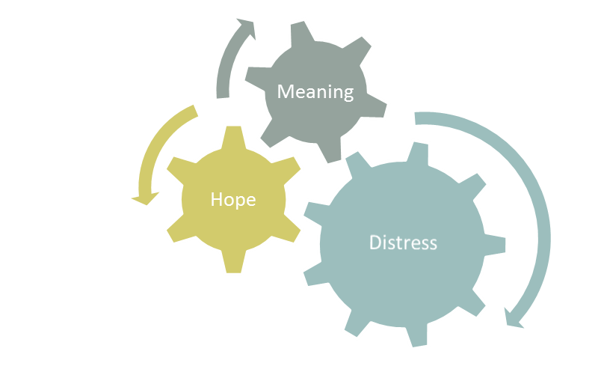
Goal: Model/Theoretical Framework
(Monforte-Royo et al. 2012)

Slide 42
Conclusion
Falling short of original vision to produce:
  Novel interpretations and valuable insights
  New innovative wholes that can be used to enhance clinical practice, theory development, and policy formation

Slide 43

Questions for Editors/Reviewers
How can editors/reviewers help to achieve the vision?
What type of feedback is helpful/appropriate?

Slide 44
Encourage authors to…

Slide 45
Go beyond coding and categorizing

Slide 46
Encourage authors to conduct post-coding analysis (Childers, 2014)

Slide 47
Fully analyze and synthesize the data
Findings that make up a meta-synthesis database have already been saturated within the context of the study in which they originated
Redundant saturation of existing metaphors is not a priority
Synthesizing more informative metaphors and moving them into relationship is of greater importance
Expect more from a meta-synthesis than from a single qualitative investigation

Slide 48
Encourage authors to avoid relying solely on qualitative data analysis software
Computer assisted analysis largely results in categorization of data, not synthesis

Slide 49
Encourage authors to recognize richness of data within small samples
Median sample size = 14
Inaccurate assumption that sample sizes are too small to sustain rigorous analysis and synthesis
Relatively small samples will support model development

Slide 50
Encourage authors to avoid relying on elaborate tables of categorized data to explicate results
These displays do not constitute synthesized findings

Slide 51
Encourage authors to avoid uneven analysis and synthesis of data
For example, some findings are presented as lines of argument and others are presented as isolated categories

Slide 52
Encourage authors to judiciously quote from original articles
It is not likely that cherry-picking quotations (i.e., qualitative findings) will convincingly support newly synthesized meta-synthesis results

Slide 53
Encourage authors to write memos and place findings into a storyline
Helps authors to identify relationships among findings, temporality, theoretical gaps, etc.

Slide 54
Encourage authors to depict storylines in figures
Figures help to explicate relationships among findings, processes, theories

Slide 55
Encourage meta-synthesis researchers to gain greater expertise using qualitative data analysis and synthesis methods
(Hannes & Macaitis, 2012)

Slide 56

Take Home Message
Simple data coding/categorizing might be a worthy objective when conducting a primary qualitative research study, but given the number of primary studies that already exist prior to conducting a meta-synthesis, it is not perceived to be a valued-added activity in the case of meta-synthesis

