Slide 1
Constructive alignment (CA) is an outcomes-based approach to teaching in which the learning outcomes that students are intended to achieve are defined before teaching takes place.
Teaching and assessment methods are then designed to
best achieve those outcomes and to assess the standard at which they have been achieved.

Slide 2
The design of the curriculum is driven by the learning outcomes that students should display at the end of the courses and programmes.
Constructive alignment (CA) is indeed a pedagogical approach that is embedded in the constructivist theory (Biggs & Tang, 2003, 2007, 2011), emphasizing the alignment between the intended learning outcomes (ILOs), teaching and learning activities (TLAs) and assessment tasks [ATs].
It is believed that courses designed upon CA will enhance
student-centered learning by encouraging students to
take an active and independent role in constructing their
own knowledge

Slide 3
Instructors adopting the CA approach should
[1] clearly describe the ILOs in class,
[2] create a learning environment and TLAs conducive to the ILOs which allow students to construct their knowledge to achieves the outcomes, and
[3] establish assessment on how well students' could achieve the corresponding ILOs.
These three components of constructively aligned
teaching constitute important pillars in OBTL.

Slide 4
Under a constructively aligned teaching and learning environment, students
[1] should be very clear as to what they have to learn,
[2] should see the teaching actively engages them in learning that is appropriate to achieving what they are supposed to
learn, and
[3] should see assessment as addressing what they are supposed to have learned.
More importantly, students receive formative feedback which
allows them to evaluate their own performance in a
continuous timeframe.

Slide 5
Constructively aligned courses/programme curricula are
designed to include materials, strategies, and
approaches which are interesting, motivating and
requiring students to actively engage. In such a highly
interactive environment, students would enjoy their
learning, and be more motivated to achieve the intended
learning outcomes.

Slide 6
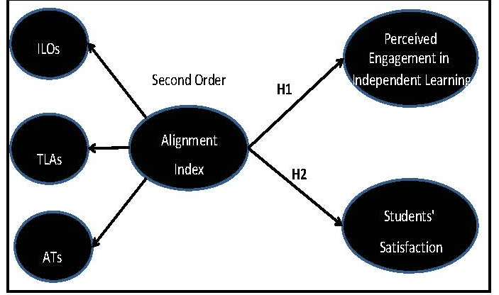
Research Model
The role of a constructive alignment index in impacting students' satisfaction and perceived engagement in independent learning in the higher education context.

Slide 7
Measurement
Measurement in this study was based on a
validated five-point scale. All first-order constructs:
[1]Intended Learning Outcomes (ILOs);
[2] Teaching and Learning Activities (TLAs);
[3] Assessment Tasks [ATs] ;
(4) Students' Satisfaction;
(5) Perceived Engagement in Independent Learning were assessed by adapting the course alignment questionnaire

Slide 8
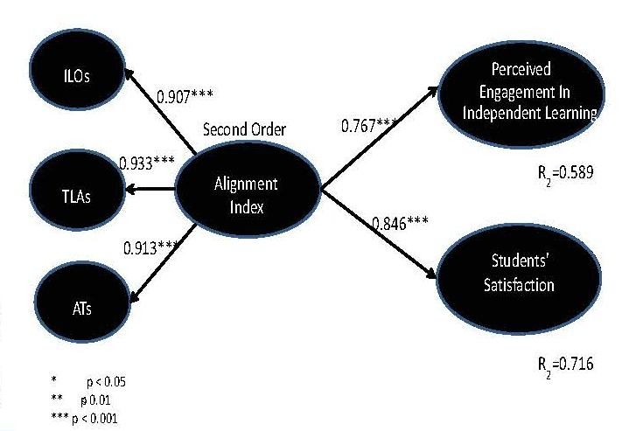
Standardize Path Coefficient for the Structural Model
The structural model and hypotheses were assessed by examining
path coefficients and their significance levels

Slide 9
Aligning assessment with intended course learning outcomes is crucial to assessment-as-learning.
Learning outcomes prescribe what students are expected to demonstrate they have learned.
The assessment plan shows how they will demonstrate their learning.
These two elements must operate in parallel if the assessment is to be valid. For example, for a learning outcome stating that students will develop professional communication skills, assessment tasks that focus only on academic communication skills cannot be regarded as valid.

Slide 10
When to use
Wherever possible, plan the assessment, including full details of each assessment task, at the time the course outline is
initially developed, so that learning outcomes can be seen to be assessable and achievable within the timeframe of the
course.
Often, learning outcomes are framed well in advance of detailed assessment plans—for example, to accord with
professional accreditation requirements. Then, when the assessment plan is being developed, and it becomes clear that the approved learning outcomes were framed poorly, it is too late to change the outcomes, and uncomfortable
compromises have to be made.

Slide 11
Benefits
By directly aligning assessment with course learning outcomes, you can achieve numerous benefits.
Students can see clearly what to focus on, and how to demonstrate their learning during assessment.
Assessment feedback framed around criteria that have been derived from the learning outcomes helps guide students towards what really counts in the course.
Staff can use learning outcomes when planning learning and assessment activities and tasks.
For example, they can map particular task types to the relevant learning outcomes, and assign grade weightings appropriate to the relative importance of those outcomes.

Slide 12
Staff can also use the alignment framework when
developing assessment criteria and strategies for engaging students in a dialogue about assessment, and when
(b) reflecting on the overall effectiveness of the curriculum and their teaching.
Learning outcomes that are systematically assessed at course level can be shown to contribute to program-level outcomes, and thus to information provided to students, employer groups, professional bodies and so on about graduation standards.

Slide 13
Challenges
Planning for assessment alignment can be difficult, especially when no neat and mutually exclusive relationship
exists between individual learning outcomes and particular assessment tasks.
All learning outcomes need to be assessable, but sometimes it might be appropriate to base assessment on a sample of actions or assessment tasks.
For example, in some exams and quizzes students are allowed to select particular questions to answer.

Slide 14
Integrate your assessment plan with all the learning outcomes for a course, or students will get the wrong idea, from
individual assessment tasks, about what's important in the course.
Learning outcomes can be seen as statements of threshold learning in that they prescribe to students the minimum
standard needed to achieve a pass.
Determine at the outset whether all the course outcomes must be achieved at the threshold level, or whether higher achievement on some will compensate for failure on others (Moon, 2005).
In your aligned assessment plan, clarify whether the criteria will be based on a threshold pass/fail point, or whether they will be set out in a detailed assessment rubric.

Slide 15
Strategies
Be explicit about constructive alignment
"Constructive alignment" (Biggs & Tang, 2007) entails designing learning and assessment around the intended learning outcomes.
If learning and planned activities explicitly state their alignment with learning outcomes, students can construct
their own learning.
The diagram below shows alignment as an iterative process, adjusted according to each experience of conducting a course.

Slide 17
When you plan assessment, and when you communicate the assessment plan to students, using a table or other visual aid can help illuminate the relationships between:
the learning outcomes the learning activities and opportunities for formative feedback, and
the gradable assessment tasks.

Slide 18
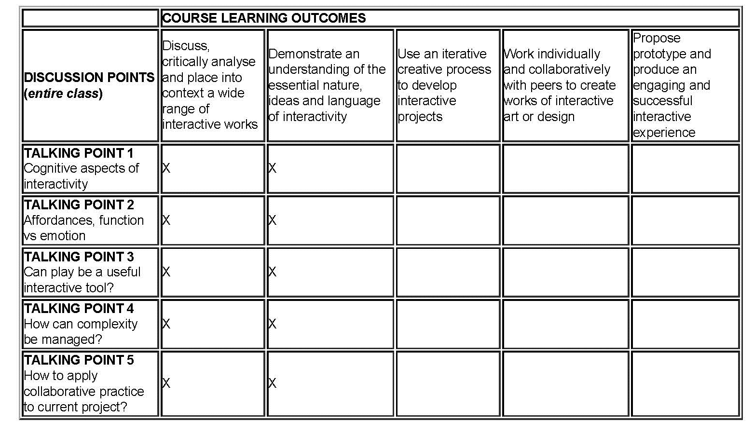

Slide 19
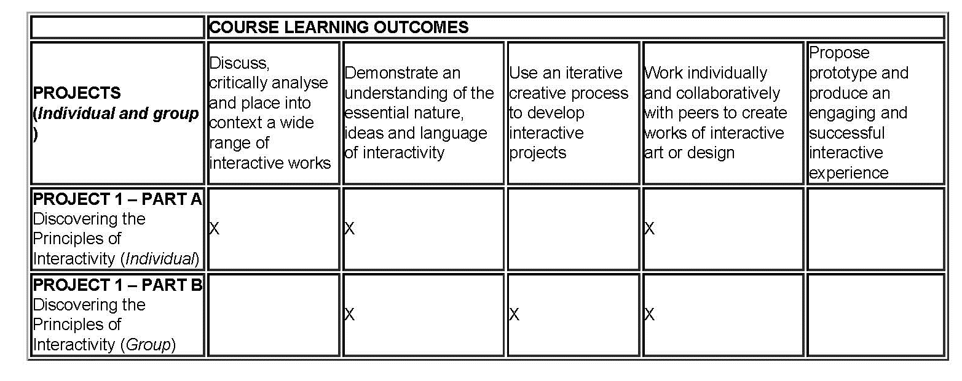
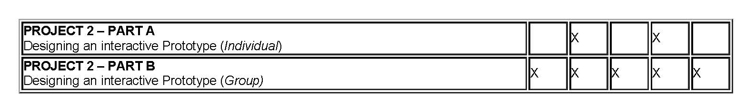
Once you've mapped a course like this, you might need to reframe the learning outcomes themselves, so that they more clearly require observable desired action or behaviour, and relate that behaviour explicitly to course content and assessment tasks.

Slide 20
Both the affective domain of attitudes, feelings and values (for example, Bloom et al., 1964) and the psychomotor domain of
physical skills (for example, Dave, 1970) can be included, where relevant, in the types of learning outcomes to be
translated into assessment plans.
Biggs and Tang's SOLO Taxonomy (Structure of the Observed Learning Outcome) (2007) is equally useful when you analyse learning outcomes with an eye to aligning them with assessment plans.
The SOLO Taxonomy frames assessment tasks using verbs that indicate the increasing complexity of, and extent of relationships among, the ideas and concepts in
which the task will engender learning.

Slide 21
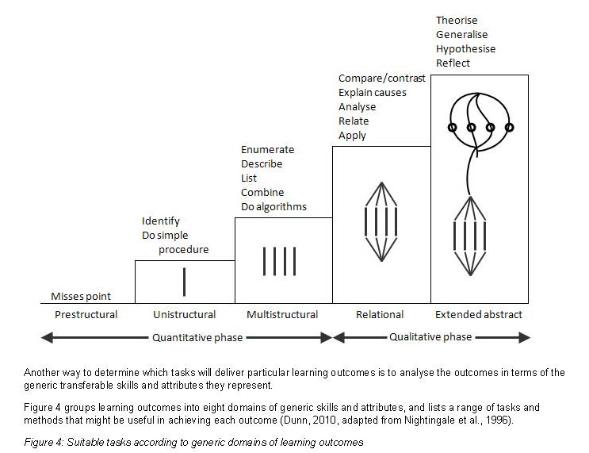

Slide 22
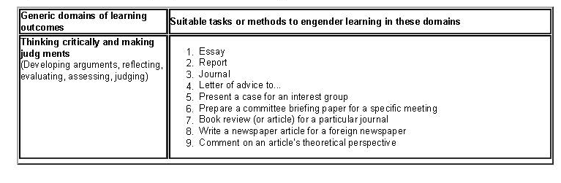
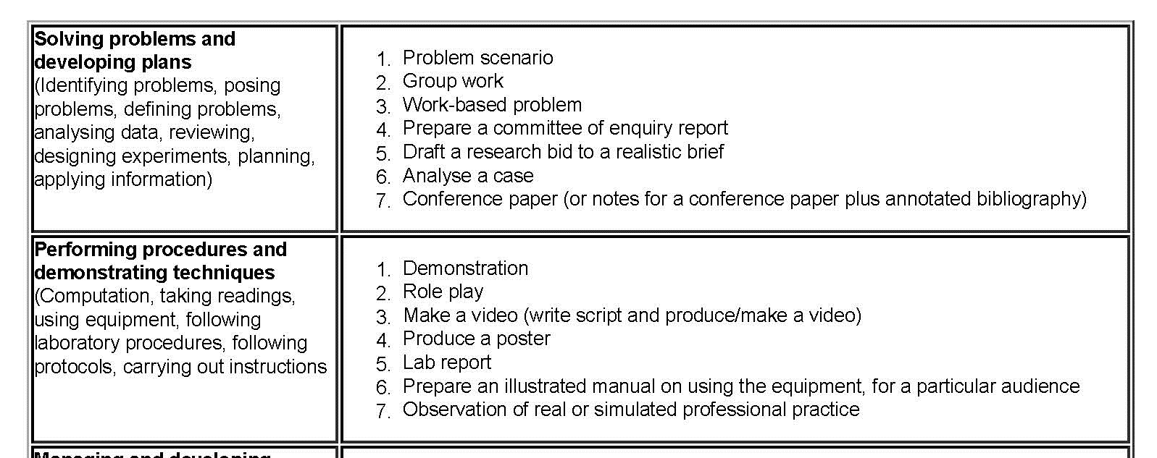

Slide 23
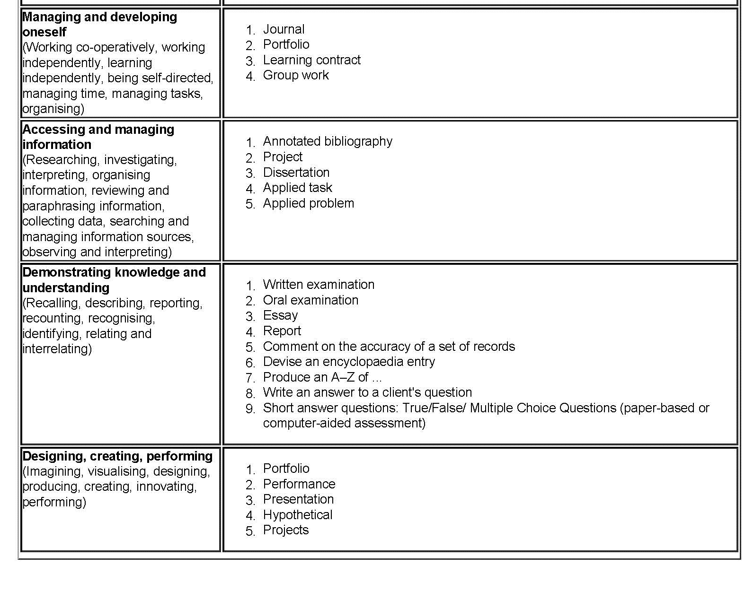

Slide 24
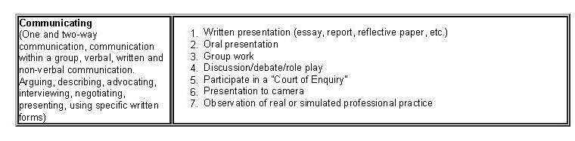

Slide 25
CA provides a framework for adjusting teaching and assessment to address the attainment of those outcomes and the standards reached.
Research indicates that CA is effective in this but it initially requires time and effort in designing teaching and assessment and, as a systems approach, it is important that supporting institutional policies and procedures are in place.
CA properly implemented enhances teaching and learning quality and thus, as a form of quality enhancement, subsumes forms of quality assurance that can often be counter-productive.

Slide 26
Constructive alignment (CA) is a design for teaching in which what it is intended students should learn, and how they should express their learning, is clearly stated before teaching takes place.
Teaching is then designed to engage students in learning activities that optimise their chances of achieving those outcomes , and assessment tasks are designed to enable clear
judgments as to how well those outcomes have been attained.

Slide 27
The concept of constructive alignment
What educational purposes should the school seek to attain?
2) What educational experiences can be provided that are likely to attain these purposes?
3) How can these educational experiences be effectively organised?
4) How can we determine whether these purposes are being attained?

Slide 28
If students are to learn desired outcomes in a reasonably
effective manner, then the teacher’s fundamental task is to
get students to engage in learning activities that are likely
to result in their achieving those outcomes. . . .
It is helpful to remember that what the student does is
actually more important in determining what is learned
than what the teacher does.

Slide 29
Reading set material, raising questions in class about that material, discussing with other students, swapping notes with a learning partner and keeping a reflective journal. It
worked.
Reflecting on what had happened, it seemed to me that here was a generalizable model for teaching virtually any unit (Biggs, 1996, 1999).
The key is to define what students are supposed to be able to do with the content they have learned, apart from reporting back in their own words what they had been taught.
Almost any content topic in any subject is taught so that students put that content to work in some way: to solve problems,
to construct hypotheses, to apply to particular situations.

Slide 30
This is the clue to defining the outcomes that it is intended students should learn: we nominate the actions, the verbs, the student is supposed to put into play, verbs such as solve problems, hypothesize, apply, design, explain, and so on.
The appropriate learning activities then fall into place: the teaching task is to get students to engage those same verbs.
The summative assessment determines how well they can perform those verbs in appropriate contexts.
Thus, assessment is about judging the whole performance against
predetermined and public rubrics, not by awarding marks analytically for aspects of the tasks and then summing them. Analytic assessment is useful formatively, for alerting the student to weak aspects of their performance, but the final summative assessment is logically on how well the performance
itself can be carried out.

Slide 31
The operational framework for this teaching design at the unit level is in its basics:
1) Describe the intended learning outcomes (ILOs) for the unit, using one verb (or at most two) for each outcome. The ILO denotes how the content or topics are to be dealt with and in what context.
2) Create a learning environment using teaching/learning activities (TLAs) that require students to engage each verb. In this way the activity nominated in the ILO is activated.
3) Use assessment tasks (ATs) that also contain that verb, thus enabling one with help of predetermined using rubrics to judge how well students’ performances meet the criteria.
4) Transform these judgments into final grades.

Slide 32
Constructive Alignment
The ‘constructive’ aspect refers to what the learner does, which is to construct meaning through relevant learning activities.
The ‘alignment’ aspect refers to what the teacher does, which is to set up a learning environment that supports
the learning activities appropriate to achieving the desired learning outcomes.
The key is that the components in the teaching system, especially the teaching methods used and the assessment tasks are aligned to the learning activities assumed in the intended outcomes.

Slide 33
Students become “entrapped” in a web of consistency through the process of constructive alignment.
Learning experiences and assessment tasks become purposeful and learners are motivated to explore concepts both in and out side their classrooms, in short a deeper approach to learning, and teaching, is facilitated, reinforced and encouraged.
An important aspect here is the role of the academic. It is
one thing to write about the need to align a unit of study it is quite another for this to happen.

Slide 34
The 'constructive' aspect refers to the idea that students construct meaning
through relevant learning activities.
That is, meaning is not something imparted or transmitted from teacher to learner, but is something learners have to create for themselves. Teaching is simply a catalyst for learning:
'If students are to learn desired outcomes in a reasonably effective manner, then the teacher's fundamental task is to get students to engage in learning activities that are likely to result in their achieving those outcomes... It is helpful to remember that what the student does is actually more important in determining what is learned than what the teacher does.' (Shuell, 1986: 429)
The 'alignment' aspect refers to what the teacher does, which is to set up a learning environment that supports the learning activities appropriate to achieving the desired learning outcomes. The key is that the components in the teaching system, especially the teaching methods used and the assessment tasks, are aligned with the learning activities assumed in the intended outcomes.
The learner is in a sense 'trapped', and finds it difficult to escape without learning what he or she is intended to learn.

Slide 35
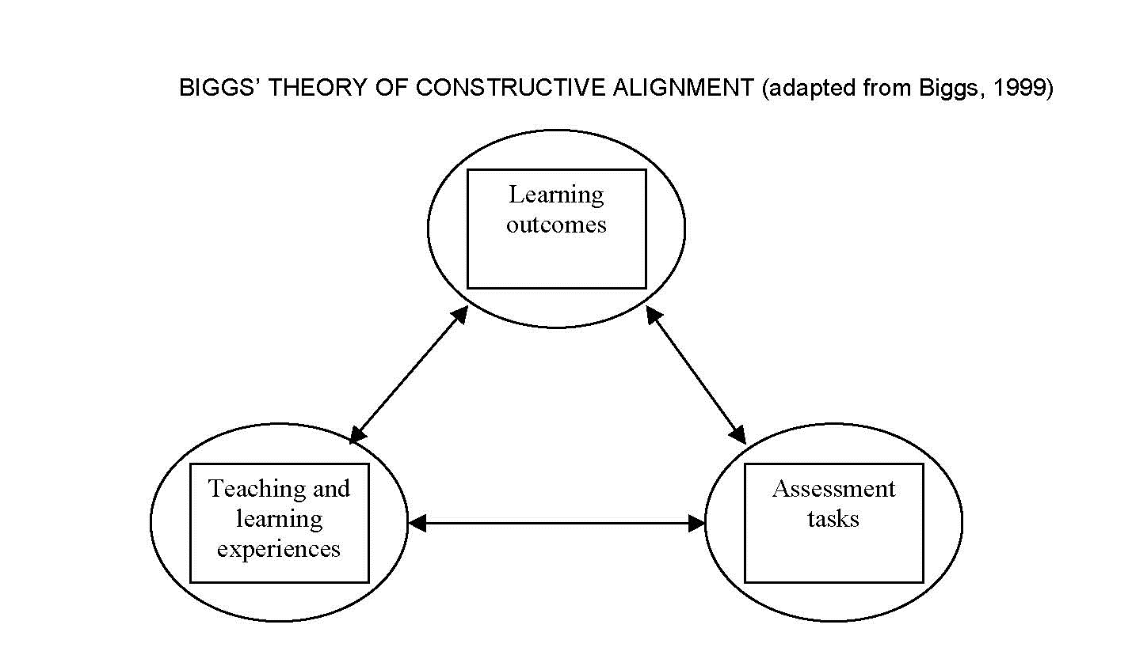

Slide 36
There are thus four major steps:
Defining the intended learning outcomes (ILOs);
2. Choosing teaching/learning activities likely to lead to the ILOs;
3. Assessing students' actual learning outcomes to see how well they match what was intended;
4. Arriving at a final grade.

Slide 37
When we teach we should have a clear idea of what we want our students to learn.
More specifically, on a topic by topic basis, we should be able to stipulate how well each topic needs to be understood.
First, we need to distinguish between declarative knowledge and functioning knowledge.
Declarative knowledge is knowledge that can be 'declared': we tell people about it, orally or in writing.
Declarative knowledge is usually second-hand knowledge; it is about what has been discovered. Knowledge of academic disciplines is
declarative, and our students need to understand it selectively.
Declarative knowledge is, however, only the first part of
the story.

Slide 38
Teaching and learning activities in many courses are restricted to lecture and tutorial: lecture to expound and package, and tutorial to clarify and extend.
However, these contexts do not necessarily elicit high level verbs. Students can get away with passive listening and selectively memorising.
Assessing students' learning outcomes
Faulty assumptions about and practices of assessment do more damage by misaligning teaching than any other single factor.
As Ramsden (1992) puts it, the assessment is the curriculum, as far as the students are concerned. They will learn what they think they will be assessed on, not what is in the curriculum, or even on what has been 'covered' in class.
The trick is, then, to make sure the assessment tasks mirror the ILOs.

Slide 39
To the teacher, assessment is at the end of the teaching-learning sequence of events, but to the student it is at the beginning.
If the curriculum is reflected in the assessment, as indicated by the downward arrow, the teaching activities of the teacher and the learning activities of the learner are both directed towards the same goal. In preparing for the assessments, students will be learning the curriculum

Slide 40
The verb in the ILO (intended Learning Outcome) becomes the common link that establishes alignment between the ILO, the teaching/learning activities, and the assessment tasks.
Typically in a semester length unit, there would be no more than five or six ILOs, with some ILOs addressing several topics.
The key to good teaching then is to get the learner to engage those activities that are most appropriate to the ILO in question.
The term “alignment” is used because both teaching and assessment need to be aligned to the intended learning outcomes.

Slide 41
There are three major issues that I see arising from this review that have a bearing on future developments in tertiary teaching.
The first is about constructive alignment itself: does it do what it claims, in terms both of enhanced learning related outcomes, and as a framework for thinking about
teaching?
The second addresses problems in implementing CA, or any
innovation institution-wide, and the need to address the institutional culture.
The third issue concerns quality assurance and quality enhancement.

Slide 42
Teaching quality has suddenly become a major concern of
universities, while their statements of graduate attributes and emphasis on learning outcomes makes a good fit for outcomes-based designs such as CA.
However, the successful implementation of any major teaching reform requires appropriate institutional support.

Slide 43
One of the greatest problems is finance and attendant staff workloads,
Today they are more like 30:1. An academic’s workload is estimated as 50 hours a week, including fifteen class contact hours or more, time outside the classroom assessing student work, setting up compulsory blogs for student feedback and discussion and in attending numerous meetings, not including time for research (Hil, 2012).
If these figures are indeed typical, little time (or motivation) is left for teachers to reflect on their teaching and to innovate. Teaching for quality learning takes time in preparation, in providing formative feedback to students and in qualitatively based summative assessment.

Slide 44
Another problem is teacher resistance to change. Some academics (Hil,2012; Meyer, 2012) feel that teaching has been taken out of their hands and they resent it; particularly when they see the imposed system as contrary to their own views of teaching.
However, there is now a shift from emphasising the individual skills of teachers to teaching as an institutional responsibility, not an individual one.
If an institution has to raise standards across the board, particularly when meeting external agencies and guidelines such as those required by the Tertiary Education Quality and Standards Agency (TEQSA), the focus has to be on an institution-wide system of teaching and assessment: “teacher-proofing” the system, as it were.

Slide 45
1. Require all course modules or units to follow this
design model, and to ensure that all assessment tasks, and
assessment criteria, clearly and directly relate to the
learning outcomes.
2. Audit all their modules’ or units’ learning outcomes and
map them against the subject’s programme specifications,
to ensure that all the programme specifications will have
been assessed for any student successfully completing the
course programme.

Slide 46
The most important development in university teaching over the past few years has been the shift from teaching seen as an individual responsibility to one that the institution should assume in matters of assessment practice, overall teaching design, in accordance with the scholarship of teaching and
learning.
Recent institutional concern for benchmarking and defining outcomes, such as in LTAS and the statements of graduate attributes, provides an outcomes-based framework into which outcomes-based models of teaching and assessment readily fit, an unusual and happy coincidence between the demands of managerialism with constructivist approaches to student learning and assessment.

Slide 47
Matching individual performances against the criteria is not a matter of counting marks but of making holistic judgments.
This is a controversial issue, and is dealt with in more detail in Biggs (2003, Chapters 8 and 9). Just let me say here that the ILOs cannot sensibly be stated in terms of marks obtained. Intended outcomes refer to sought-for qualities of performance, and it is these that need to be stated clearly, so that the students' actual learning outcomes can be judged against those qualities.
If this is not done, we are not aligning our objectives and our assessments.

Slide 48
Constructive alignment is more than criterion-reference assessment, which aligns assessment to the objectives.
CA includes that, but it differs
(a) in talking not so much about the assessment matching the objectives, but of first expressing the objectives in terms of intended learning outcomes (ILOs), which then in effect define the assessment task; and
(b) In aligning the teaching methods, with the intended outcomes as well as aligning just the assessment tasks.

