Slide 1
Reflection
Reflection is a pedagogically and theoretically contentious concept in Higher Education.
It incorporates multiple approaches that are open to interpretation and quite context
specific.
That said one thing most will agree upon is that it is a necessary part of quality
practices in Higher Education which should happen at multiple points in the learning and teaching cycle (developing outcomes, constructing Unit of Study outlines, choosing
learning and teaching methods, assessment, and evaluation).
In this very brief introduction we have drawn out some starting concepts and ideas for your benefit, as well as a list of useful references.

Slide 2
All manner of formal and informal occasions that are often quite complex (for example: lectures, field trips, laboratories, practicum placement, tutorial, participation in an assessment task, group work, unplanned occurrences, responses to student or staff comments, world events, personal or internal feelings).
For the teacher and student these responses will include what they think, feel, do and conclude both at the time and/or after the experience.

Slide 3
Kind of critical reflection which is more cognisant of the various socio-cultural factors and subjectivities which impinge upon teachers and students.
The practice of reflection as viewed as ideologically transformative.

Slide 4
Becoming a critically reflective teacher
Recognizing and appreciating difference and diversity from a number of angles
(for example race, ethnicity, gender, class, culture, religion, disability, age) and how these factors impact on learning and teaching
• challenging and dealing with the taken for granted assumptions about teaching, learning, learners, and the learning environment
• identifying and negotiating how power operates in an always contested learning and teaching context
• nurturing, facilitating and enabling a learning and teaching environment which challenges students to think critically and morally about a variety of issues
• initiating socially engaged lifelong and transformative learning

Slide 5
Reflective practice is more than thinking about the nuts and bolts of teaching, it involves evaluating the processes of teaching and learning, and questioning why we do something rather than how. Importantly it involves learning from this process and
initiating change when and where required.
This is an iterative process with infinitely connected lines and loops
"good teachers are always evaluating themselves

Slide 6
Critically reflective teachers are always thinking about how they influence and effect the learning and teaching environment, and importantly upon the likely effects of their
teaching and presence upon the quality of their students' learning.
A critically reflective educator will ‘frame’ their reflections from a student perspective and will embark upon a deliberate process of gathering information and evidence, and finding out how students’ are experiencing learning and teaching.
Both evaluation and reflection are more productive when reinforced by evidence.

Slide 7
Appreciate how students perceive our intentions as teachers and assessors
understand the institution's intentions towards us in terms of evaluation
design and use methods of assessment that will contribute to deeper student learning
• choose evaluation methods which contribute to the development and improvement of learning and teaching

Slide 8
• consider your own ideas, beliefs, and values about reflection, as well as your current level of reflective skills and abilities
• avoid assuming that everyone knows what reflection is or how to do it
• research, gather information, appreciate and understand the diverse definitions, purposes, practices, processes and desired outcomes of reflection in the learning and teaching contexts (for both teachers and learners, and others such as
employers, peers, managers)
• develop a clear picture of how reflection can enable you to continuously monitor and evaluate your teaching, and your learning and teaching environment

Slide 9
• commit to an ongoing and strategic process of personal and professional
reflection, and do it! (use formal and informal methods)
clearly explain the what, why and how of reflection to students
facilitate teaching and classroom procedures and practices which allow students to learn how to develop skills in order to become reflective (practice, practice, practice!)
regularly reflect upon your own work, teaching styles and methods, assumptions about students, the learning process (and the like)
• reflect upon and evaluate the effectiveness of your reflection and evaluation schedules, methods, and purposes

Slide 10
The reflective teacher develops many questions to choose from to serve as objects of reflection.
Such as …
What is it about my work and the learning and teaching context that I want to know about?
How do I find out about these things?
• Who will I ask about these things?

Slide 11
Writing
Collaborative journaling
Diary
Personal journals
Narrative
Biography
Autobiography
Creative writing
Discourse analysis
Reflective writing
(free, independent, open
ended, focussed, supported)
Portfolio
Action research
Questionnaire
Talking
Role simulations
Debates
Discussion (understandings and practices)
Self (student/teacher)
Auto-ethnography
Self assessment, Self reflection
Reflecting aloud
Self disclosure, confession
Making time to reflect

Slide 12
Peer/work
Peer coaching/mentoring
Peer observation and feedback
Work based learning
Systematic observation
Questioning
Practical inquiry
Critical incident analysis
Developing higher order skills
Teacher directed/led
Guided reflection
Values clarification
Problem solving
Childhood memory work
Reflection through spirituality
Encouraging voice
Reading
Student-created case studies
Stimulated recall using video and
audiotape
Other
Artifact collection
Action learning
Metaphor use
Read- Reflection.pdf

Slide 13
The role of reflection in education has created an upsurge of interest amongst educators and researchers since Dewey’s (1991) ground-breaking work, which emphasized the positive roles that reflection might play in fostering students’ self-reflection, critical thinking, and in the demonstrable development of professional values or skills

Slide 14
Mann et al. (2009), they suggest that Dewey’s definition of reflection shares similarities with our understanding of critical thinking.
Boud et al. (1985) aptly define reflection in the context of learning and focus more on one’s personal experience as the object of reflection, as referring to “those intellectual and affective activities that individuals engage into explore their experience, which leads to new understanding and appreciations”
advocacy to improve student learning. In the present study, self-reflection is influenced by these interpretations

Slide 15
Problem-based learning (PBL) tend to be characterized by students working collaboratively in small groups, with learning centred on problems relevant to the students’ domain of study and much time spent on self-directed learning.
In PBL, students learn by solving problems and reflecting on their experiences (Hmelo-Silver 2004).
Reflecting on the relationship between problem solving and learning is a critical component of PBL and is needed to support the construction of extensive and flexible knowledge (Salomon and Perkins 1989).

Slide 16
Self-reflection helps students to
review the group process and their own personal functioning in the group,
(b) understand how their learning and problem-solving strategies might be reapplied, and
(c) relate new knowledge to prior understanding (i.e. contents that were discussed and taught).
PBL incorporates reflection several times throughout the learning process and when completing a problem. At the completion of a problem, students reflect on what they have learned, how well they collaborated with the group, and how effectively they directed their learning. As such, students learn self-reflection when they become proficient in assessing their own progression in learning.

Slide 17
Reflection journal writing is believed to enable students to critically review processes of their own learning and behaviours, and to understand their ability to transform their own learning strategies (Gleaves et al. 2008). Reflection journals are variously referred to as “reflective journals” (e.g. Chirema 2007), “reflective learning journals” (e.g. Thorpe 2004) or “learning journals” (e.g. Moon 1999).
The purposes of reflection journal writing include: to critically review the behaviours (e.g. strengths and weaknesses; learning styles and strategies) (Weinstein and Mayer 1986); learning of self and
others; setting or tracking learning goals (i.e. how learning took place) (Lew and Schmidt 2011); and exploring connections between knowledge that was learned and students’ own ideas about them

Slide 18
Through reflecting and writing about new information or ideas, learners can better understand and remember them. In addition, the articulation of connections between new information, ideas, prior or existing knowledge also deepens learning (O’Rourke 1998).
Students in the experimental group used more cognitive strategies during a learning task as compared to those in the control group.
Students who kept learning journals also showed more sophisticated conceptions of learning, greater awareness of cognitive strategies, and demonstrated the construction of more complex and related knowledge structures when learning from text. They also performed significantly better on the final examination for the course.

Slide 19
While reflection journals did not necessarily assist students with earning high grades on achievement tests, they did assist students in developing abstract thinking thereby enabling them to better conceptualize the meaning of technical definitions.
Students appeared to develop better strategies in problem solving through writing as compared to mere memorizing of calculations.
In addition, students also showed improvements in their reflective writing skills, for instance, they were able to develop personal conceptual definitions that were more understandable than technical definitions of the texts.
Read-Self-reflection and academic performance.doc

Slide 20
Benefits of critical reflection
Research has shown how deliberate and critical reflection on teaching practices contributes to excellence in teaching, and improved educational outcomes for all students.
Critically reflective teaching practices encourage teachers to:
• regularly evaluate their approaches to teaching and learning
• understand more about the positive impacts of high-quality effective pedagogies on student’s learning

Slide 21
become more aware of the importance of high-quality interactions, including strategic intervention and substantive conversations to maximise children’s learning
use action research approaches — e.g. drawing on alternative teaching strategies to help students to learn when familiar methods fail
• co-construct learning with students.

Slide 22
Critical reflection involves analysing your own learning and teaching practices that may contribute to effective pedagogies within key components of an effective curriculum.
These key components are:
• understanding students
• building partnerships
• establishing flexible learning environments
• creating contexts for learning
• exploring what students learn.

Slide 23
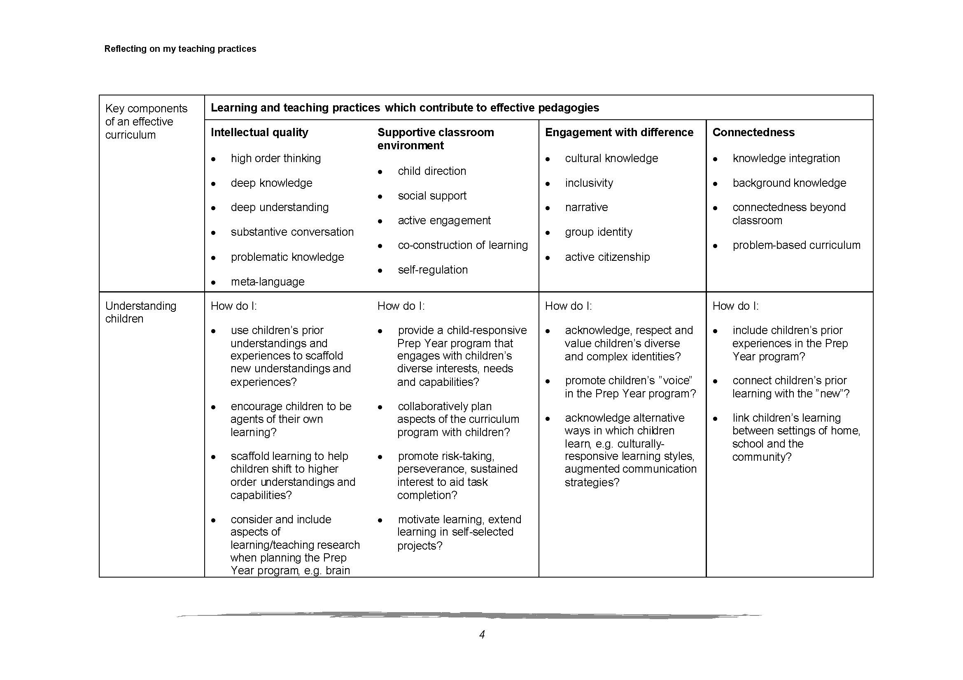

Slide 24
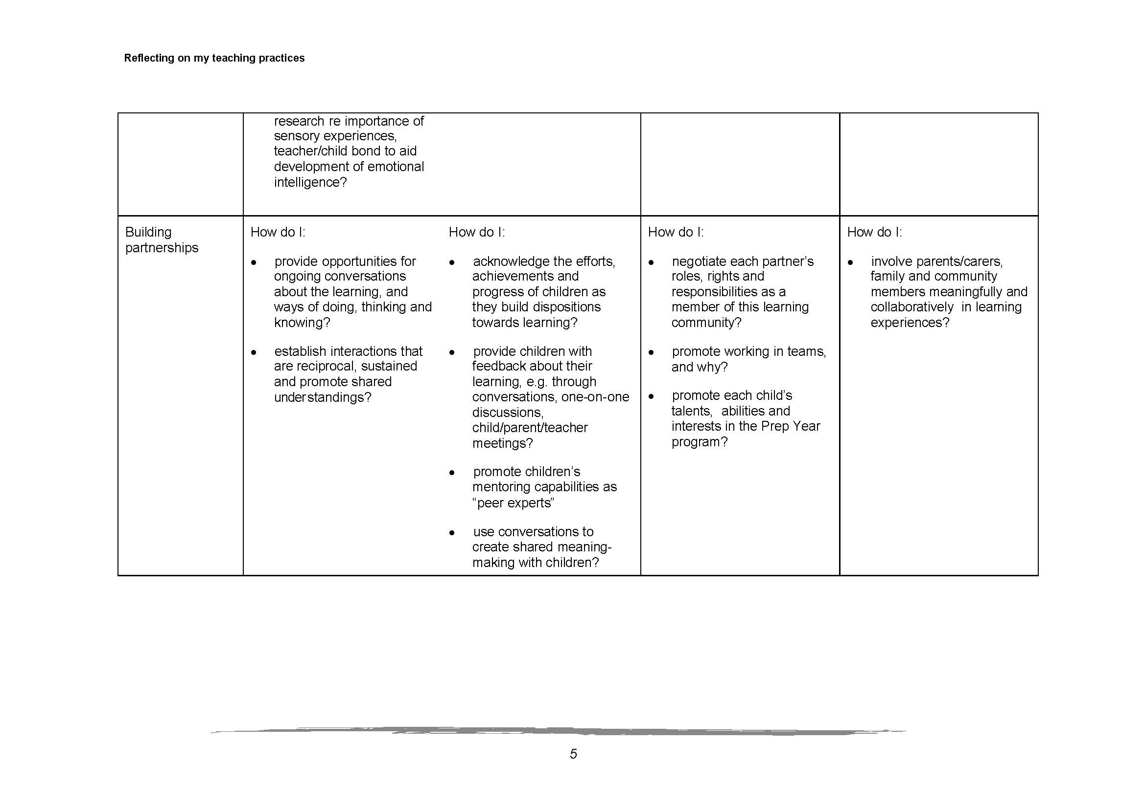

Slide 25
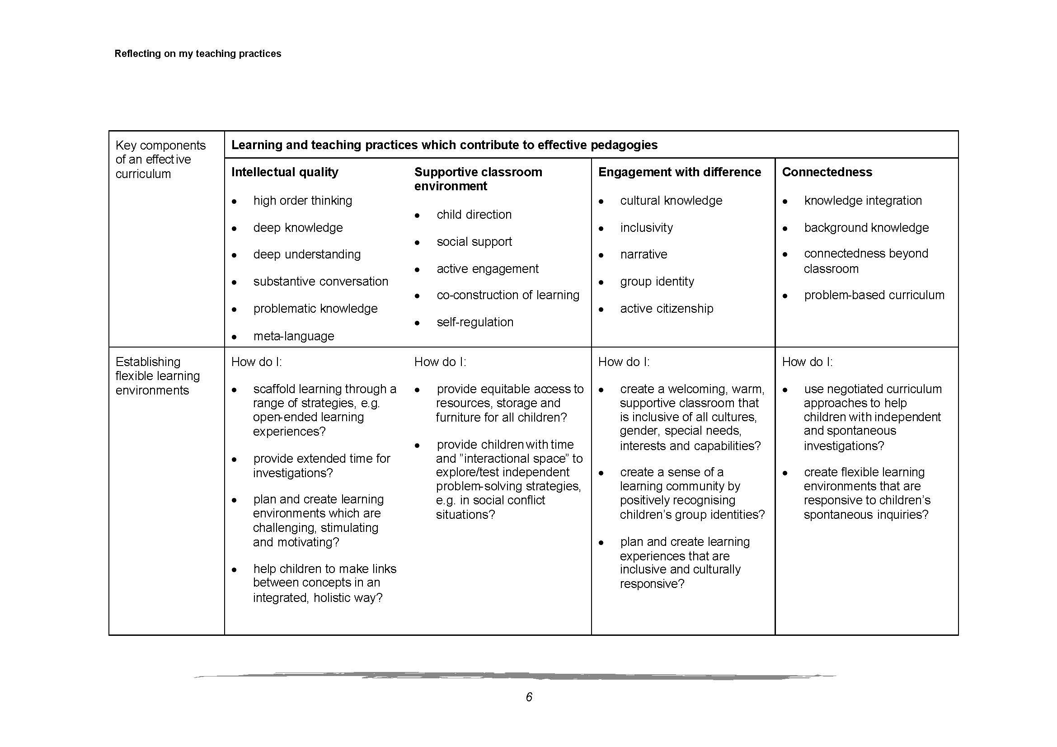

Slide 26
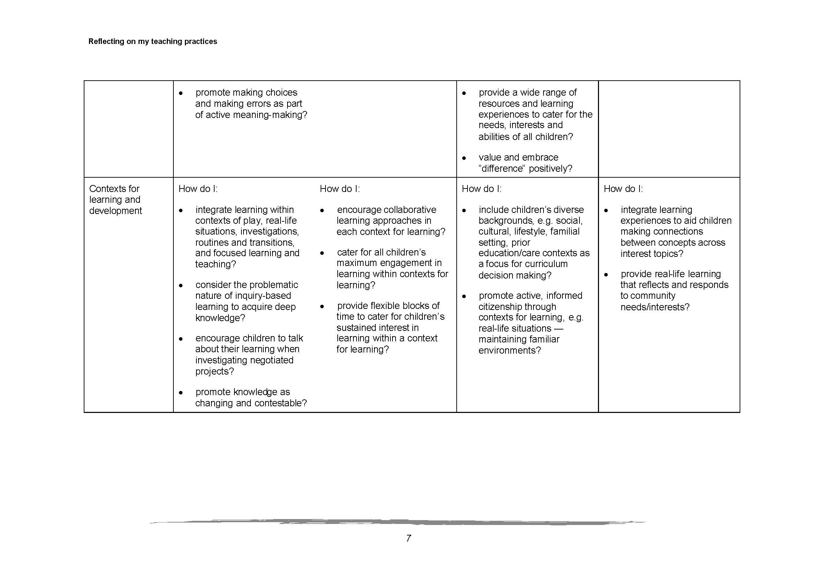

Slide 27
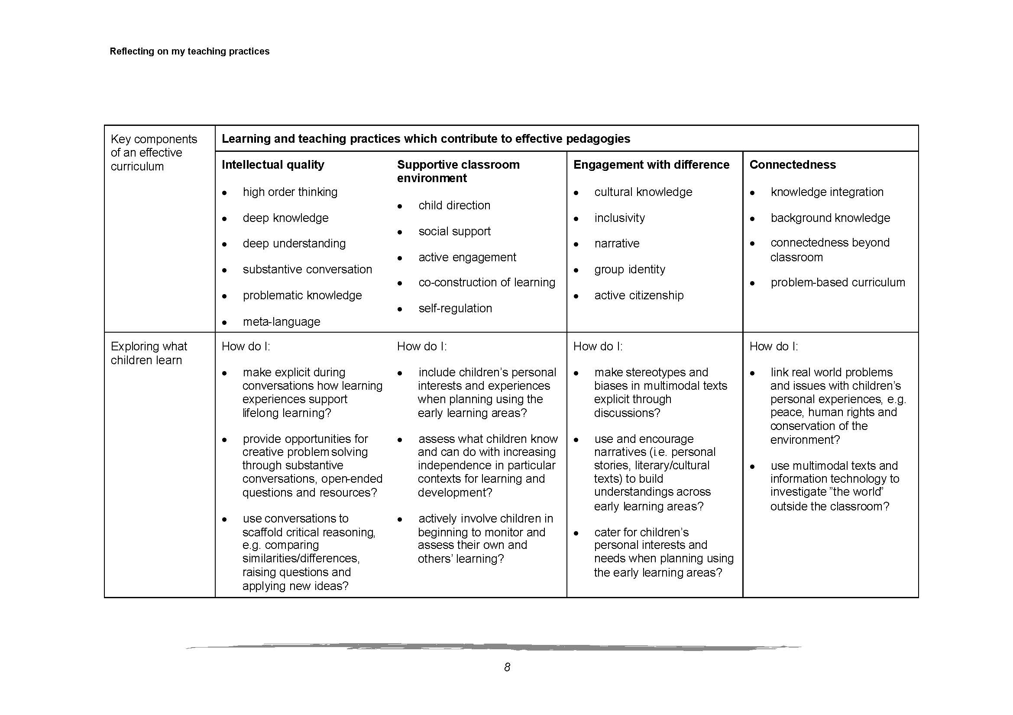

Slide 28
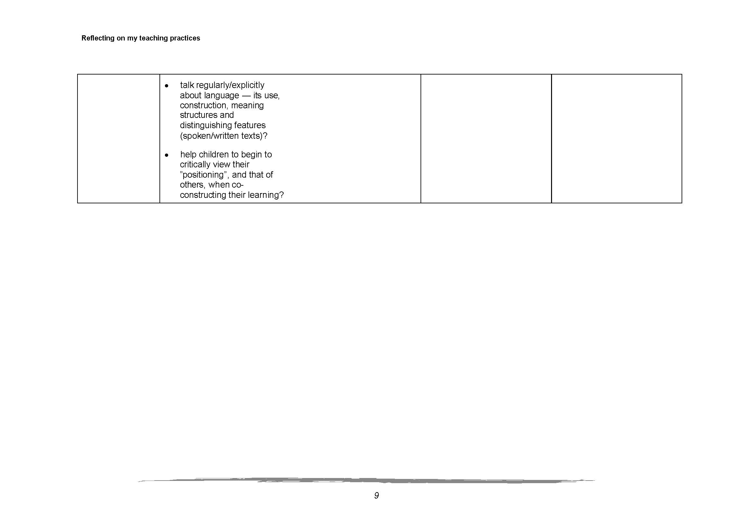

Slide 29
1. Effective teachers draw out and work with the pre-existing understandings that their students bring with them.
2. Effective teachers teach some subject matter in depth, providing many examples in which the same concept is at work and providing a firm foundation of factual knowledge.
3. Effective teachers focus on the teaching of metacognitive skills, integrating those skills into the curriculum in a variety of subject areas.

Slide 30
Going deeper into the process of self-assessment
Reflect on the different ways you have undertaken self-assessment in your service:
Who was involved? Why?
What was the purpose?
What strengths did you identify from your assessment and reflection?
What quality areas did you identify that needed to improve?
What strategies or actions did you plan and/or implement to address the areas for improvement?

